Slide 1
Beyond Compliance:
Effective Recruitment & Retention Measurement Techniques
Monday, July 16, 2017
Rosemary J Cox, M.S., SPHR, SHRM-SCP, Sr. CAAP
Jana Garman, M.A.

Slide 2
Disclaimer
The information in this PowerPoint is provided for general information purposes only and these materials are not intended to provide legal advice. These copyrighted materials may not be reproduced, copied or used without prior permission from the authors.
COPYRIGHT © 2017 DCI CONSULTING ALL RIGHTS RESERVED

Slide 3
About DCI
www.dciconsult.com
DCI is a risk management/human resource management consulting firm strategically located in Washington, D.C.
Primary focus on EEO/Affirmative Action compliance statistical analyses, and validation research
Developed proprietary software for AA Planning/Adverse Impact Analyses and Compensation Analysis.
Diverse client base of fortune 500 and smaller organizations developed primarily through company/attorney referral.
Consulting services include:
  Affirmative Action Plan Development
  Statistical Analyses of Systemic Discrimination Allegations (e.g., hiring, promotion, compensation, etc.)
  Selection Procedure Validation
  Proactive EEO Audits
  Litigation and OFCCP Audit Consulting
COPYRIGHT © 2017 DCI CONSULTING ALL RIGHTS RESERVED

Slide 4
Agenda
  The Numbers
  A Business Imperative
  Measuring Effectiveness
    Why
    How
  Success on the Job
COPYRIGHT © 2017 DCI CONSULTING ALL RIGHTS RESERVED

Slide 5
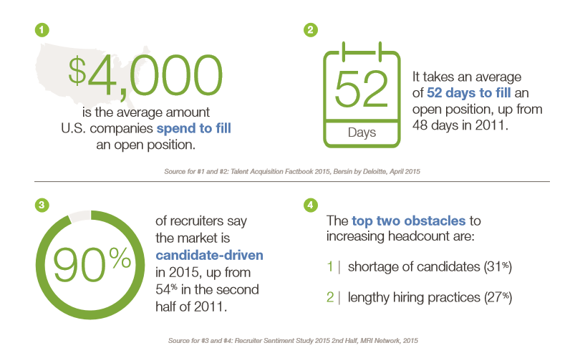
  The Numbers –
  Recruiting is getting harder
50 HR and Recruiting Statistics for 2016 - Glassdoor
COPYRIGHT © 2017 DCI CONSULTING ALL RIGHTS RESERVED

Slide 6
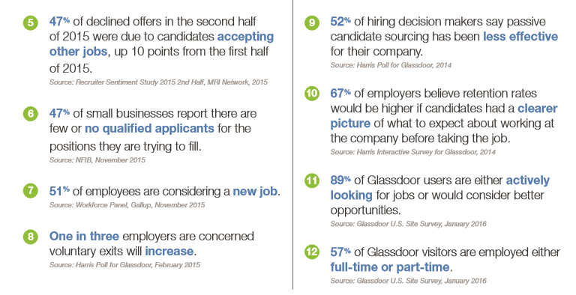
50 HR and Recruiting Statistics for 2016 - Glassdoor
COPYRIGHT © 2017 DCI CONSULTING ALL RIGHTS RESERVED

Slide 7
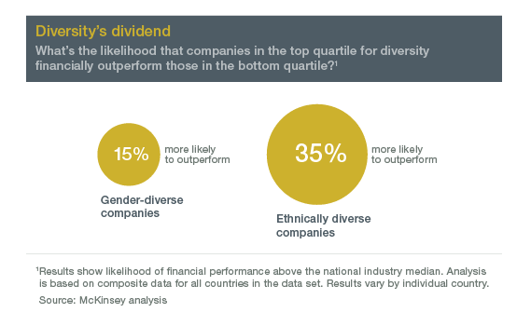
Diversity is important…
“More diverse companies, we believe, are better able to win top talent and improve their customer orientation, employee satisfaction, and decision making, and all that leads to a virtuous cycle of increasing returns. This in turn suggests that other kinds of diversity—for example, in age, sexual orientation, and experience (such as a global mind-set and cultural fluency)—are also likely to bring some level of competitive advantage for companies that can attract and retain such diverse talent.”
COPYRIGHT © 2017 DCI CONSULTING ALL RIGHTS RESERVED

Slide 8
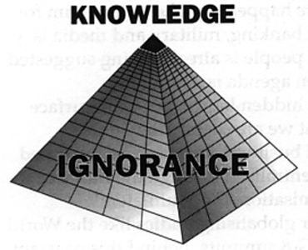
Don’t miss the big picture
Most companies miss the big picture strategy, they recruit and hire blindly
COPYRIGHT © 2017 DCI CONSULTING ALL RIGHTS RESERVED

Slide 9
  A Business Imperative
Business Imperative
Develop an Action Plan
Address Policies, Procedures and Barriers
Educate Managers and Supervisors
Gain support above and beyond HR
Determine company long term strategy
Measure and Evaluate
COPYRIGHT © 2017 DCI CONSULTING ALL RIGHTS RESERVED

Slide 10

Considerations
Moving Toward Meaningful Assessment
Consider feasibility and appropriateness of incorporating additional, non-required criteria and/or approaches within evaluations
  Multiple sources of information
  Quantitative criteria
  Qualitative criteria
COPYRIGHT © 2016 DCI CONSULTING ALL RIGHTS RESERVED
COPYRIGHT © 2017 DCI CONSULTING ALL RIGHTS RESERVED
Notes:
Rachel
In Light of Shortcomings
** speak to looking at mu
Identify methods for incorporating multiple sources of information to arrive at a decision on the effectiveness of each resource
Incorporating additional quantitative criteria if and where possible
Incorporating relevant qualitative criteria when evaluating efforts that are not easily linked to quantitative data
ltiple years of criteria/data

Slide 11

Qualitative Assessment
Values-based judgments regarding partnerships;
Recruiter feedback on quality of talent sourced;
Reputation of the organization within the protected group community;
Responsiveness to company requests;
Industry or job-specific referrals
COPYRIGHT © 2016 DCI CONSULTING ALL RIGHTS RESERVED
COPYRIGHT © 2017 DCI CONSULTING ALL RIGHTS RESERVED
Notes:
Rachel
Starting point: Consider how you evaluated minority and female outreach effectiveness
Additional considerations:
Although not required, can compare 44K analytics to VEVRAA hiring benchmark
May consider “any” attraction or placement of Veterans and Individuals with disabilities as positive outreach and recruitment
Could evaluate trends of representation over time for Individuals with Disabilities
Return on investment for events sponsored or attended
Documentation:
Annually evaluate efforts, document criteria used, and indicate conclusion as to activity’s effectiveness.

Slide 12

Define your Approach
Will your organization:
Take a more focused approach
  Utilize resource-specific metrics (e.g., number of qualified applicants obtained via a recruitment source)
Take a broader approach
  Aggregating metrics for purposes of assessing company-wide initiatives
COPYRIGHT © 2016 DCI CONSULTING ALL RIGHTS RESERVED
COPYRIGHT © 2017 DCI CONSULTING ALL RIGHTS RESERVED
Notes:
Rachel
Recommendations
Consider feasibility and appropriateness of implementing additional, non-required approaches to evaluating efforts:
Taking a more focused approach by incorporating resource-specific metrics (e.g., number of qualified applicants obtained via specific recruitment source);
Taking a broader approach by incorporating relevant aggregate metrics for evaluations of company-wide initiatives;
Identifying methods for incorporating multiple metrics/sources of information in conclusions of resource effectiveness.
Best practices for proactive assessments
Best practices audit submissions will likely differ
Needs to be evaluated over the next few years through OFCCP audit activity and what organizations are doing (this is a new area)!

Slide 13
Measuring Effectiveness
All good business plans have measurement and accountability components. Senior leaders want “proof” of success.
How can we measure?
Self ID at applicant and employee stages
Application recruiting resource field
Third party vendor information
Work with partnering agencies/orgs
Recruiter tracking
Employee retention
Employee surveys/focus groups
COPYRIGHT © 2017 DCI CONSULTING ALL RIGHTS RESERVED

Slide 14
Measuring Effectiveness, cont’d
Concerns with Required Criteria
Applicant/Hiring Metrics: Under-representation of actual recruitment numbers likely
Quantitative Metrics are not always the most appropriate/well suited criteria for purposes of evaluating organizational outreach efforts
Amount or type of information maintained within system
Documenting/tracking for efforts having more of an indirect influence on recruitment numbers (e.g., workshops, community events)
Quantity and/or quality of self-identification data
COPYRIGHT © 2016 DCI CONSULTING ALL RIGHTS RESERVED
COPYRIGHT © 2017 DCI CONSULTING ALL RIGHTS RESERVED
Notes:
Rachel
Use of required evaluation criteria give rise to the following concerns:
Applicant/hiring metrics will likely under-represent actual recruitment numbers due to data collection limitations (e.g., not counting “non-protected” veterans) and extremely low disability self-ID response rates via the OFCCP-proscribed form
Job opening/jobs filled metrics do not yield relevant evaluative data
Quantitative metrics cannot easily be linked to certain recruitment efforts and are limited by system capabilities (i.e., ATS/HRIS)

Slide 15
Measuring Effectiveness, cont’d
Quantitative Assessment Options
Annually inspect personnel transaction numbers to see how the workforce is flowing into and within your organization
    Applicant pools (across years)
    Workforce distributions
Trends in underutilization
Consider conducting ROI and cost/benefit analytics if possible. Examples may include:
    Example: Comparing the cost of a recruitment source against the number of qualified applicants or the average tenure of hires obtained from that source
COPYRIGHT © 2017 DCI CONSULTING ALL RIGHTS RESERVED
Notes:
Jana
Workforce - certain areas where there are higher rates of protected veterans and IWDs, for example?
Return on investment for events sponsored or attended

Slide 16
Sample Assessment – Female/Minority
Annually inspect personnel transaction numbers to see how the workforce is flowing into and within your organization
Job Group | Target Group | Prior Year Goal | Hires | Promotions | Total Opportunities | Goal Attained?
4A | Minority | 13.23% | 1 of 8 (12.5%) | 1 of 4 (25%) | 2 of 12 (16.67%) | YES
4A | Female | 52.22% | 1 of 5 (20%) | 0 of 1 (0%) | 1 of 6 (16.66%) | NO
COPYRIGHT © 2016 DCI CONSULTING ALL RIGHTS RESERVED
COPYRIGHT © 2017 DCI CONSULTING ALL RIGHTS RESERVED
Notes:
Jana
Requirement comes from the scheduling letter itemized listing - it is not required by the regs. Also as noted above the method is not required - other contractors may evaluate goal attainment slightly different. DCI mirrors what has been historically done

Slide 17
Sample Assessment
Sample Assessment of Outreach/Recruitment Efforts
Date | Event/ Activity | Focus Area | Internal Focus | Description | External POC | Location | Comments
Ongoing | State Postings | Vets, Disability, Minority, Women | Recruitment | Posting with state ESDS for all job openings | Andrea Smith | MD
July-2 | Women’s Leadership Conference | Women | Partnership | Event sponsorship, booth, panel presentation | George Johnson | Washington, DC
Nov-13 | Engineering Career Fair | Vets, Disability, Minority | Recruitment | Booth | Sam Black | Baltimore, MD
Dec-15 | Veteran’s at Work Forum | Veterans | Employee Engagement | Employee focus group and forum | Martha Fox | HQ
COPYRIGHT © 2016 DCI CONSULTING ALL RIGHTS RESERVED
14
COPYRIGHT © 2017 DCI CONSULTING ALL RIGHTS RESERVED
Notes:
Jana
Talking point: be sure to mention these criteria are the 44k analytics. These must be used a min but can use other methods too

Slide 18
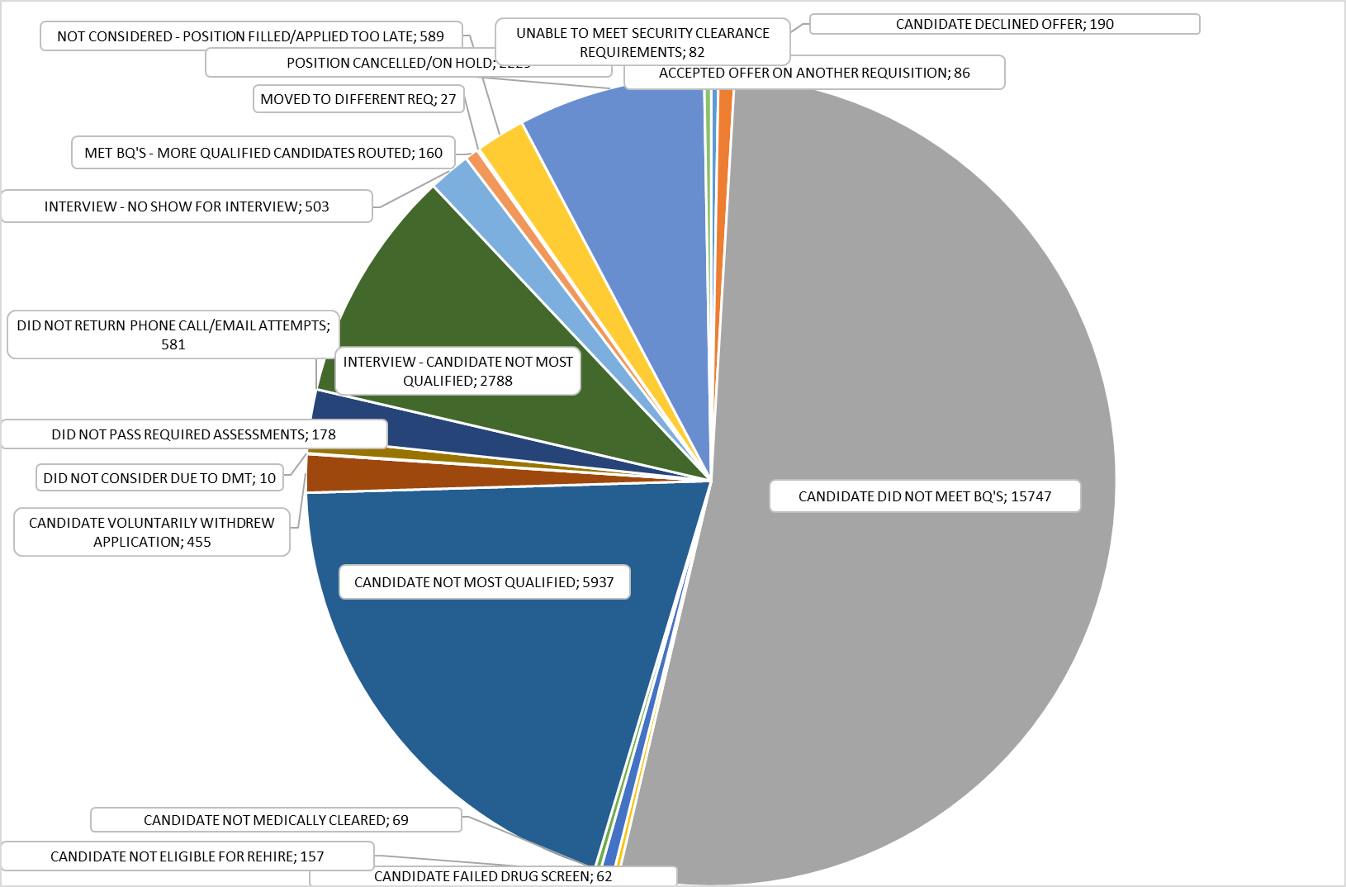
What can you glean from this data?
COPYRIGHT © 2017 DCI CONSULTING ALL RIGHTS RESERVED

Slide 19
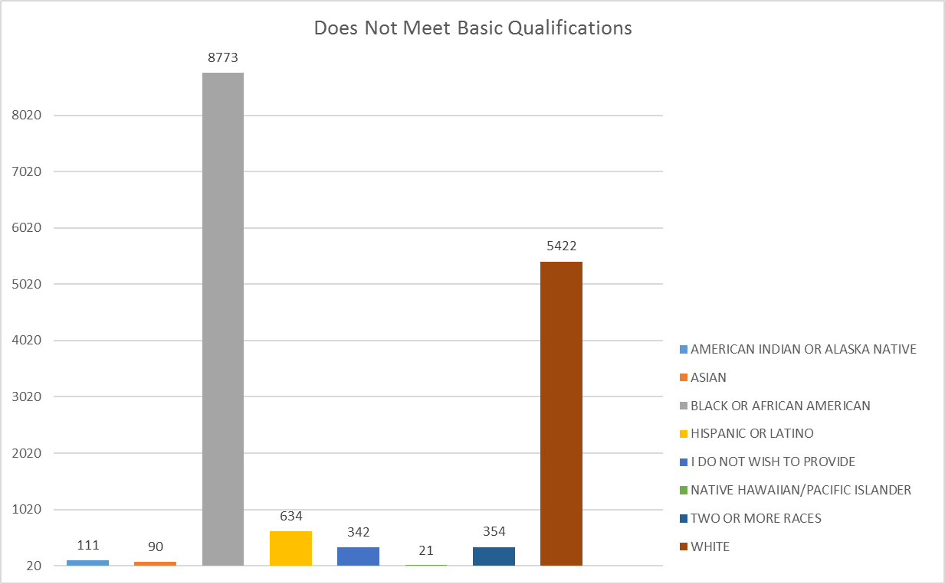
What can you glean from this data?
Review by Male/Female or add title to see if certain positions are problematic
COPYRIGHT © 2017 DCI CONSULTING ALL RIGHTS RESERVED

Slide 20
What can you glean from this data?
Source of Applicant
Unsolicited (3.20%)
Other (16.96%)
Newspaper (11.83%)
Staffing Agency (3.46%)
College Recruiting (2.78%)
Employee Referral (6.22%)
Internal (7.58%)
Referral Networks (1.73%)
Internet Job Board (44.15%)
Source of Hire
Referral Networks (4.16%)
Job Fair (2.10%)
Employee Referral (11.46%)
College Recruiting (6.63%)
Internal (24.94%)
Unsolicited (6.85%)
Job Fair (2.25%)
Other (10.90%)
Staffing Agency (15.39%)
Newspaper (7.87%)
Internet Job Board (9.55%)
COPYRIGHT © 2017 DCI CONSULTING ALL RIGHTS RESERVED

Slide 21
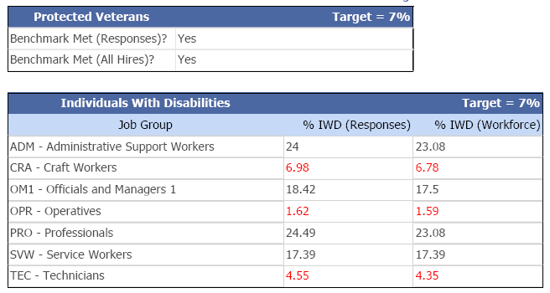

Are you meeting your benchmarks?
Attracting Disabled/Veteran Applicants?
Hiring Disabled/Veteran Applicants?
COPYRIGHT © 2017 DCI CONSULTING ALL RIGHTS RESERVED

Slide 22
What is your Story?
Warehouse Operations
COPYRIGHT © 2017 DCI CONSULTING ALL RIGHTS RESERVED

Slide 23
It’s Your Turn - - How would you tell your your story in this case?
COPYRIGHT © 2017 DCI CONSULTING ALL RIGHTS RESERVED

Slide 24
Welcome to DCI Training Company
FACTS:
Located in downtown Atlanta Georgia
Global K-12 Book maker/seller (online and hardback)
Approximately 3700 employees in Atlanta and 2500 located outside of the US
Employs many levels of writers, editors, and IT people
Heavy administrative staff
Minimal warehouse and other operations positions
At DCI Training Company, diversity is a core value reflected in our leadership's commitment to an inclusive workplace that values each individual and their contributions and enables them to reach their full potential.
In an increasingly global marketplace, our commitment to a diverse and inclusive work environment becomes ever more critical to our future success. The diverse characteristics, perspectives, ideas and backgrounds that our employees bring to the table give us a vital competitive edge in anticipating and exceeding our customers' needs.
We rely on our employees to bring their unique point of view and understanding of the world and apply it to their work. By anticipating our customers' need for knowledge, we provide people with the tools they need to succeed in life.
COPYRIGHT © 2017 DCI CONSULTING ALL RIGHTS RESERVED

Slide 25
DCI Training Co – Breakout Task
Describe what you see here.
What story can you see developing?
What further information would you want to have? What questions do you have?
What recommendations do you have for the company based on what is in front of you?
COPYRIGHT © 2017 DCI CONSULTING ALL RIGHTS RESERVED

Slide 26
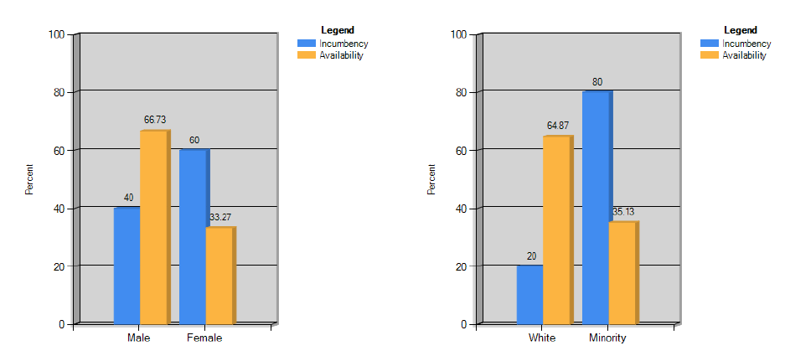
Science Technology Sales Department –
Incumbency to Availability Comparison
DCI Training Co - Current Workforce
COPYRIGHT © 2017 DCI CONSULTING ALL RIGHTS RESERVED

Slide 27
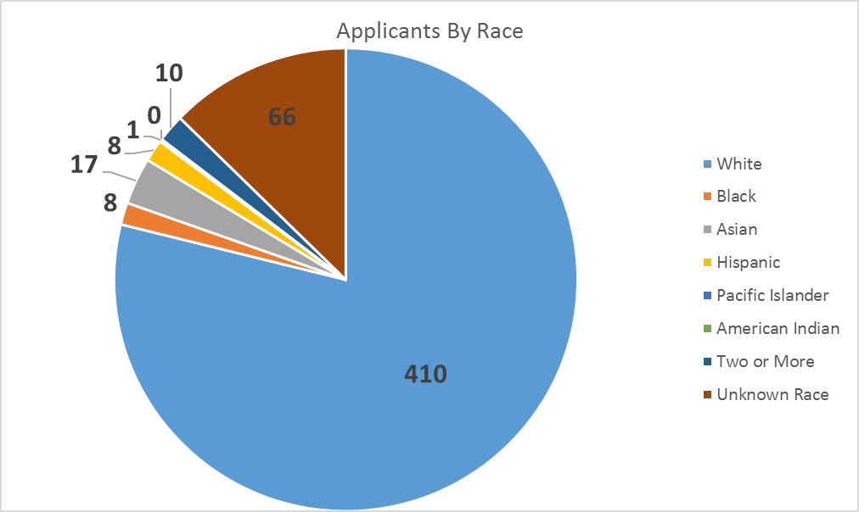
DCI Training Co - Applicant Flow
Writer Position
 | White | Black | Asian | Hispanic | Pacific Islander | American Indian | Two or More | Unknown Race | Unknown Gender
Male | 56 | 2 | 5 | 0 | 0 | 0 | 1 | 12 | 18
Female | 354 | 6 | 12 | 8 | 1 | 0 | 9 | 54 | 50
TOTALS | 410 | 8 | 17 | 8 | 1 | 0 | 10 | 66 | 68
Recruiting Sources
Atlanda Writers Club
Linkedin
Clark Atlanta University
Piedmont College
Savannah State Univ
Village Writers Group
Georgia Writers Association
COPYRIGHT © 2017 DCI CONSULTING ALL RIGHTS RESERVED

Slide 28
DCI Training Co - Workforce Retention
Year over year, the DCI Training Company has found underutilization of females in the sales
job group. The company has had successful campaigns for outreach and recruitment of
female sales hires, yet each year there is underrepresentation of females identified in the
workforce metrics. Below are the counts of employees at the start and end of the year,
as well as, all internal movements throughout the year in review.
Year Start Count |  | Year End Count |  | Terminations Count |  | Promotions Into Count |  | Promotions Out of Count
Female | Male | Female | Male | Female | Male | Female | Male | Female | Male
50 | 150 | 35 | 155 | 15 | 3 | 1 | 7 | 0 | 5
COPYRIGHT © 2017 DCI CONSULTING ALL RIGHTS RESERVED

Slide 29

If Efforts are not Working
Align recruiting efforts to company short/long term goals
Explore new recruitment resources (appendix)
Implement recruitment efforts that are more targeted in nature
Build relationships
Remove or reduce ineffective recruitment resources
Use analytics to guide efforts
Get involved in community events and activities
Educate managers on expectations, ensure they are part of the process
Review manager board positions and strategically place in key areas
Think differently – explore new areas
COPYRIGHT © 2016 DCI CONSULTING ALL RIGHTS RESERVED
COPYRIGHT © 2017 DCI CONSULTING ALL RIGHTS RESERVED
Notes:
Jana
Explore new recruitment resources
-develop new connections
Implement recruitment efforts that are more targeted in nature
Build relationships
Remove or reduce ineffective recruitment resources
Use analytics to guide efforts

Slide 30

Success on the job
Follow up with manager to ensure everything is ok
Have managers follow up with individuals frequently – don’t assume that everything is going well
Check to ensure accommodations are appropriate – don’t assume, for example, that the person can access everything they need to do their job
Monitor to ensure people are moving up in the organization
Track attrition rates
Evaluate and measure progress every 6 months
COPYRIGHT © 2017 DCI CONSULTING ALL RIGHTS RESERVED

Slide 31

Success on the job, part 2
Start an Affinity Group / ERG
  Different groups have different conversations. Caregivers, individuals with disabilities, Islamic Network, LGBTQ Together, etc.
Create a development program
  Mentoring
  Job shadowing
Try lunch-n-learns featuring individuals with disabilities (those who are comfortable)
Keep in mind that you may need to change your process in order to make a difference!
COPYRIGHT © 2017 DCI CONSULTING ALL RIGHTS RESERVED

Slide 32

Innovative Companies do innovative things
Proctor & Gamble:
Reverse Mentoring – an individual with a disability mentors a senior executive
Affinity Groups – sponsored fully by a member of senior leadership
Host an Annual conference – “Breaking the Disability Ceiling” a two-day workshop for area HR managers
Walgreens:
Disability goal – to fill 20% of its distribution center jobs with people with disabilities
Walgreens Disability Inclusion Network – recommended disability inclusive technology and policy enhancements
Built for success and access – installed touch screens and adjustable work stations to accommodate individuals with disabilities
Partnership with agencies – created a 12-week Transitional Work Group (TWP) training program to ensure success
COPYRIGHT © 2017 DCI CONSULTING ALL RIGHTS RESERVED

Slide 33

Questions
COPYRIGHT © 2017 DCI CONSULTING ALL RIGHTS RESERVED

Slide 34
RECRUITING RESOURCES
COPYRIGHT © 2017 DCI CONSULTING ALL RIGHTS RESERVED

Slide 35
Sample Recruiting Sources
DiversityClassifieds
WorkPlaceDiversity
DiversityInc
IM Diversity
HireDiversity
AffinityCircles
WomenatWork
American Indians Jobs Online
WhereWomenWanttoWork
Black Collegian
LatPro
National Asian Pacific American Bar Association
Hispanic National Bar Association
Association of Latino Professionals in Finance
Society of Women Engineers
Women in Technology
National Association of Black Accountants
COPYRIGHT © 2017 DCI CONSULTING ALL RIGHTS RESERVED

Slide 36





Recruitment
Job fairs
Newspaper ads
Third party vendors
Social media
COPYRIGHT © 2017 DCI CONSULTING ALL RIGHTS RESERVED

Slide 37
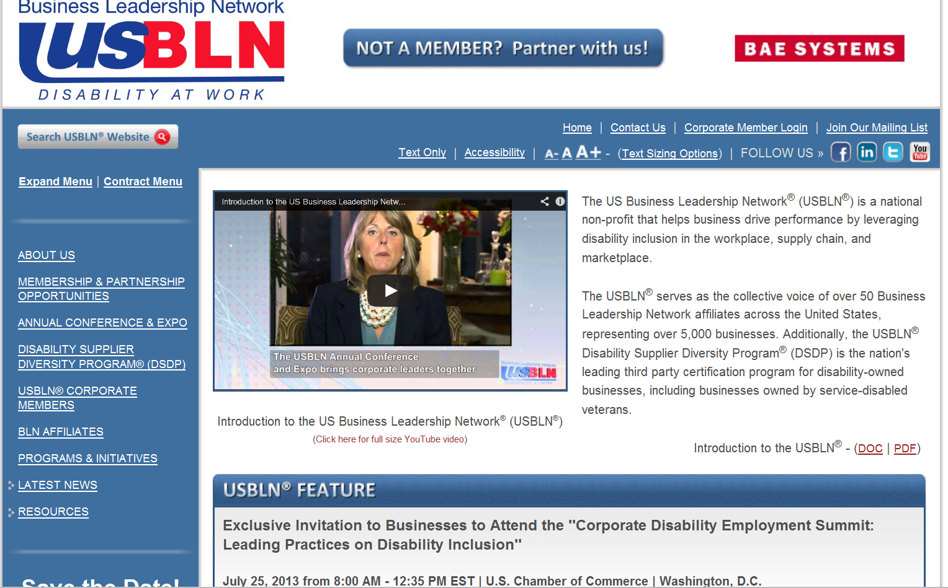
Resources (www.usbln.org)
COPYRIGHT © 2017 DCI CONSULTING ALL RIGHTS RESERVED

Slide 38
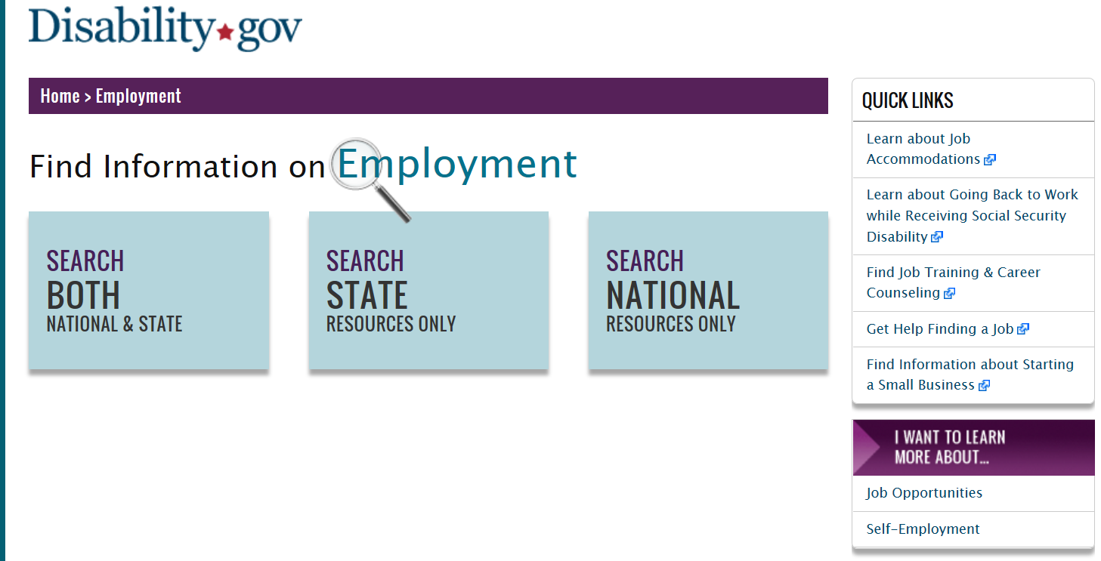
Resources
(www.disability.gov/employment)
COPYRIGHT © 2017 DCI CONSULTING ALL RIGHTS RESERVED

Slide 39
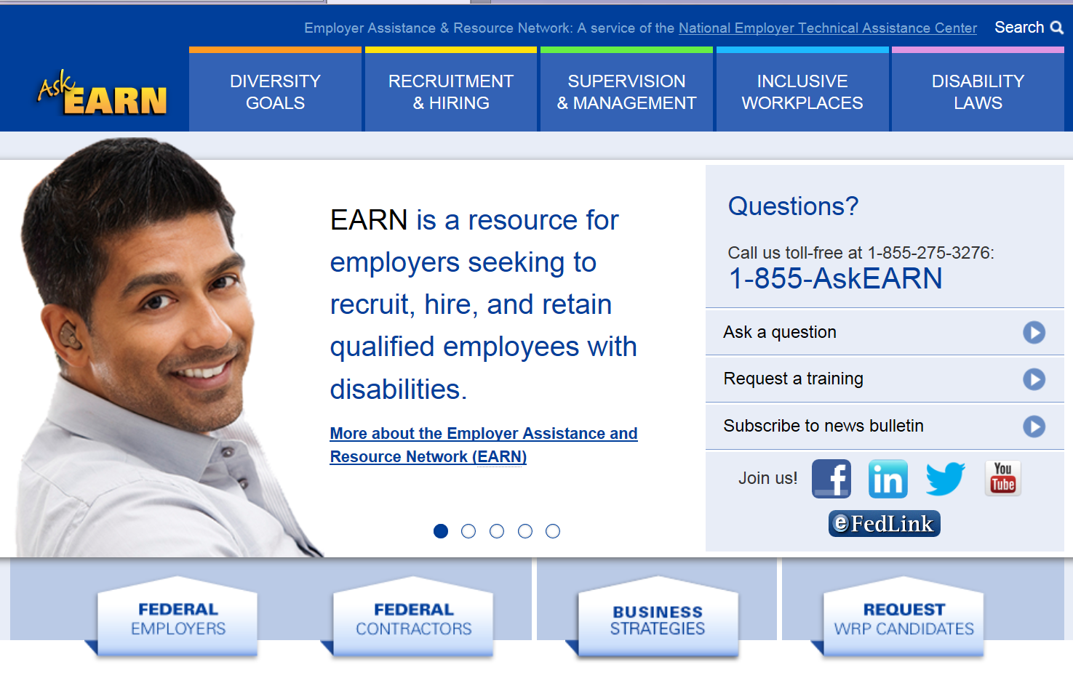
Resources (http://askearn.org)
COPYRIGHT © 2017 DCI CONSULTING ALL RIGHTS RESERVED

Slide 40
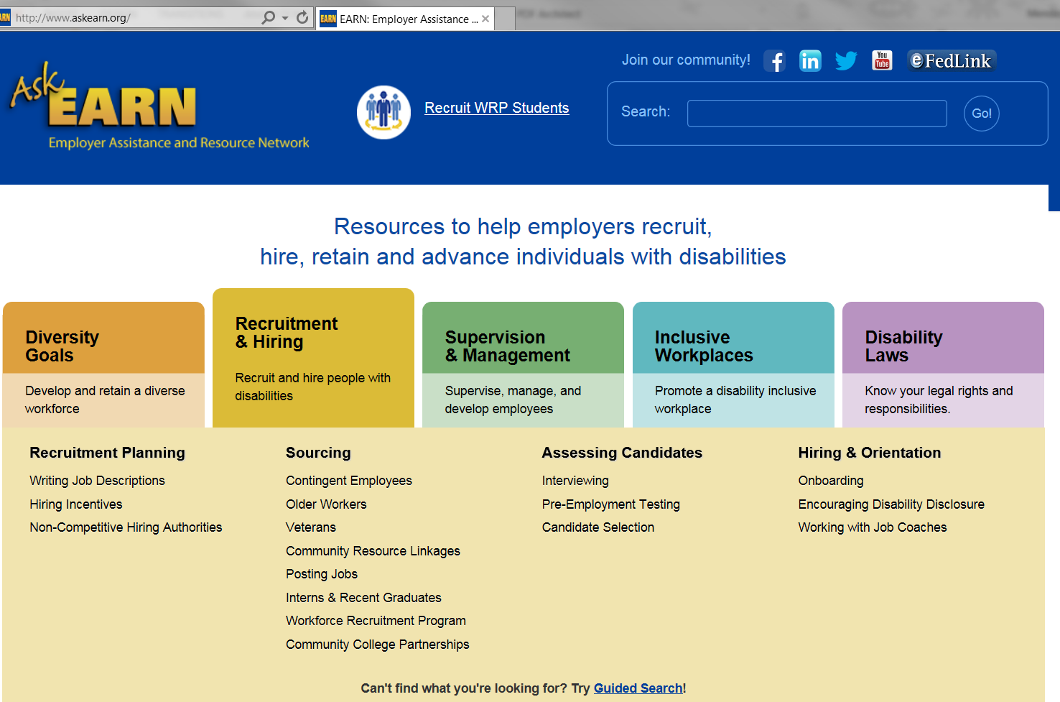
COPYRIGHT © 2017 DCI CONSULTING ALL RIGHTS RESERVED

Slide 41
Recruiting Sources for Individuals with Disabilities
Ability Jobs
disABLED Person
Disaboom Jobs
Getting Hired
Hire Disability Solutions
One More Way
COPYRIGHT © 2017 DCI CONSULTING ALL RIGHTS RESERVED

Slide 42
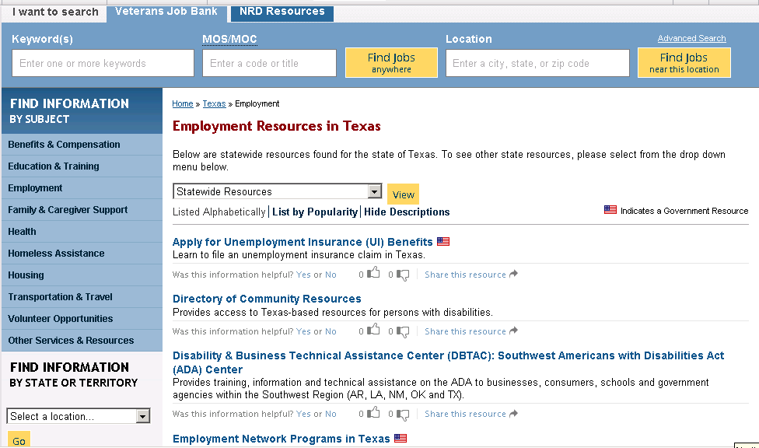
https://www.nationalresourcedirectory.gov/
COPYRIGHT © 2017 DCI CONSULTING ALL RIGHTS RESERVED

Slide 43
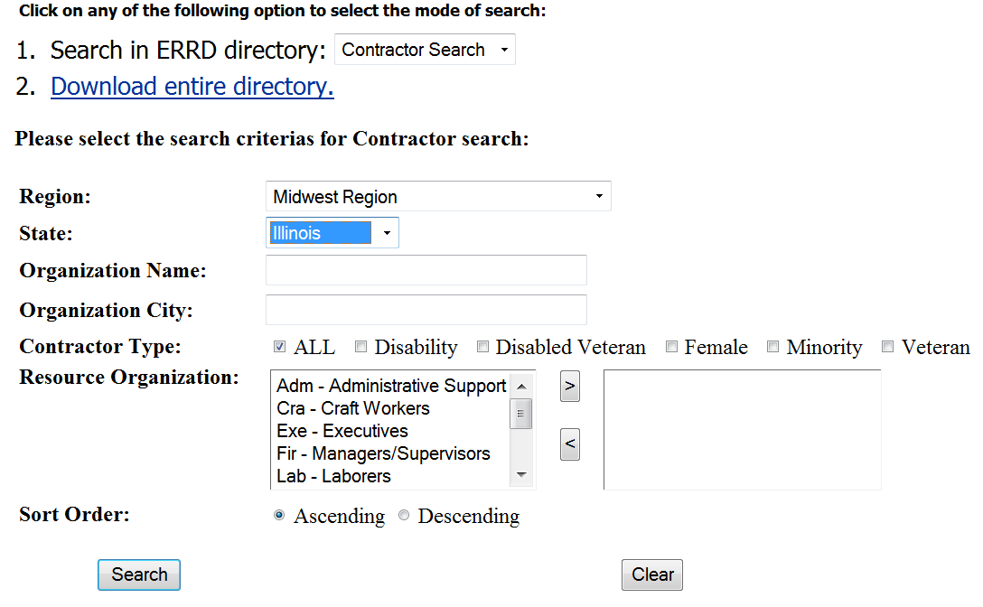
Recruiting
(http://www.dol-esa.gov/errd/index.html)
COPYRIGHT © 2017 DCI CONSULTING ALL RIGHTS RESERVED
Notes:
http://www.dol-esa.gov/errd/index.html

Slide 44

Attracting Individuals with Disabilities
Online/virtual career (http://ww.thinkbeyondthelabel.com)
COPYRIGHT © 2017 DCI CONSULTING ALL RIGHTS RESERVED

Slide 45
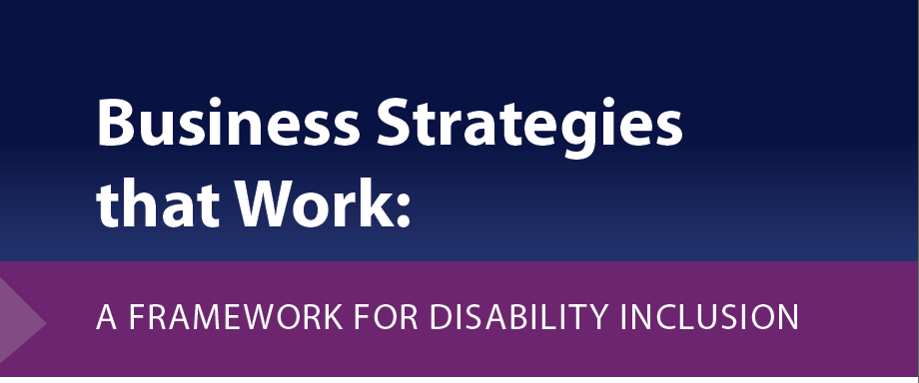
http://www.dol.gov/odep/pdf/BusinessStrategiesThatWork.pdf
• Lead the Way: Inclusive Business Culture
• Hire (and Keep) the Best: Personnel Processes
• Ensure Productivity: Reasonable Accommodation Procedures
• Build the Pipeline: Outreach and Recruitment
• Communicate: External and Internal Communication of Company Policies and Practices
• Be Tech Savvy: Accessible Information and Communication Technology
• Grow Success: Accountability and Continuous Improvement Systems
COPYRIGHT © 2017 DCI CONSULTING ALL RIGHTS RESERVED
Notes:
http://www.dol.gov/odep/pdf/BusinessStrategiesThatWork.pdf
These practices are organized into seven action areas:
• Lead the Way: Inclusive Business Culture
• Hire (and Keep) the Best: Personnel Processes
• Ensure Productivity: Reasonable Accommodation Procedures
• Build the Pipeline: Outreach and Recruitment
• Communicate: External and Internal Communication of Company Policies and Practices
• Be Tech Savvy: Accessible Information and Communication Technology
• Grow Success: Accountability and Continuous Improvement Systems

Slide 46
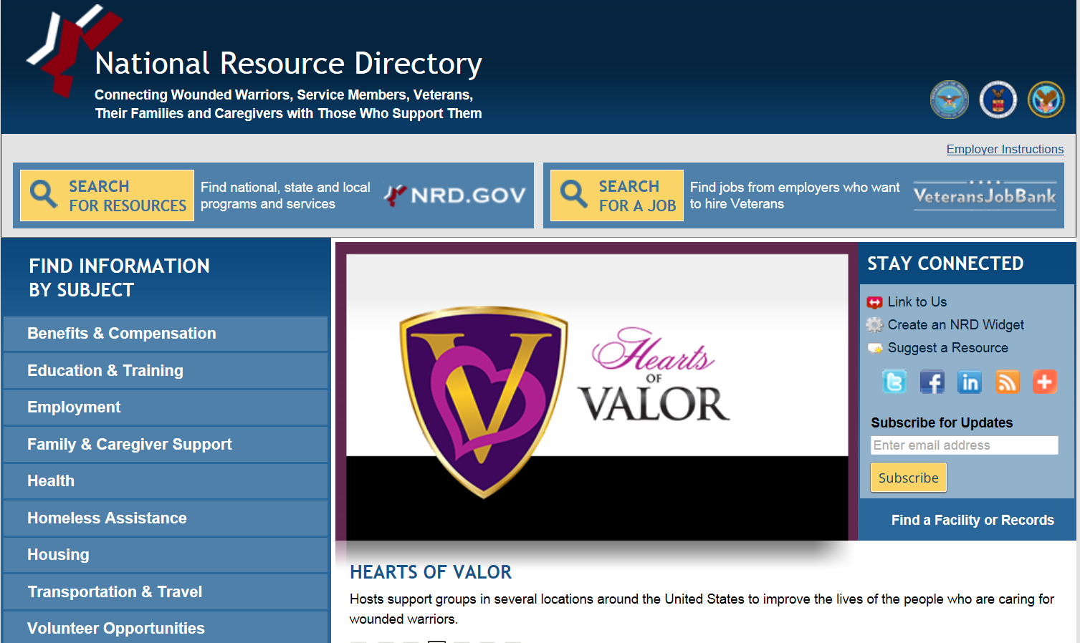
COPYRIGHT © 2017 DCI CONSULTING ALL RIGHTS RESERVED

Slide 47
Outreach for Veterans
Local Veterans' Employment Representative in the local employment service office nearest the contractor's establishment
The Department of Defense Transition Assistance Program (TAP) http://www.dol.gov/vets/programs/tap/tap_fs.htm
Employer Resources section of the National Resource Directory http://www.nationalresourcedirectory.gov/employment/job_services_and_employment_resources
COPYRIGHT © 2017 DCI CONSULTING ALL RIGHTS RESERVED

Slide 48
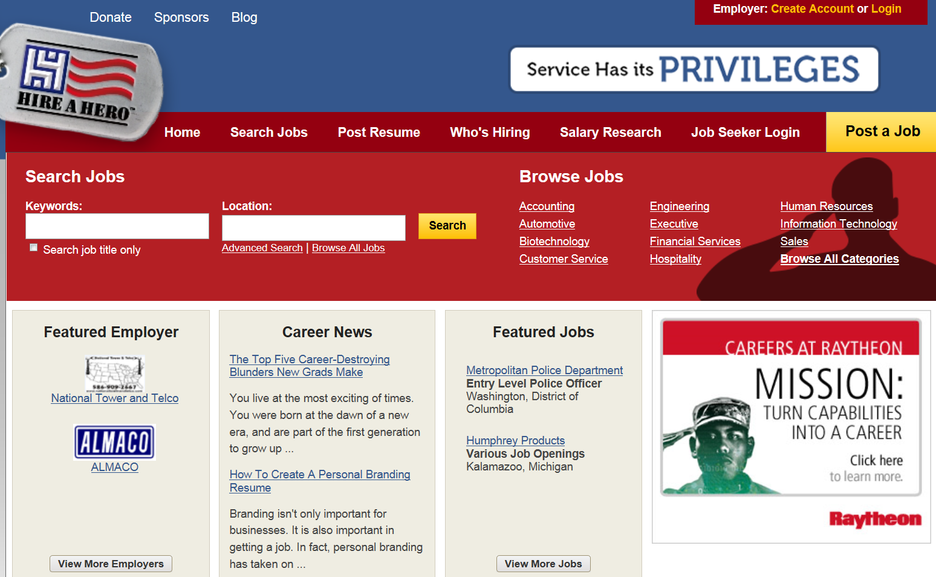
www.hireahero.org
COPYRIGHT © 2017 DCI CONSULTING ALL RIGHTS RESERVED

Slide 49
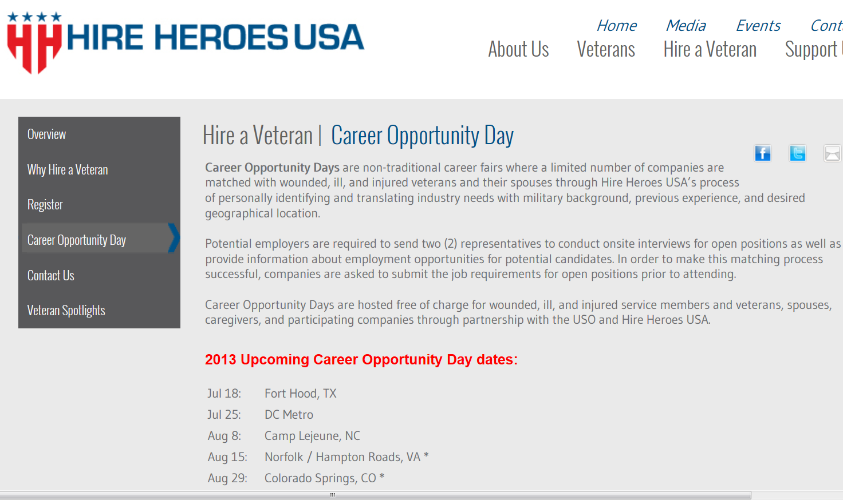
http://www.hireheroesusa.org/
COPYRIGHT © 2017 DCI CONSULTING ALL RIGHTS RESERVED
Notes:
Helps spouses of veterans also find work.

Slide 50
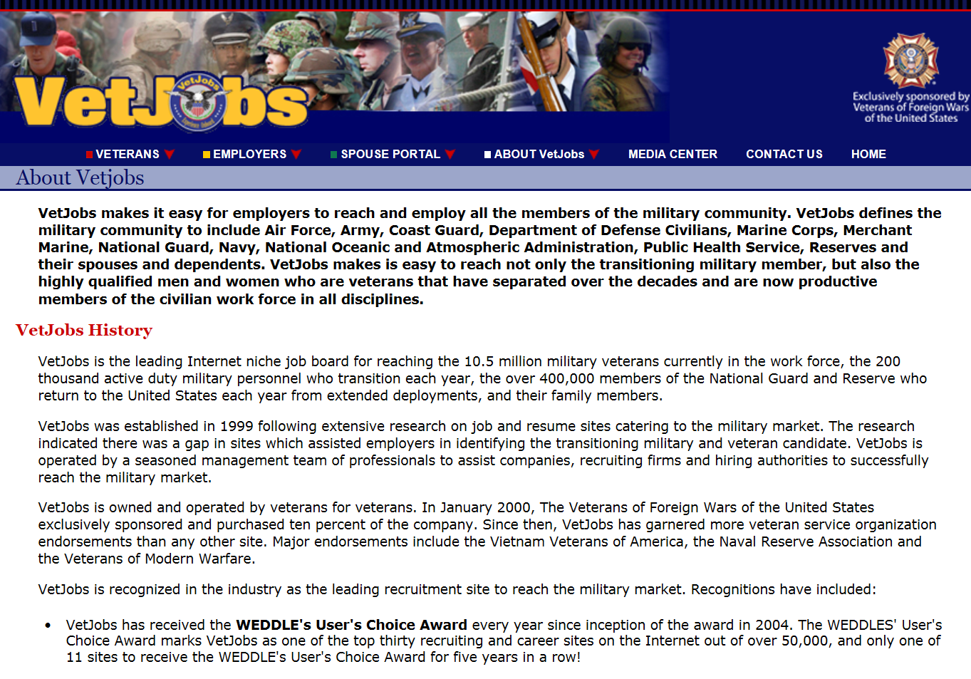
VetJobs
COPYRIGHT © 2017 DCI CONSULTING ALL RIGHTS RESERVED
Notes:
For example, this year, our Transition Assistance Program − TAP − will serve approximately 200,000 transitioning service members and their spouses through three-day employment workshops. And we offer hands-on assistance to veterans and military families through American Job Centers. Veterans seeking job training or placement assistance, or just advice about how to improve their resumes, will receive priority service in any of our 2,717 centers (follow the link to locate a center near you). Online tools like My Next Move for Veterans are making it easier for veterans to connect with employment opportunities, too.
www.vetsjobs.com

Slide 51
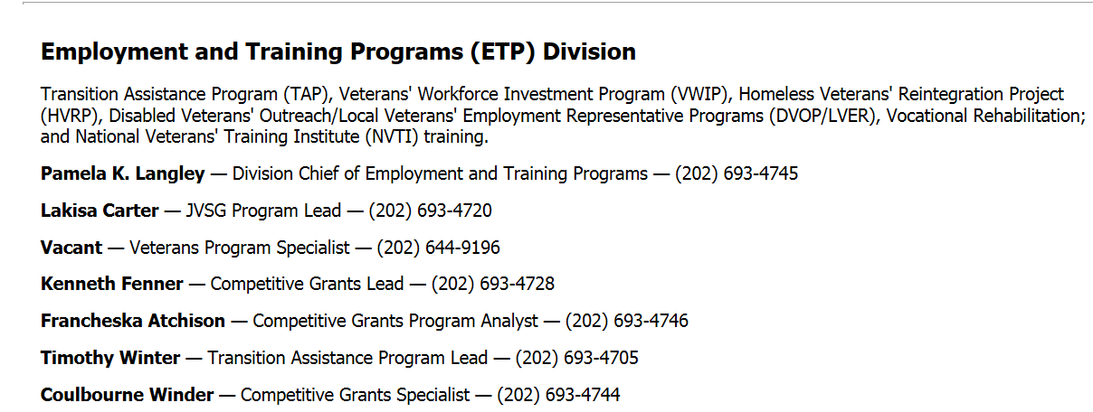
Transition Assistance Program
http://www.dol.gov/vets/aboutvets/contacts/main.htm
COPYRIGHT © 2017 DCI CONSULTING ALL RIGHTS RESERVED
Notes:
The Transition Assistance Program (TAP) was established to meet the needs of separating service members during their period of transition into civilian life by offering job-search assistance and related services.
The law creating TAP established a partnership among the Departments of Defense, Veterans Affairs, Transportation and the Department of Labor’s Veterans’ Employment and Training Service (VETS), to give employment and training information to armed forces members within 180 days of separation or retirement.
TAP helps service members and their spouses make the initial transition from military service to the civilian workplace with less difficulty and at less overall cost to the government. An independent national evaluation of the program estimated that service members who had participated in TAP, on average, found their first post-military job three weeks sooner than those who did not participate in TAP.
TAP consists of comprehensive three-day workshops at selected military installations nationwide. Professionally-trained workshop facilitators from the State Employment Services, military family support services, Department of Labor contractors, or VETS’ staff present the workshops.
Workshop attendees learn about job searches, career decision-making, current occupational and labor market conditions, and resume and cover letter preparation and interviewing techniques. Participants also are provided with an evaluation of their employability relative to the job market and receive information on the most current veterans’ benefits.

Slide 52
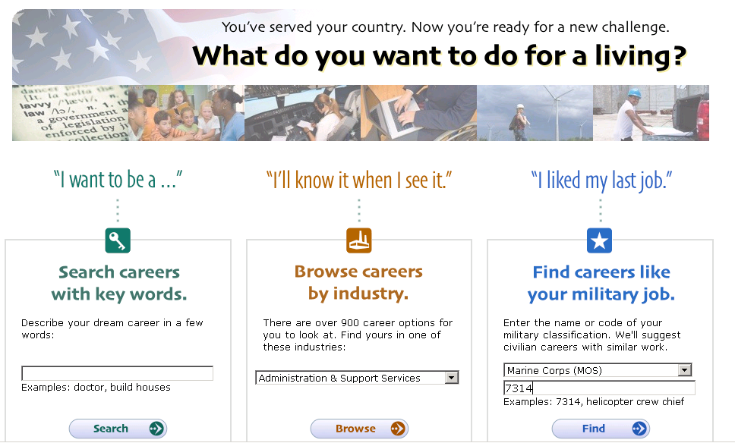
www.mynextmove.org/
COPYRIGHT © 2017 DCI CONSULTING ALL RIGHTS RESERVED
Notes:
www.mynextmove.org/
Helps veterans transition from military life to civilian jobs.

Slide 53
Recruiting Veterans
Recruit Military http://www.recruitmilitary.com
Army Reserve http://www.armyreserve.army.mil/arweb/
A Hero’s Calling http://www.aheroescalling.com
Directory of regional and state offices: http://www.dol.gov/vets/aboutvets/contacts/main.htm
State Employment Office http://www.jobbankinfo.org/
Americas Heroes At Work http://www.americasheroesatwork.gov/
http://vetjobs.com/
COPYRIGHT © 2017 DCI CONSULTING ALL RIGHTS RESERVED

