Slide 1
The Development and Validation of an Executive Training and Development Type Taxonomy
July 17, 2017
J. Peter Leeds
Senior Research Psychologists
Office of Policy and Evaluation
U.S. Merit Systems Protection Board
Scott Burtnick, Krystal Roach, and Holly Moody
University of Baltimore

Slide 2
Defining Executive Training & Self-Development
Executive training and development (T&D) is crucial to the success of an organization because it prepares leaders for future challenges they may face within an organization.
Executives are at the greatest liberty to craft their own T&D programs as they engage in self-development efforts.
Choice of self-development activities may vary among executives meeting different needs for different executives.
Little is known about the patterns of T&D activities that executives choose to participate in.
(Bernthal & Wellins, 2006; Reichard & Johnson, 2011)
Notes:
While leader t&d is good, it’s not the best and orgs have been shifting the responsibility to employees. So, we should identify the types of t&d and how it effects the org (e.g., EEO complaints).

Slide 3
Current Methods of Executive Development
Leader (e.g., Executive) self-development is: “any self-initiated behaviors focused on developing leadership capacities” (Reichard & Johnson, 2011, p. 35).
Executive self-development should be better understood and encouraged because it can have large returns of investment (ROI).
Organizations may benefit from:
Recruiting individuals with self-development characteristics
Working to improve employee self-development resolve
(Reichard & Johnson, 2011)
Notes:
In other words, while training leadership for specific skillsets (e.g., conflict resolution) can benefit the organization, leaders who have the ability and desire to self-develop will continuously learn and improve themselves, increasing the return on investment for organizations.
Tack on to our addition to leader self-development: Not simply “involvement” in training. More than that. We want to see the specific behaviors of involvement and their attitudes.

Slide 4
Purpose of this study
Literature lacks models for understanding how advanced leaders (e.g., managers and executives) choose to develop themselves. We sought to:
Develop a taxonomy of executive self-developers to identify the unique patterns of preferred self-development activities
Determine if executive self-development types could predict organizational outcomes (e.g., EEO complaints, employee engagement)
Notes:
Literature lacks models for understanding how advanced leaders (e.g., managers and executives) choose to develop themselves

Slide 5
Measure
We used data obtained from the U.S. Office of Personal Management (OPM)
All three surveys included items about a variety of workplace attitudes (e.g., engagement, satisfaction, commitment, fairness)
2011 Senior Executive Service (SES) Survey (work attitudes and T&D activities and preferences)
4,954 participants (response rate of 65%)
Administration began in August 2011 and closed in September 2011
2011 & 2012 Federal Employee Viewpoint Survey (FEVS) (work attitudes)
2011 FEVS: 560,084 participants (response rate of 49.3%)
Administration began in April 2012 and closed in May 2011
2012 FEVS: 687,000 participants (response rate of 46%)
Administration began in April 2012 and closed in June 2012
Notes:
2011 SES Survey: The survey had 116 items measuring perceptions of pride in SES, accountability, long career tenure and experience, developmental opportunities, challenges in dealing with poor performers, pay for performance, and satisfaction with pay and recognition. A specific set of binary questions asked the SES member about whether they availed themselves to eleven different T&D opportunities (e.g., sabbatical, 360, action learning, etc., ).
2011 and 2012 FEVS: The survey consisted of 98 items grouped into eight topics: (1) personal work experiences, (2) work unit, (3) agency, (4) supervisor/team leader, (5) leadership, (6) satisfaction, (7) work/life, and (8) demographics. A total of 14 questions assessed demographic information while 84 items measured employees’ perceptions of the effectiveness of workforce management within their agency.
*2011*** FEVS only open to full-time, permanent Federal employees, while 2012 FEVS was open to full-time permanent employees, along with part-time, non-seasonal employees.

Slide 6
Data Analysis Strategy
K-Means Cluster – to identify sets of SES training pattern preference (5)
Chi Square tests – to identify which survey items differentiated the most training from the least training patterns.
Principle components – to identify SES work attitude factors from the items that best differentiated the 2 extreme training patterns
Discriminant function analysis – To confirm that work attitudes differentiated the 2 patterns
Correlational analysis to measure the relationship between..
1) agency-level distribution of T&D types (% of each type)
2) agency-level employee work attitudes and number of EEO complaints.
Notes:
K-Means Cluster analysis- to identify the patterns of training of SES survey participants
Principle components analysis- to reduce the dimensionality of 2011 FEVS responses. Identify principle component themes to characterize SES members in a T&D type
Discriminant function analysis- examine the extent to which workplace attitudes are useful in distinguishing the T&D types
Correlational analysis-measure the relationship between 1) agency-level distribution of T&D types and 2) agency-level favorableness of employee attitudes and behaviors as well as equal employment opportunity complaints.

Slide 7
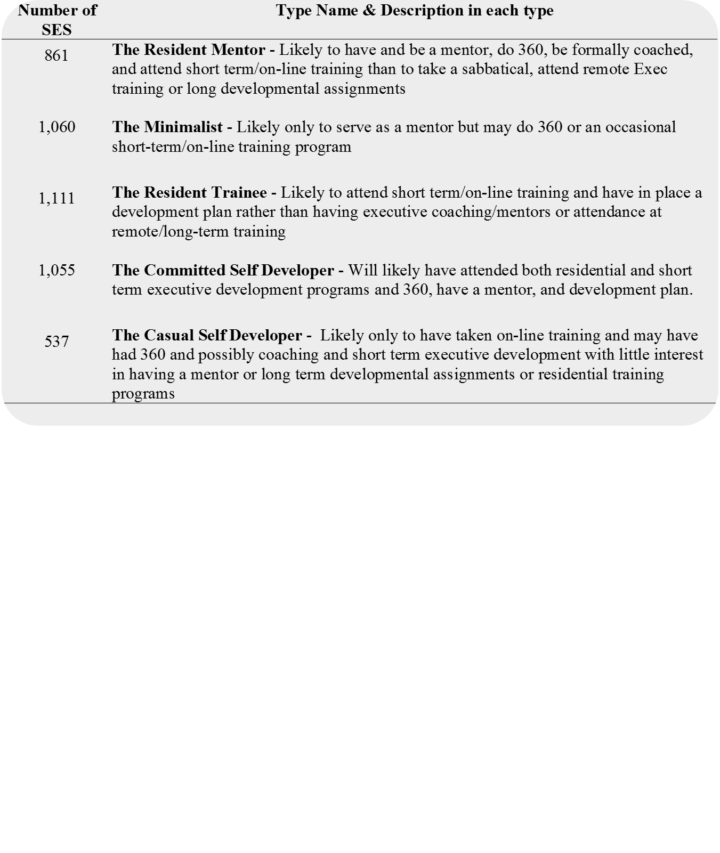
Results: Cluster Analysis
The 4,624 SES members were empirically clustered and then clusters were rationally labeled based on the T&D behaviors SESs reported using.
The five types were:
Minimalist
Resident Trainee
Casual Self-Developer
Resident Mentor
Committed Self-Developer
Notes:
The first author chose between 2 and 8 cluster solutions and chose 5 as the most interpretable
The 5-cluster solution instead of 2 or 8 segregated training preferences into buckets that were rationally consistent and relatively evenly populated
The 5-cluster solution was supported by comparing different solutions using multinomial and binary logistic regression.
To explain the rationale of the nomenclature, participants in one cluster tended to have been mentors as part of there development. These individuals were likely to have participated in a 360-degree feedback exercise as well as having been formally coached. Additionally, the participants within this cluster preferred short term/online training programs and seemed to avoid sabbaticals and developmental activities that were not in residence. Thus, the individuals in this cluster were given the label “Resident Mentor.” Similar rationale was used to name the additional four types.

Slide 8
Results: Cluster Analysis (cont.,)
We show the probability of each of the 5 SES types engaging in each of the 11 T&D opportunities
Notes:
For example, Minimalists had a 16% chance of having attended a residential executive development program while a Committed Self-Developer had a 100% chance of doing the same. This table corresponds exactly to the Final Cluster Centers output from the K-Means Cluster Analysis performed in SPSS

Slide 9
Results: Principle Components Analysis
Crosstabulations of each of the 92 attitudinal items with the 5 types identified 28 significantly differentiating items to include in further analyses
Principles component analysis on 29 themes assigned 28 items into seven themes used to differentiate T&D types:
Performance Appraisal Experience
Developmental Opportunities
Onboarding Support Experience
Provision of Performance Management Information
SES Service Length
Career Mobility and Responsibilities
Performance Plan Involvement
Notes:
Only those items that produced a statistically significant chi-squared test (χ²) and had a Cramer’s V of at least 0.1 (Rea & Parker, 1992) were selected for inclusion in the principles components analysis (PCA).
For each theme, component scores were generated from the factor scores available in the SPSS PCA options. These scores were subjected to additional analysis to confirm their differentiating potential.

Slide 10
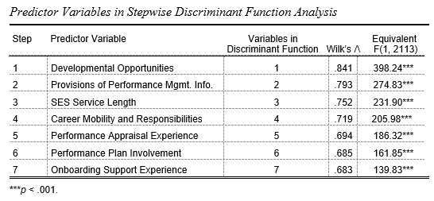
Results: Discriminant Function Analysis
When cross-validated, the discriminant function of the work attitudes placed individuals into the correct T&D type 75.0% of the time.
Notes:
The canonical correlation for the function was significant at .563 (Wilk's Λ = 0.768, p < .001).

Slide 11
Results: Correlation Analysis
On the 2012 FEVS, the more agencies have Committed Self Developers and Resident Mentors (i.e., took more training) and less Minimalists and Casual Self Developers, the more favorably the employees regarded the agencies.
Results show that the more Committed Self-Developers an agency has, the fewer the EEO complaints (r = -.39, p < .05) and the more Minimalists, the more the complaints (r = .44, p < .05).
The pattern or relations was similar when compared to the 2012 FEVS survey results
Notes:
We conducted a correlation analysis to explore the relation between 1) the proportion of SES members in each T&D type within each of the 28 agencies in 2011 and 2) the 2011 Federal Employee Viewpoint Survey (FEVS) scores for employees in those same agencies
Analysis aggregated on agency…we did not have enough data to conduct analyses for each agency
We believed that the more SES members with favorable attitudes and behaviors towards self-development there are in an agency, the more favorable employee attitudes towards the organization will be within those agencies
In general, the pattern of correlations reflects the amount of training inherent to each of the five T&D types with the strongest correlations observed for the most well-trained type—Committed Self-Developer

Slide 12
Implications of executive self-development taxonomy
Executive career paths meander through many different organization with various T&D resources.
Self-developing executives assume the responsibility for their own T&D.
Executives may be characterized by 5 different patterns of T&D activities
An executive T&D taxonomy would allow organizations to…
Characterize executives according to T&D preference
Identify executive attitudes which may be associated with each T&D type.
Results of our analysis suggest a business case for executive training by showing that executive T&D is related to employee attitudes and EEO complaints.

Slide 13
Questions?
Want more info? Contact us:
Peter.Leeds@mspb.gov

Slide 14
References
Bernthal, P., & Wellins, R. (2006). Trends in leader development and succession. Human Resource Planning, 29, 31-40.
Reichard, R. J., & Johnson, S. K. (2011). Leader self-development as organizational strategy. The Leadership Quarterly, 22, 33-42. doi: http://dx.doi.org/10.1016/j.leaqua.2010.12.005

Slide 15
Appendix A: 2011 and 2012 FEVS Indexes and Scales

Slide 16
Appendix B: PCA Themes and Examples

