Slide 1
Diversity Shrinkage:
Cross-Validating Pareto-Optimal Weights
to Enhance Diversity via Hiring Practices
Q. Chelsea Song
UNIVERSITY OF ILLINOIS AT URBANA-CHAMPAIGN
Serena Wee
SINGAPORE MANAGEMENT UNIVERSITY
Daniel A. Newman
UNIVERSITY OF ILLINOIS AT URBANA-CHAMPAIGN
IPAC Student Paper Award
IPAC 2017 Conference, Birmingham, AL | July 17th, 2017
Notes:
I would like to first thank the International Personnel Assessment Council for the honor and my collaborators, Dr. Serena Wee and Dr. Dan Newman.
The paper investigates the generalizability of a method to enhance diversity in personnel selection.
Specifically, how well can Pareto-optimal weighting strategy work when we apply to multiple samples from one population?
An R package and an click-and-point web application was also built to help easily implement the technique free of charge.

Slide 2
Diversity and Adverse Impact
Diversity can be valued for a variety of reasons:
Moral and ethical imperatives related to fairness and equality of the treatment, rewards, and opportunities afforded to different demographic subgroups
Business case for enhancing organizational diversity (mixed evidence), based on the ideas that diversity initiatives improve access to talent, help the organization understand its diverse customers better, and improve team performance
Notes:
When implementing personnel selection procedures to hire new employees, some managers and executives place value on the diversity of the new hires (Avery, McKay, Wilson, & Tonidandel, 2007).

Slide 3
Diversity and Adverse Impact
Title VII of the 1964 Civil Rights Act
Protected subgroups: defined on the basis of various demographics (e.g., race, sex, age, religion, national origin)
Rule of thumb: when the AI ratio falls below 4/5ths (i.e., 80%), this is generally considered prima facie evidence of adverse impact discrimination
$$AI Ratio=\frac{SR_{minority}}{SR_{majority}}= \frac{{\# of selected minority applicants}/{total \# of minority applicants}}{{\# of selected majority applicants}/{total \# of majority applicants}}$$
Notes:
The attainment of organizational diversity is, in large part, a function of hiring practices.

Slide 4
Diversity-Performance Trade-Off
Criterion-Related Validity
Diversity
Notes:
In personnel selection, we usually want to hire candidates with high potential performance and also have certain amount of diversity in selected candidates. However, these two purposes usually are hard to achieve simultaneously, and there is a trade-off between diversity and performance.

Slide 5
Diversity-Performance Trade-Off
Cognitive ability tests strongly predict job performance (Schmidt & Hunter, 1998)
Cognitive ability tests have large Black-White subgroup differences (Roth et al., 2001)
Job Performance/ Criterion Validity | Diversity/ Subgroup Difference
Meta-analytically estimated operational validity with job performance r = .52 (medium-complexity jobs; Roth, Switzer et al., 2011) | Average Black-White difference d = .72 (within-jobs, medium complexity; Roth, BeVier, Bobko, Switzer, & Tyler, 2001)
Notes:
The trade-off is usually caused by using predictors with high criterion validity but also large subgroup difference, such as cognitive ability test.
For example, on the one hand, cognitive ability tests are strong predictors of job performance (r = .52).
But on the other hand, they also have large Black-White subgroup difference (d = -.72).
---
*Adverse Impact ratio, subgroup d and diversity can all be mathematically transformed into each other, so I’ll use these terms interchangeably.
*I’m also going to use job performance and criterion validity interchangeably.
*For example, given same level of performance, Black applicants tend to score lower than White applicants on cognitive ability tests. When we use cognitive ability tests in selection, Black applicants are less likely to be selected.

Slide 6
Diversity-Performance Tradeoff
Diversity-performance tradeoff is caused by using predictors with:
High criterion validity (r), and
High impact (subgroup d).
Can include alternative predictors (e.g., conscientiousness, structured interview, biodata) that have:
High criterion validity
Low impact
Low correlations with cognitive ability
(Schmitt, Rogers et al., 1997; Bobko, Roth, & Potosky, 1999)
Notes:
More generally, the problem with diversity-performance tradeoff is when you use predictors with high validity and high impact. Classic example will be cognitive ability.
Popular recommendation is to supplement cognitive tests with alternative, low impact predictors (conscientiousness, interviews).
However, is it possible to improve diversity-performance tradeoff without changing the predictors we’ve using?

Slide 7
Pareto-Optimal Weighting
De Corte, Lievens and Sackett (2007)
Pareto-optimal weighting - selection predictors are weighted with the goal of simultaneously optimizing two criteria: job performance and diversity.
Pareto solution provides
Best possible diversity outcome at a given criterion-related validity, and
Best possible job performance outcome at a given AI ratio.
Notes:
In 2007, De Corte et al. wrote a GROUND BREAKING PAPER (almost ten years ago), borrowing from the multiple objective optimization literature in industrial engineering.
Under Pareto-optimal weighting, selection predictors are weighted with the goal of simultaneously optimizing two criteria: job performance and diversity.

Slide 8
Pareto-Optimal Weighting
Notes:
Here is the Pareto-optimal trade-off curve, where we have AI ratio in the x axis and job performance in the y axis.
Each point represents a set of predictor weights.
When we say diversity-performance tradeoff, it means to pick a point where we get some amount of diversity and some amount of performance.

Slide 9
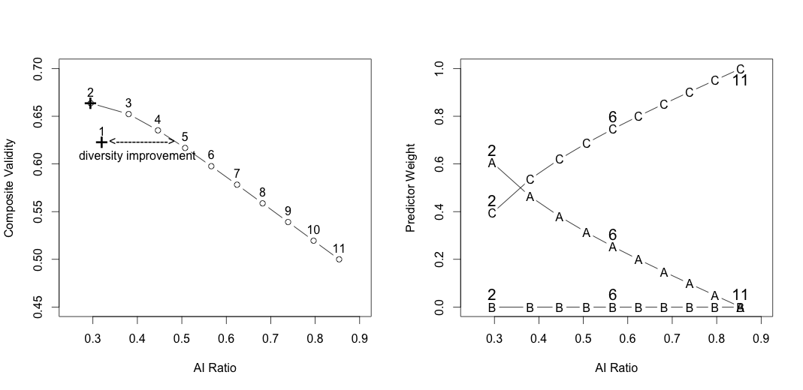
Pareto-Optimal Weighting
Notes:
De Corte explained that if you have a given set of predictors (both high and low impact predictors), you can assign different weights to predictors to give different job performance and diversity outcomes for the selection system.

Slide 10
Pareto-Optimal Weighting
Notes:
(point with hands) Solution number 2 gives you high job performance and low diversity.
Solution number 11 gives you low job performance but high diversity.
The fact that the Pareto curve has a negative slope is the reason that there’s a diversity-performance tradeoff.
(use arms to show slope) If the curve were very steep, it means that you have to give away a lot of job performance to gain a little bit more diversity.
(use arms to show slope) If the curve were very flat, it means that you do not have to give up much job performance to get a lot more diversity.

Slide 11
Pareto-Optimal Weighting
Notes:
Point #6 is where both were equally maximized.

Slide 12
Pareto-Optimal Weighting
Notes:
Any solution below the curve are sub-optimal, which means that we can find optimal solutions that can provide higher AI ratio at same level of predictive performance.
Point #1 is the common unit-weighted solution. Studies had found that Pareto solution provides diversity improvement, or gain in diversity compared to unit-weighting at same level of job performance.

Slide 13
Pareto-Optimal Weighting
De Corte, Lievens, & Sackett, 2008
Pareto-weighting a composite of cognitive and non-cognitive tests enhances both the criterion-related validity and the AI ratio, compared with using a cognitive test alone.
Cognitive tests are given less weight.
Wee, Newman, & Joseph, 2014
Pareto-weights of cognitive ability subtests (verbal, numerical, technical, clerical ability subtests) could result in substantial diversity improvement (i.e., adverse impact ratio increases) in contrast to unit weighting.
Verbal ability and technical knowledge subtests (ASVAB) are given less weight, but math and clerical tests are given more weight.
Notes:
Previous researchers had tested the use of Pareto-optimal weighting technique in personnel selection using empirical conditions.
De Corte et al. (2008) and Wee et al. (2014) each tested Pareto-optimal weighting strategy.
Pareto-optimal weighting strategy gave better solutions compared to using a single predictor and compared to unit-weighting.
Pareto-method typically give lower weight to high impact predictor.
----
*De Corte et al., 2008: Pareto-optimally weighted cognitive ability test + structured interview > cognitive ability test (alone)
*Wee et al., 2014: Pareto-optimal weighting > unit weighting; cognitive subtests

Slide 14
Pareto-Optimal Method - Caveat
How well do Pareto-weights cross-validate to a new sample?
De Corte et al. (2011)
Discussed cross-validation for Pareto-optimal selection system from population to sample and from sample to population
Did not address sample to sample cross-validation
Only used one population input matrix
Notes:
The optimization technique give us beneficial outcomes when applied to one sample, but what happens if we generalize to a new sample?
But a question remains: How well do Pareto-weights cross-validate to a new sample?
[MUST mention De Corte et al., 2011]
De Corte et al. (2011) discussed cross-validation of Pareto-weights. We are extending De Corte et al. (2011) to look at cross-validation with different population input matrices.
---
*De Corte et al., 2011:
Cross-validated on Pareto optimal selection system
Sample -> population, population -> sample
6 major selection design issues: (1) the predictor subset, (2) the selection rule, (3) the selection staging, (4) the predictor sequencing, (5) the predictor weighting, and (6) the stage retention decision issue.

Slide 15
Validity/Diversity Shrinkage
Validity shrinkage: decrease in $R^{2}$ when applying optimal weights (OLS or Pareto) from the original sample to the population or to a new sample.
Current Sample
Population
New Sample
Wherry (1931);
Olkin & Pratt (1958)
Lord (1950); Nicholson (1960); Browne (1975)
Notes:
In practice, we only know performance data of current employees, not job candidates. Thus, when hiring for new candidates, we can only estimate optimal weights from current employee data and apply it to select job candidates. In OLS regression, common practice is to estimate shrunken R-squared, or adjusted R-squared using these formulae.

Slide 16
Validity/Diversity Shrinkage
Diversity shrinkage: decrease in diversity/AI ratio when applying optimal weights (OLS or Pareto) from the original sample to the population or to a new sample.
Two aspects of shrinkage in Pareto-optimal weighting: criterion validity shrinkage vs. diversity shrinkage
Current Sample
Population
New Sample
Criterion Validity Shrinkage
Diversity Shrinkage
Notes:
Pareto-optimal weighting optimizes both job performance and diversity simultaneously. Thus, we also need to consider diversity shrinkage.

Slide 17
Validity/Diversity Shrinkage
Validity
Shrinkage
Diversity
Shrinkage
Notes:
[[ shift down (validity shrinkage), shift left (diversity shrinkage) ]]
When we apply a set of weights derived from one sample, which we call calibration sample, to another sample, which we call validation sample,
It is our hunch that validity shrinkage will move the tradeoff curve down and diversity shrinkage will move the tradeoff curve to the left.

Slide 18
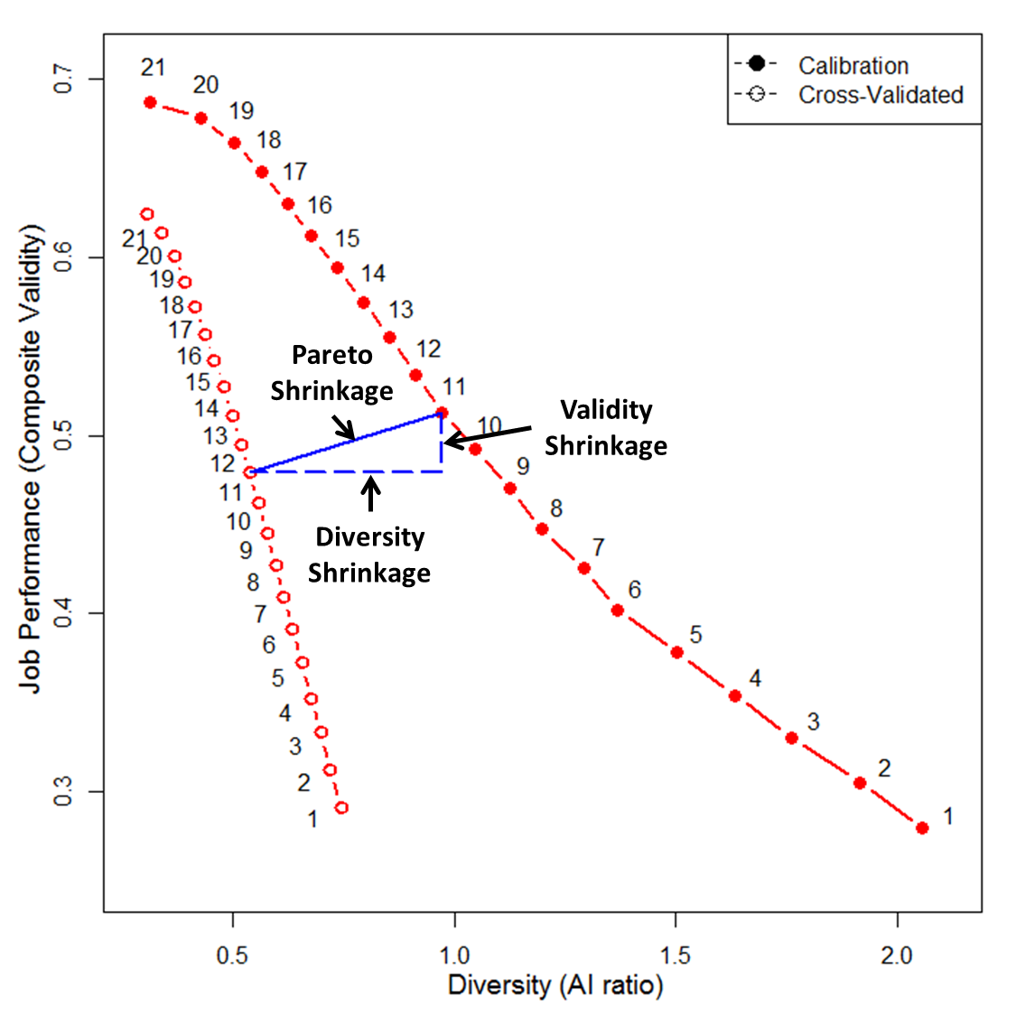
Validity/Diversity Shrinkage
Notes:
Illustrated in figure, here we have trade-off curves for calibration sample and validation sample, or a new sample. They share same Pareto weights , which were obtained using calibration data.
We notice that when the Pareto weights were applied to a new sample, the solid curve moves down and to the left – both job performance and diversity decreases.
For Pareto point 11, the vertical distance between calibration sample validity and validation sample validity is validity shrinkage, whereas the horizontal distance between calibration sample diversity and validation sample diversity is the diversity shrinkage.

Slide 19
Research Question #1
How large are job performance validity shrinkage and diversity shrinkage?
Is job performance validity shrinkage greater when job performance is being maximized?
Is diversity shrinkage greater when diversity is being maximized?
Notes:
[[ 2 research questions ]]
Thus, our first research question is: How large are job performance validity shrinkage and diversity shrinkage?
---
Based on shrinkage formula from regression, (Lord-Nicholson formula) – when R^2 is bigger, shrinkage is bigger – thus, we predict that job performance validity shrinkage is greater when job performance is being maximized, and diversity shrinkage is greater when diversity is maximized.

Slide 20
Research Question #2
At what sample size do shrunken Pareto weights outperform unit weights?
Do results differ when using different predictor combinations?
Cognitive and non-cognitive predictor composites (De Corte et al., 2008)
Cognitive subtest composites (Wee et al., 2014)
Notes:
[[ characteristics that influence shrinkage, calibration sample size, predictor combination ]]
Also, we are interested in whether the shrunken Pareto-optimal solutions still outperform unit weights.
We look at different calibration sample sizes and predictor combinations.
---

Slide 21
Contributions
Extend cross-validation to multiple objective optimization.
Examine the extent to which different predictor combinations and sample sizes impact validity shrinkage and diversity shrinkage.
Compare shrunken Pareto solutions to unit-weighted solutions.
Notes:
[[ contributions ]]
We have three intended contributions.
First, we extend cross-validation to multiple objective optimization.
Second, we examine the extent to which different predictor combinations and sample sizes impact validity shrinkage and diversity shrinkage.
Third, we compare shrunken Pareto solutions to unit-weighted solutions.
---

Slide 22
Method
Monte-Carlo Simulation Conditions
Population Correlation Matrix Bobko-Roth Cognitive & Non-Cognitive Predictors Obtained from Bobko & Roth, 2013; Roth et al., 2011, Van Iddekinge et al., 2012; McKay & McDaniel, 2006 Cognitive Subtest Predictors (ASVAB; 7 job families) Obtained from Wee et al., 2014 | Samples Calibration Sample N = 40, 100, 200, 500, 1000 Validation Sample N = 10,000 Weighting methods Pareto weighting Unit weighting
Notes:
[[ Monte-Carlo simulation ]]
Monte Carlo simulation was used.
Two predictor set conditions were studied…
We examined across five calibration sample sizes and one validation sample size.
Two weighting methods were compared.
---
Bobko-Roth predictor correlations are meta-analytic correlations.

Slide 23
Method
Population Correlation Matrix
Bobko-Roth Predictors
Variable | 1 | 2 | 3 | 4 | 5
Roth et al., 2011 predictors
1. Biodata | 1.00
2. Cognitive Ability | .37 | 1.00
3. Conscientiousness | .51 | .03 | 1.00
4. Structured Int. | .16 | .31 | .13 | 1.00
5. Integrity Test | .25 | .02 | .34 | -.02 | 1.00
Job Performance | .32 | .52 | .22 | .48 | .18
Black-White race (Subgroup d) | .39 | .72 | -.09 | .39 | .04
Notes:
[[ cognitive-noncognitive predictor condition ]]
Bobko-Roth predictors include following five predictors, and here are the population correlation matrix used.

Slide 24
Method
Population Correlation Matrix
Cognitive Subtest Predictors (ASVAB)
Variable | 1 | 2 | 3 | 4
ASVAB cognitive subtests
1. Verbal Ability | 1.00
2. Mathematical Ability | .79 | 1.00
3. Technical Knowledge | .78 | .68 | 1.00
4. Clerical Speed | .46 | .64 | .23 | 1.00
Predictor Validities
Machinery Repair | .52 | .58 | .54 | .36
Control & Communication | .40 | .55 | .37 | .43
Black-White race (Subgroup d) | .91 | .69 | 1.26 | .06
Notes:
[[ cognitive subtest predictor condition ]]
Cognitive subgroup predictors include following four predictors, and here are the population correlation matrix used.
Seven job families were studied.

Slide 25
Method
Step 1
Step 2
Step 3
Step 4
Step 5
Generate Calibration & Validation Samples
Run TROF program (De Corte, 2006) for calibration samples and obtain Pareto-optimal weights
Calculate Pareto-optimally weighted job performance criterion validity and diversity for calibration and validation samples
Calculate unit-weighted job performance criterion validity and unit-weighted diversity
Aggregate and Plot
*R programming language (R Core Team, 2015) was used
Notes:
[[ procedure ]]
Simulation was based on following procedure.

Slide 26
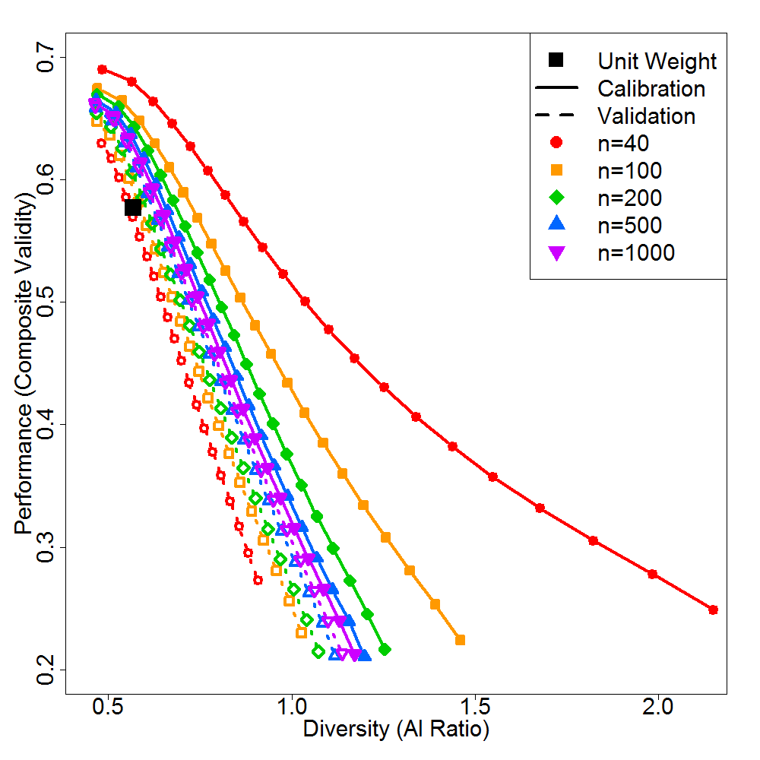
Results: Bobko-Roth Predictors
Notes:
[[ result, rainbow figure, curve, Bobko-Roth predictors ]]
This is what we call a rainbow figure, where we plotted the Pareto-optimal tradeoff curves for calibration and validation samples.

Slide 27
Results: Bobko-Roth Predictors
Notes:
[[ example, calibration sample, validation sample, shrinkage ]]
[Solid red line & dotted red line only.]
For example, the solid red line at the top is the average Pareto curve estimated from calibration samples of size 40. The dotted red at the bottom is the average Pareto curve estimated from validation sample using Pareto weights extracted from calibration samples of size 40.
[Shrinkage is the difference between the solid line and the dotted line of the same color. (POINT)]

Slide 28
Results: Bobko-Roth Predictors
Notes:
Here is the result for Bobko-Roth cognitive and non-cognitive predictors.
What it looks like here is that if your calibration sample have 40 people in it and you are trying to maximize validity, you’ll get this much shrinkage (POINT), and if you are trying to maximize diversity, you’ll get this much shrinkage (POINT).
As the calibration sample size gets bigger (moving down the rainbow from red to orange to green), there’s less shrinkage.
The black square represents the single solution you get if you unit-weight the predictors.
The unit-weighted solution has fairly high performance and fairly low diversity.
The fact that the black square is below the orange line means that the unit-weighted solution is SUB-OPTIMAL, unless your Pareto-weights are based on sample sizes of less than 100.

Slide 29
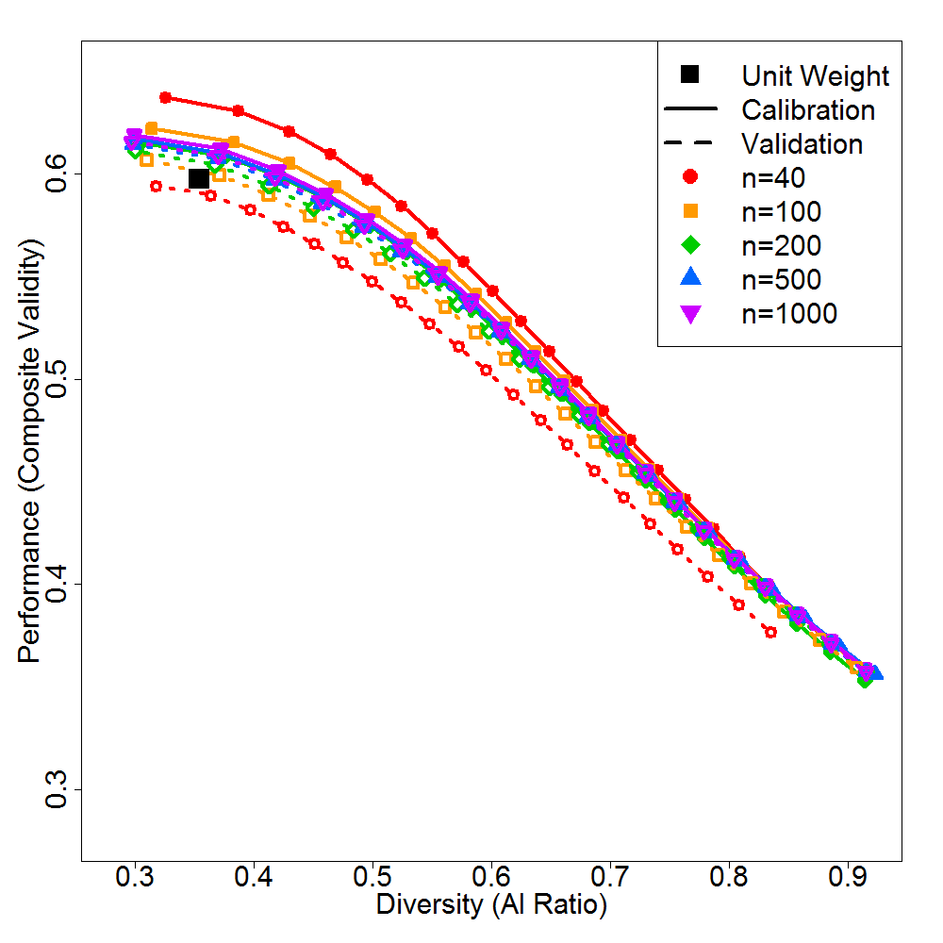
Results: Cog. Subtest (Machinery Repair)
Notes:
[[ cognitive subtest, Machinery repair job family, shrinkage, unit-weighting ]]
Here, we are looking at another set of predictors – cognitive subtest predictors, numerical ability, verbal ability and clerical ability as used in Wee et al., 2014.
There’s not very much shrinkage in this solution.
Again, the unit-weighted solution is sub-optimal, when your calibration sample size is less than 100.
This solution comes from just the Machinery Repair job family.
[For me, I thought the result was very encouraging, because it means that even after accounting for shrinkage, the Pareto-optimal strategy provides us with as good or better selection solution than common method of unit-weighting.
(don’t over sell)
Let’s look at rest of results.
---

Slide 30
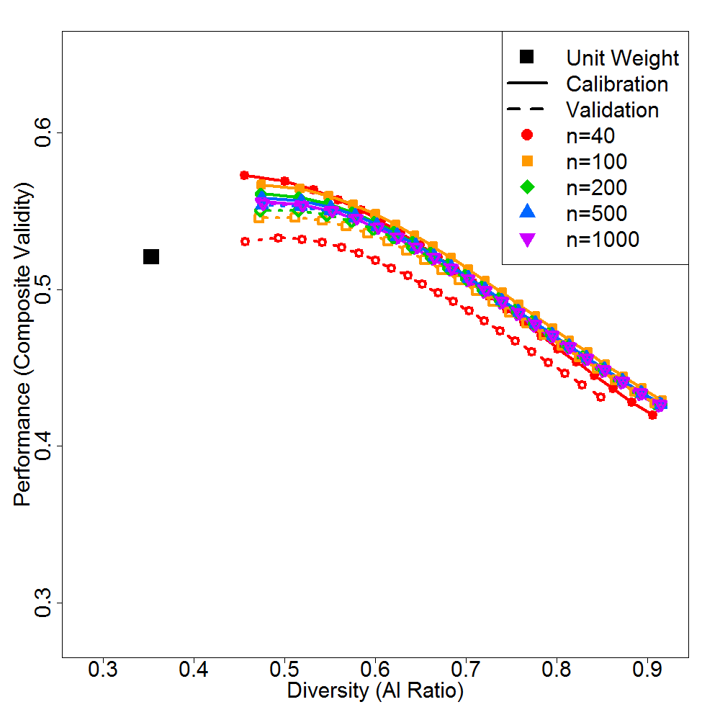
Results: Cog. Subtest (Control & Comm.)

Slide 31
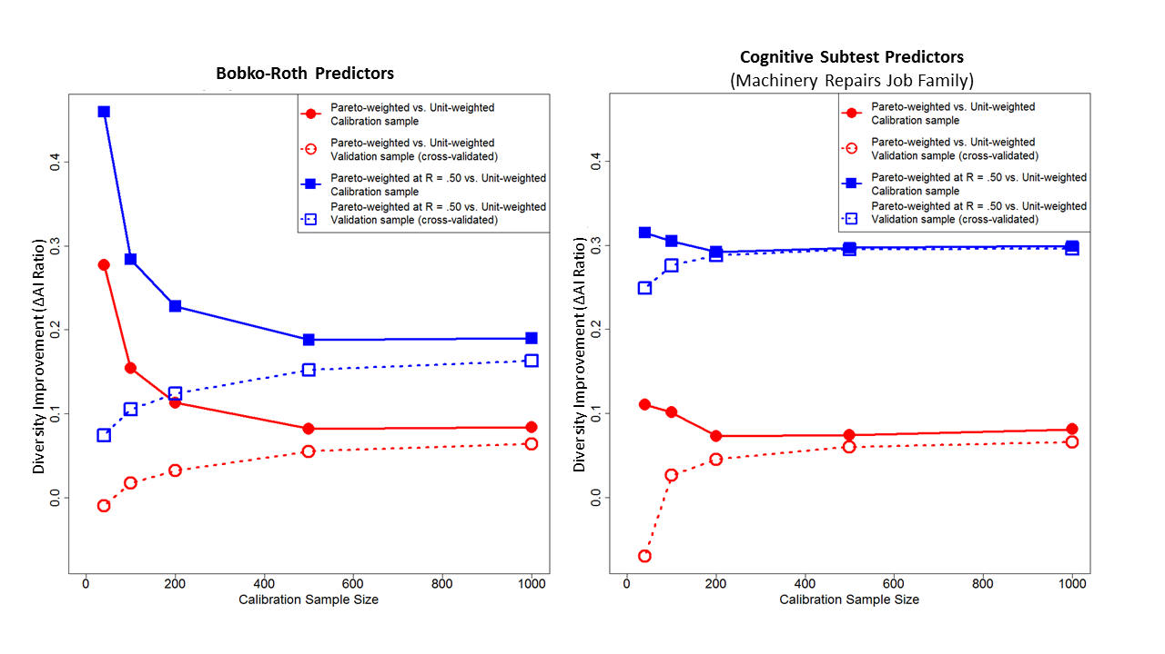
Results: Diversity Improvement
Notes:
We also plotted the diversity improvement and found that diversity improvement is possible, especially when sample size is small, or when we are willing to sacrifice certain amount of job performance criterion validity.

Slide 32
Summary of Findings (1)
Validity shrinkage and diversity shrinkage both decrease when sample size increases. The incremental benefit of sample size is greater when sample size is small.
In the current simulation, diversity shrinkage was sizable when using the standard set of Bobko-Roth predictors (cognitive and noncognitive tests), whenever sample size was at or below 500.
In the current simulation, diversity shrinkage was typically negligible for cognitive subtest predictors, whenever sample size was at or above 100.

Slide 33
Summary of Findings (2)
Diversity shrinkage is greater when diversity is being maximized. Validity shrinkage is greater when job performance is being maximized.

Slide 34
Summary of Findings (3)
Including low impact predictors tends to increase diversity shrinkage.
When maximizing a particular criterion, shrinkage decreases as $R^{2}$increases (this can be clearly seen in classic shrinkage formulas).
For this reason, validity shrinkage should decrease when you have high-validity predictors (because high-validity predictors increase $R^{2}$).
Likewise, diversity shrinkage should decrease when you have high-impact predictors (because high-impact predictors increase $R^{2}$ for predicting race). Conversely, low impact predictors would increase diversity shrinkage.

Slide 35
Summary of Findings (4)
Pareto-optimal weights typically outperform unit weights.
Pareto-optimal weights generally (but not always) yield equal or greater job performance outcomes than unit-weights (even after accounting for shrinkage; when calibration sample size is N ≥ 100)
Pareto weights can typically yield greater diversity outcomes compared to unit weights, at no cost in terms of job performance.

Slide 36
Summary of Findings (4)
Pareto-optimal weights typically outperform unit weights.
Further, if practitioners are willing to sacrifice a moderate amount of job performance (e.g., using R = .50, instead of unit-weighted R = .58 [with Bobko-Roth predictors]), usually a notably greater diversity outcome can be achieved (e.g., AI ratio = .78, instead of unit-weighted AI ratio = .63 [with Bobko-Roth predictors]) by using Pareto weights.

Slide 37
Implications
R Package – ParetoR
library(‘devtools’)
install_github(‘Diversity-ParetoOptimal/ParetoR’)
https://github.com/Diversity-ParetoOptimal/ParetoR

Slide 38
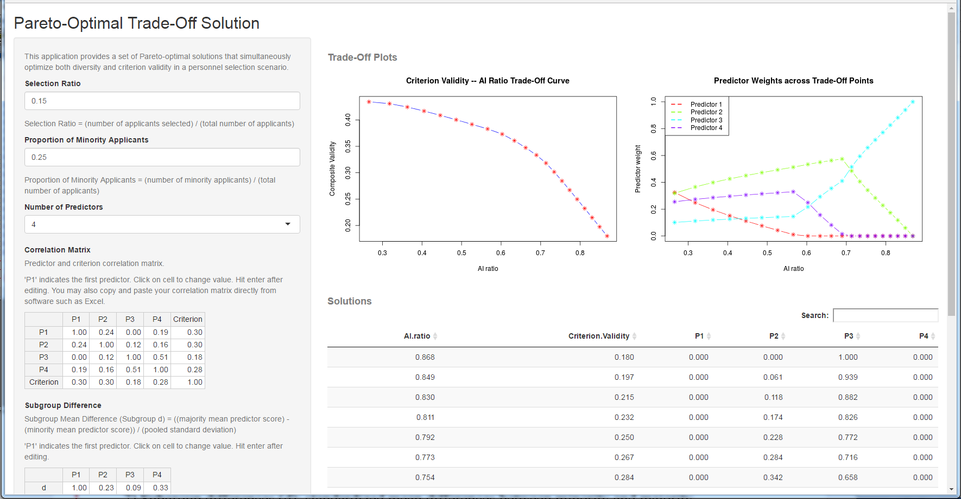
Implications
Pareto-Optimal ShinyApp – click-and-point web application
https://qchelseasong.shinyapps.io/ParetoR/

Slide 39
Conclusion
The current work addresses the possibility of diversity shrinkage in Pareto-optimal solutions.
We found evidence for both validity shrinkage and diversity shrinkage.
Despite shrinkage, Pareto weighting often outperforms unit-weighting, especially when calibration sample sizes were above 100.
Some results generalize across both cognitive-noncognitive predictor sets and cognitive subtest predictor sets.

Slide 40
Limitation and Future Direction
Future studies can systematically manipulate number of predictors (k).
Shrinkage formulas: Do shrinkage formulas from OLS apply to Pareto-optimal weighting?
If not, how should we estimate validity and diversity shrinkage for Pareto-optimal weighting?
What aspects are related to shrinkage in Pareto-optimal weighting?

Slide 41
Study 2
Development of Pareto-Optimal
Shrinkage Formula:
Approximation of Diversity Shrinkage from Pareto Weights

Slide 42
Study 2: Purpose
Develop closed-form equations to approximately correct for validity shrinkage and diversity shrinkage in Pareto-optimal weighting
Evaluate shrinkage formulas using Monte-Carlo simulation

Slide 43
Pareto-Optimal Shrinkage Formula: Development
$$R_{Adj.P}=R_{Adj.max}−\left(R_{Cal.max}−R_{Cal.P}\right)×\frac{R_{Adj.max}−R_{Adj.min}}{R_{Cal.max}−R_{Cal.min}}$$
Notes:
We developed following simple shrinkage formula to correct for shrinkage in set of solution at each Pareto point.

Slide 44
Pareto-Optimal Shrinkage Formula: Development
$$R_{Adj.P}=R_{Adj.max}−\left(R_{Cal.max}−R_{Cal.P}\right)×\frac{R_{Adj.max}−R_{Adj.min}}{R_{Cal.max}−R_{Cal.min}}$$
$R_{Cal.P}$: Calibration sample Pareto outcome (performance, diversity) at current Pareto point
$R_{Adj.P}$: Shrunken Pareto outcome (performance, diversity) at current Pareto point
$R_{Cal.max}$: Calibration sample Pareto outcome (performance, diversity) at endpoint where that outcome is maximized
$R_{Adj.max}$: Shrunken Pareto outcome (performance, diversity) at endpoint where that outcome is maximized
$R_{Cal.min}$: Calibration sample Pareto outcome (performance, diversity) at endpoint where that outcome is least maximized (or ignored)
$R_{Adj.min}$: Shrunken Pareto outcome (performance, diversity) at endpoint where that outcome is least maximized (or ignored);
Assumes: $R_{Adj.min}$ =$R_{Cal.min}$ (no shrinkage on ignored criterion)
Notes:
Here are the notations.

Slide 45
Simulation Study
Conditions
Calibration Sample Size
N = 40, 100, 200, 500, 1000
Validation Sample Size
N = 10,000
Selection Setting
Selection ratio = 0.15
Proportion of minority applicants = 0.17 (i.e., 1/6)
Population Correlation Matrix
Bobko-Roth Cognitive & Non-Cognitive Predictors
Meta-analytic estimates: Obtained from Bobko & Roth, 2013; Roth et al., 2011; Van Iddekinge et al., 2012; McKay & McDaniel, 2006
Trials: 1,000
Notes:
We also conducted simulation to evaluate the performance of the shrinkage formula.

Slide 46
Simulation Study
Population Correlation Matrix
Bobko-Roth Predictors
Variable | 1 | 2 | 3 | 4 | 5
Roth et al., 2011 predictors
1. Biodata | 1.00
2. Cognitive Ability | .37 | 1.00
3. Conscientiousness | .51 | .03 | 1.00
4. Structured Int. | .16 | .31 | .13 | 1.00
5. Integrity Test | .25 | .02 | .34 | -.02 | 1.00
Job Performance | .32 | .52 | .22 | .48 | .18
Black-White race (Subgroup d) | .39 | .72 | -.09 | .39 | .04
Notes:
Again using these predictors.

Slide 47
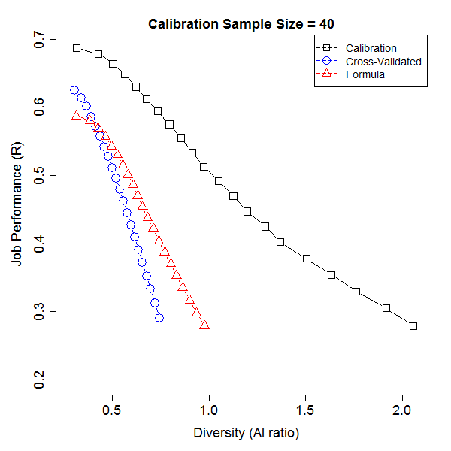
Simulation Study - Results
Notes:
Here is result when calibration sample size is 40. Black line is the calibration sample trade-off curve, blue line is the cross-validated trade-off curve (the curve that we want to estimate), and red line is the trade-off curve estimated using our formula and the calibration sample data. Red line is much closer to the blue line than the black.

Slide 48
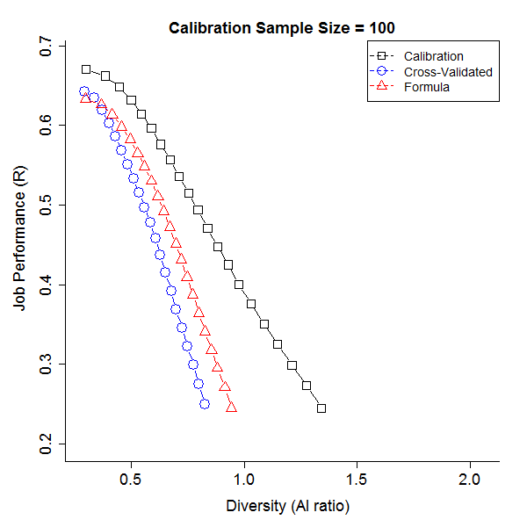
Simulation Study - Results
Notes:
This is when calibration sample size is 100.

Slide 49
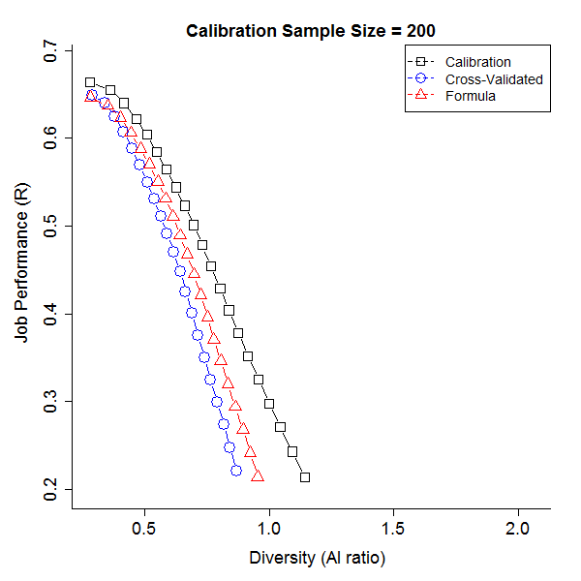
Simulation Study - Results
Notes:
200.

Slide 50
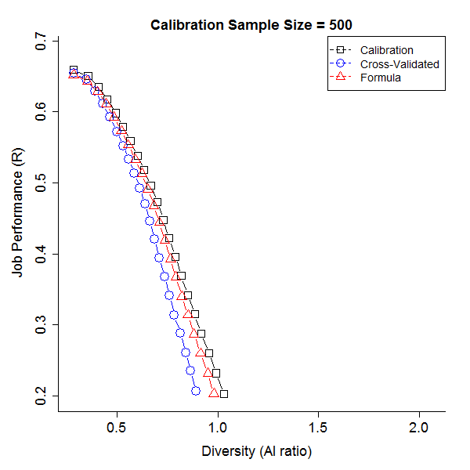
Simulation Study - Results
Notes:
500.

Slide 51
Simulation Study - Results
Notes:
And 1000.
---
Overall, results showed that: 1) formula solution is very close to cross-validated result – formula does good job in predicting the validity when applied to new sample;
2) as calibration sample size increases, there is less shrinkage.

Slide 52
Simulation Study – Sensitivity Analysis
Proportion of minority applicants
Prop. = 0.25 (i.e., 1/4)
Prop. = 0.17 (i.e., 1/6)
Prop. = 0.10 (i.e., 1/10)
Selection ratio
SR = 0.30
SR = 0.15
SR = 0.10
Notes:
We also conducted a sensitivity analysis to examine whether result varied across different proportion of minority applicants and selection ratio.

Slide 53
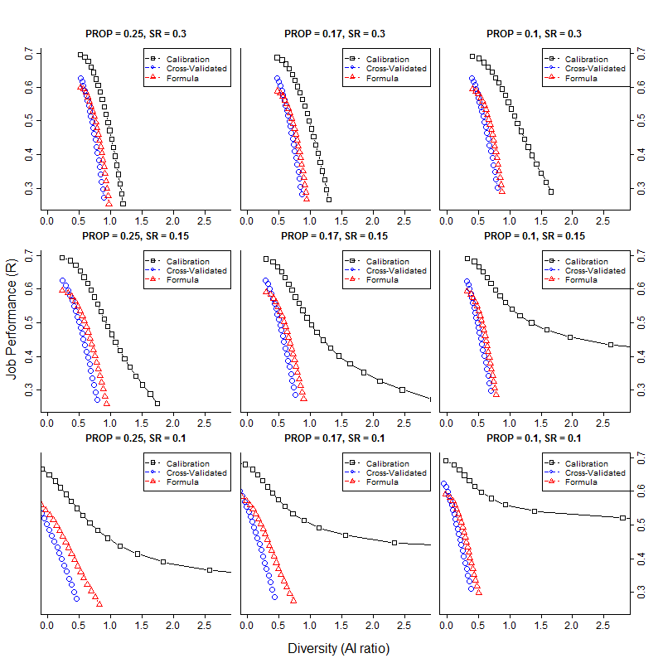
Simulation Study
Notes:
Result showed that the formula consistently does good job in predicting cross-validated solution.

Slide 54
Conclusion
We developed an approximate formula to correct for validity shrinkage and diversity shrinkage when using Pareto-optimal weighting on two criteria.
The method can be used to easily estimate shrunken Pareto solutions (i.e., when Pareto weights are applied to new samples).

Slide 55
Thank you!
Contact
Q. Chelsea Song
qsong6@illinois.edu

Slide 56
Appendix

Slide 57
Appendix: Study 1

Slide 58
Shrinkage and Cross-Validation for OLS Regression
Generalizing to new sample
Browne’s shrinkage formula (Browne, 1975, p. 85)
Generalizing to population
Olkin & Pratt’s shrinkage formula (approximation, see Cattin, 1980, p. 409)
$${{\hat{ρ}}_{c}}^{2}=\frac{\left(N−k−3\right){\hat{ρ}}^{4} +{\hat{ρ}}^{2} }{\left(N−2k−2\right){\hat{ρ}}^{2} +k}$$
$${\hat{ρ}}^{2}=1−\frac{N−3}{N−k−1}\left(1−R^{2}\right)×\left[1+\frac{2(1−R^{2})}{N−k+1}+\frac{8{(1−R^{2})}^{2}}{(N−k−1)(N−k+3)}\right]$$
N = calibration sample size k = # of predictors $R^{2}$ = calibration sample $R^{2}$ | ${\hat{ρ}}^{2}$ = population $R^{2}$ ${{\hat{ρ}}_{c}}^{2}$ = new (validation) sample $R^{2}$
Notes:
Here, Browne formula depends on output from Olkin & Pratt’s formula.
[Important] Note that when Olkin & Pratt developed their shrinkage formula, there was no assumption of OLS, meaning the shrinkage formula could be used universally.
OLS regression only optimizes one criteria. How could we correct for shrinkage when we optimize two criterion in Pareto-optimal weighting?

Slide 59
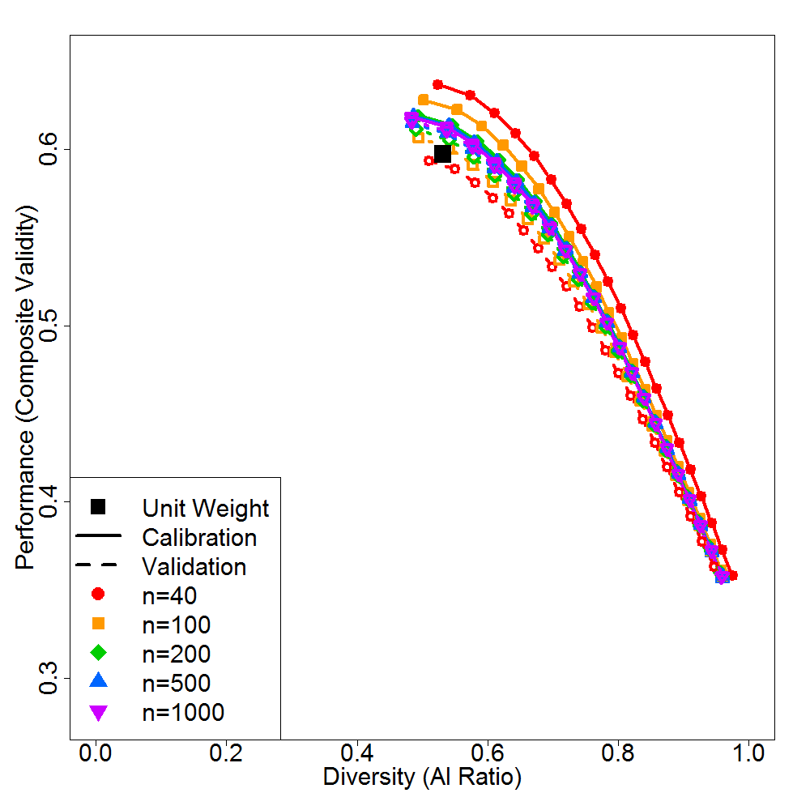
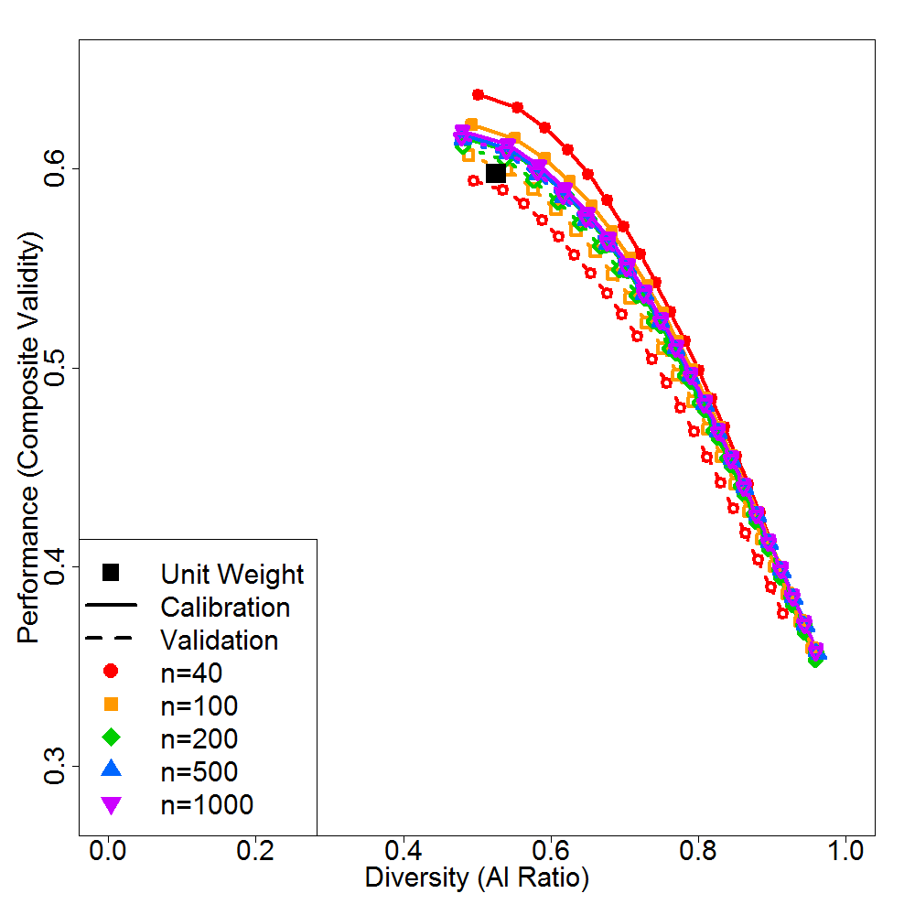
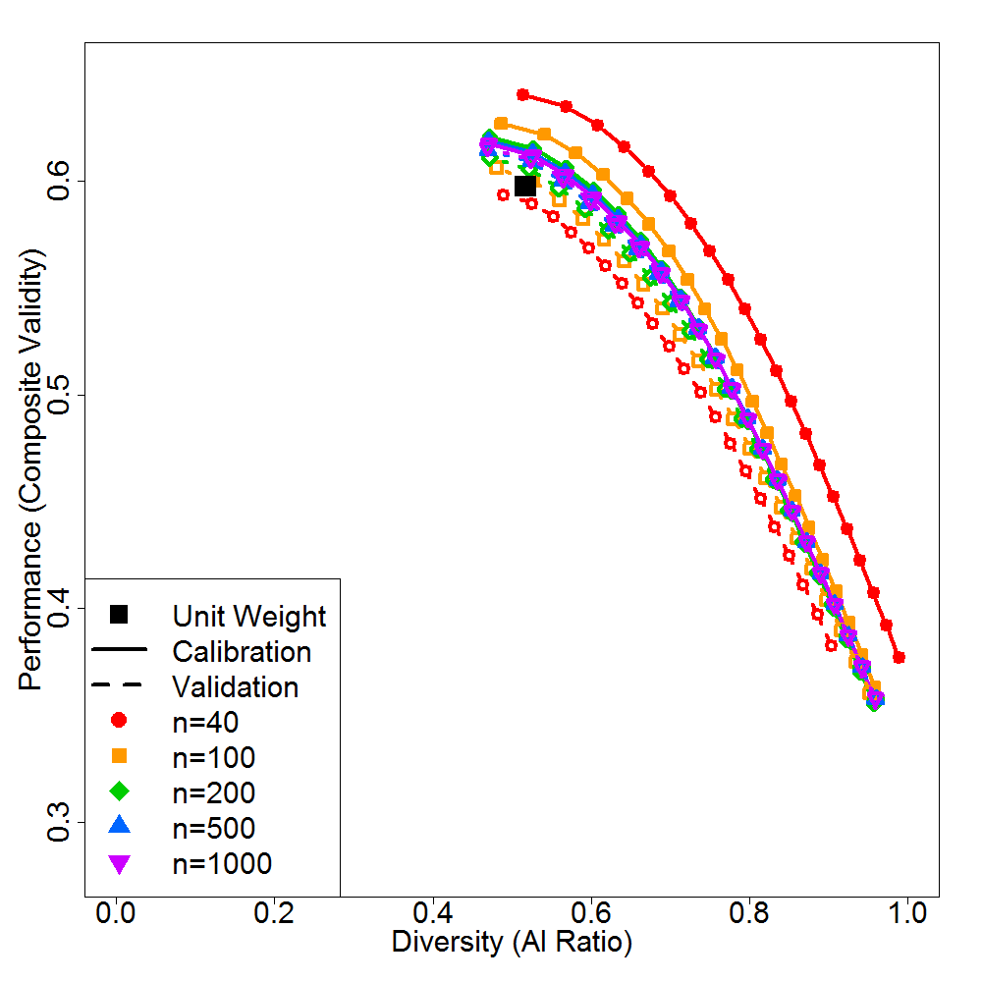
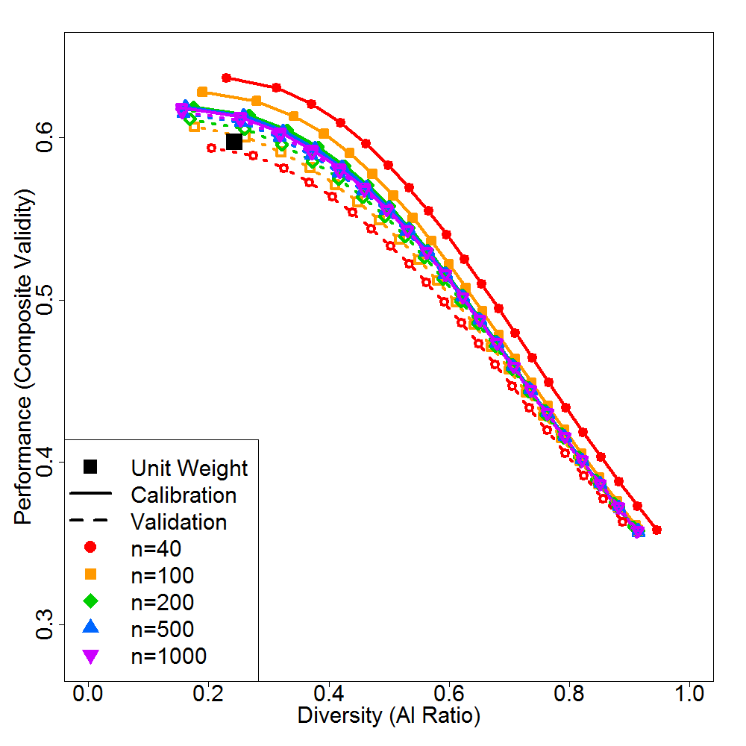
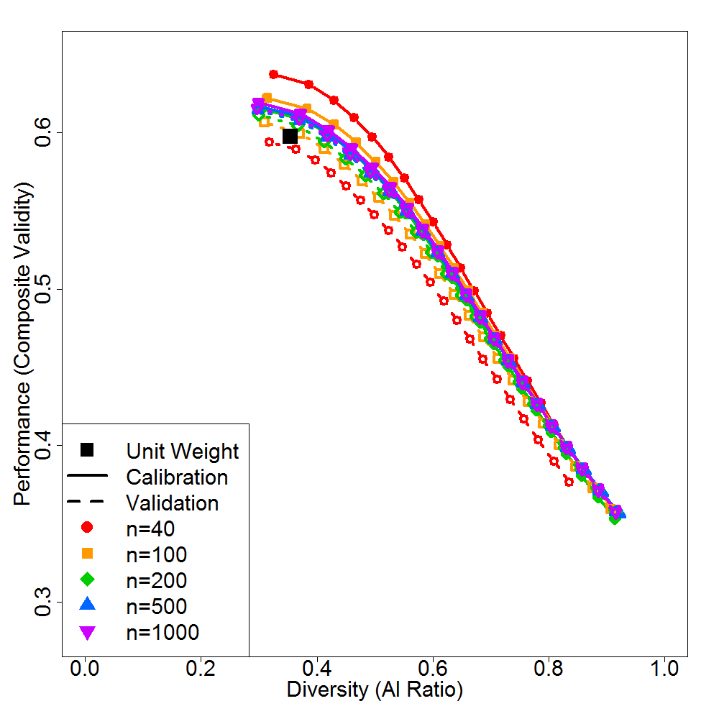
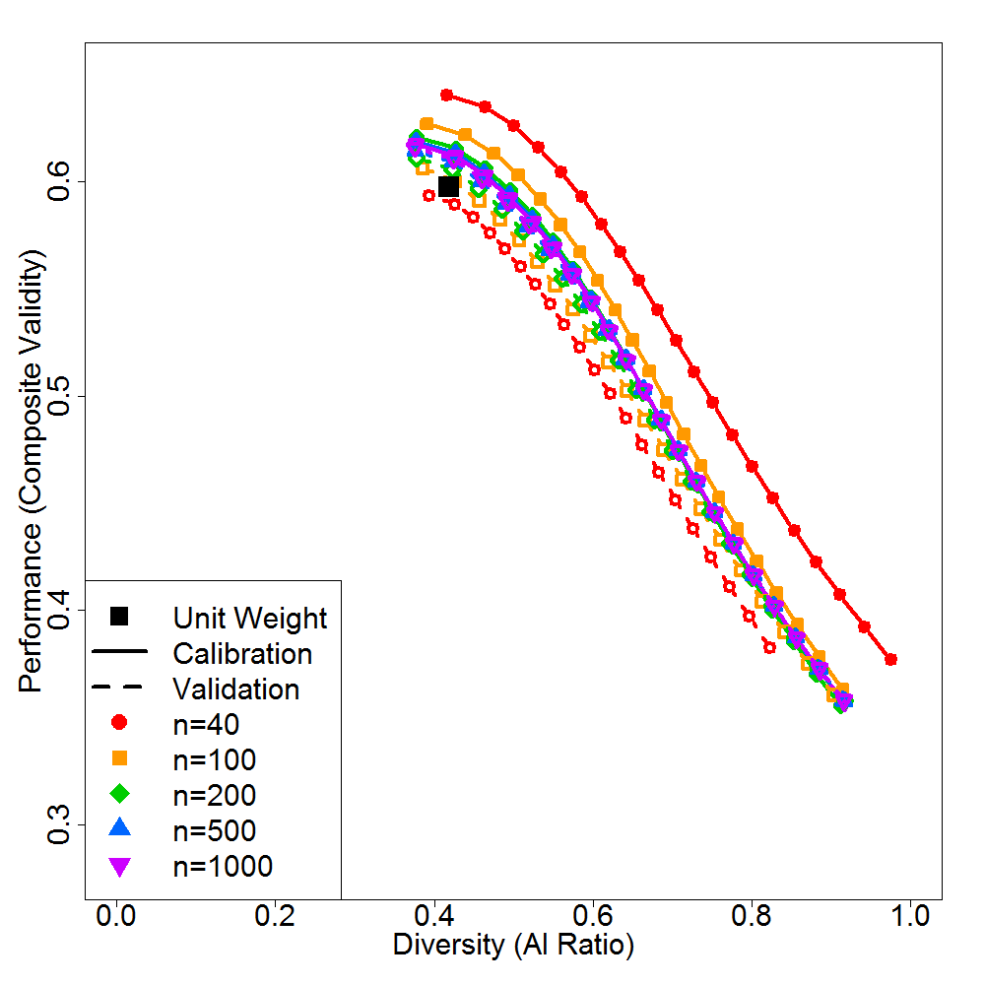
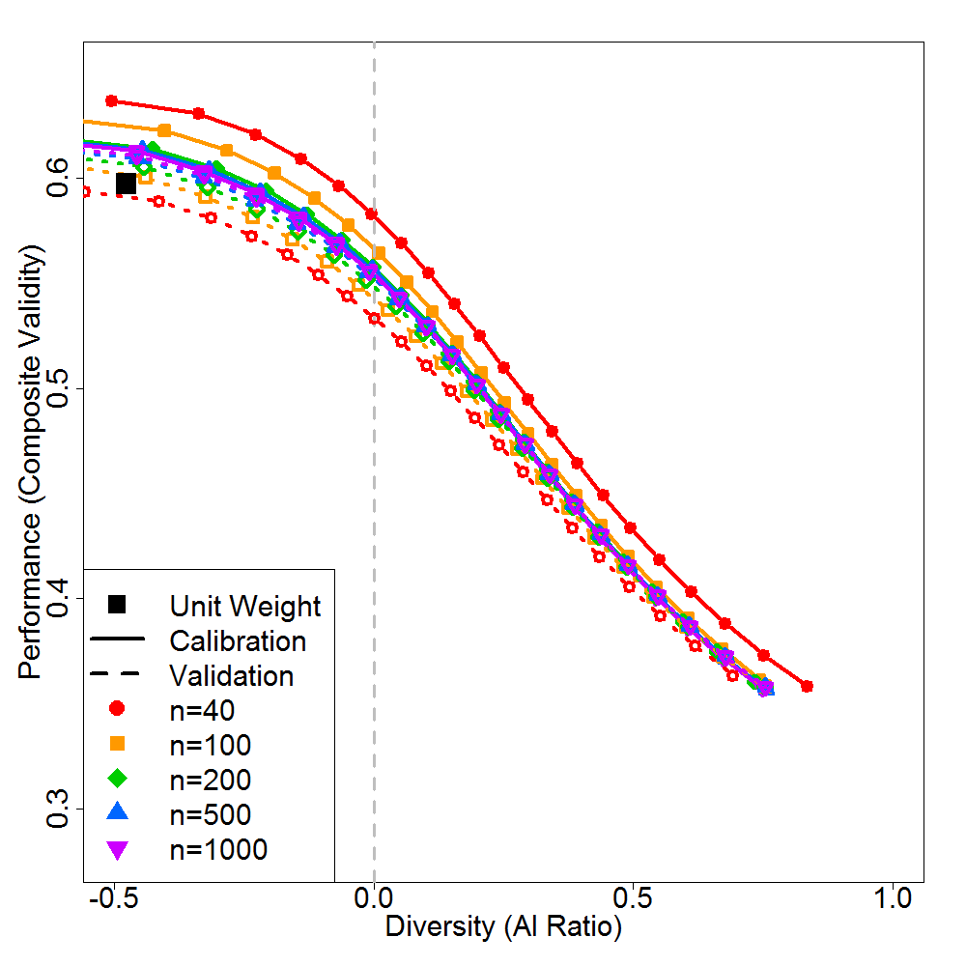
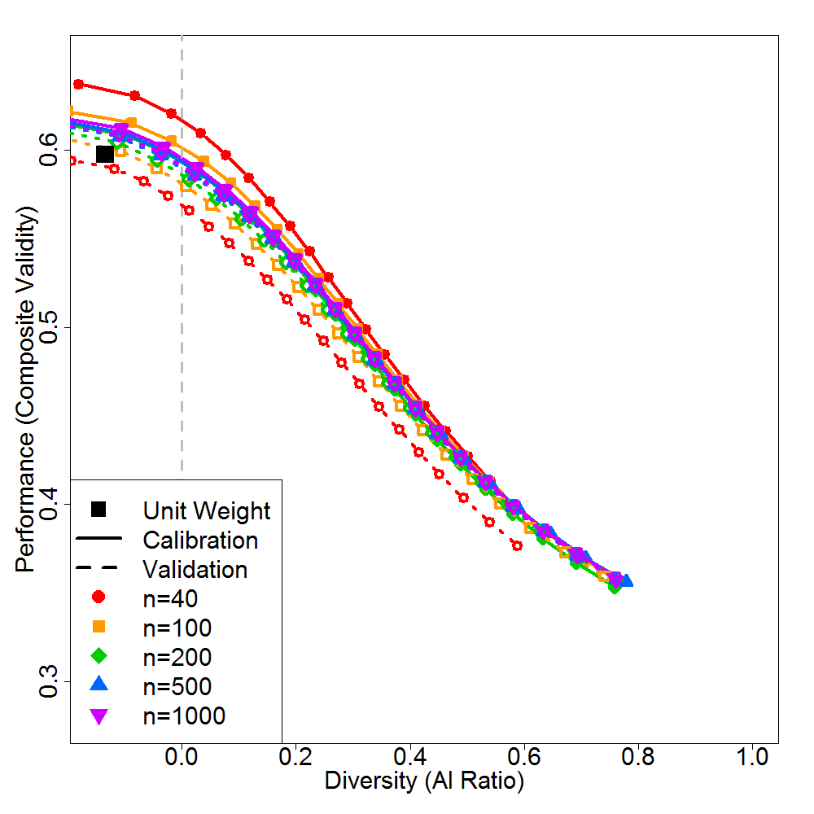
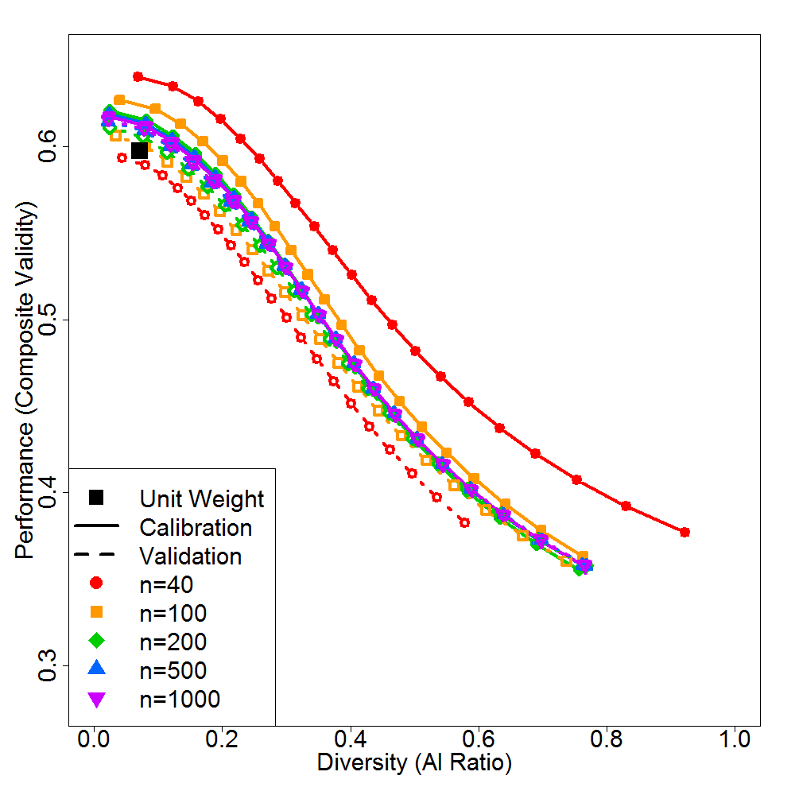
(SR = .30, prop = 1/4) | (SR = .30, prop = 1/6) | (SR = .30, prop = 1/10)
(SR = .15, prop = 1/4) | (SR = .15, prop = 1/6) | (SR = .15, prop = 1/10)
(SR = .10, prop = 1/4) | (SR = .10, prop = 1/6) | (SR = .10, prop = 1/10)
Notes:
As a conclusion, …

Slide 60
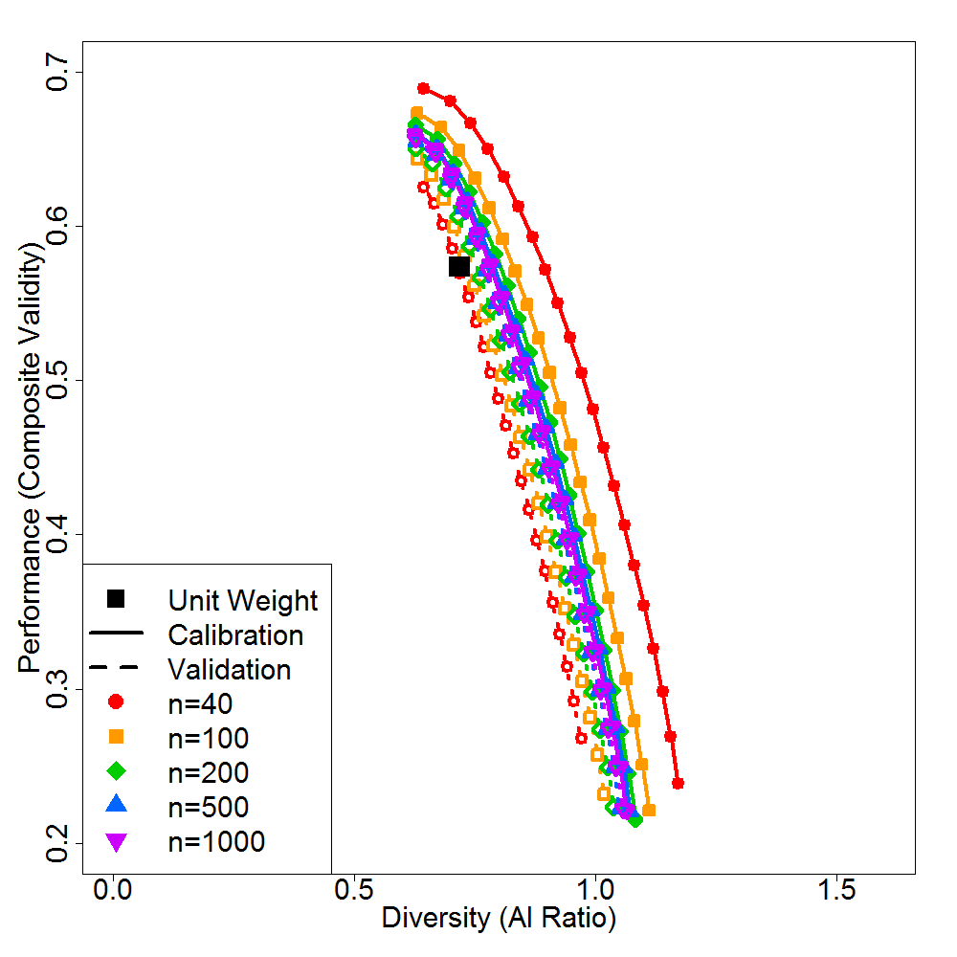
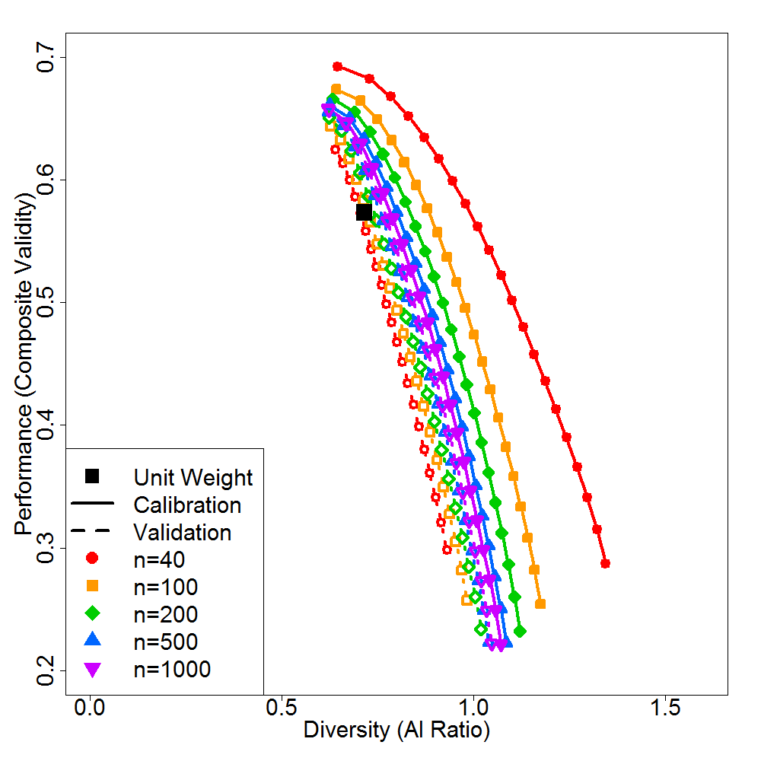
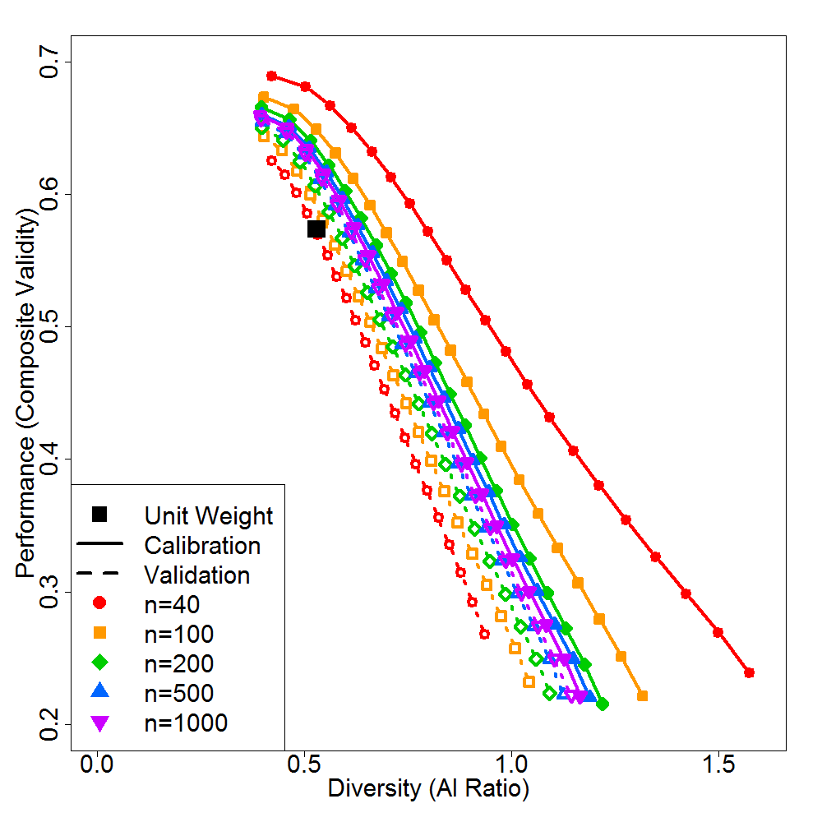
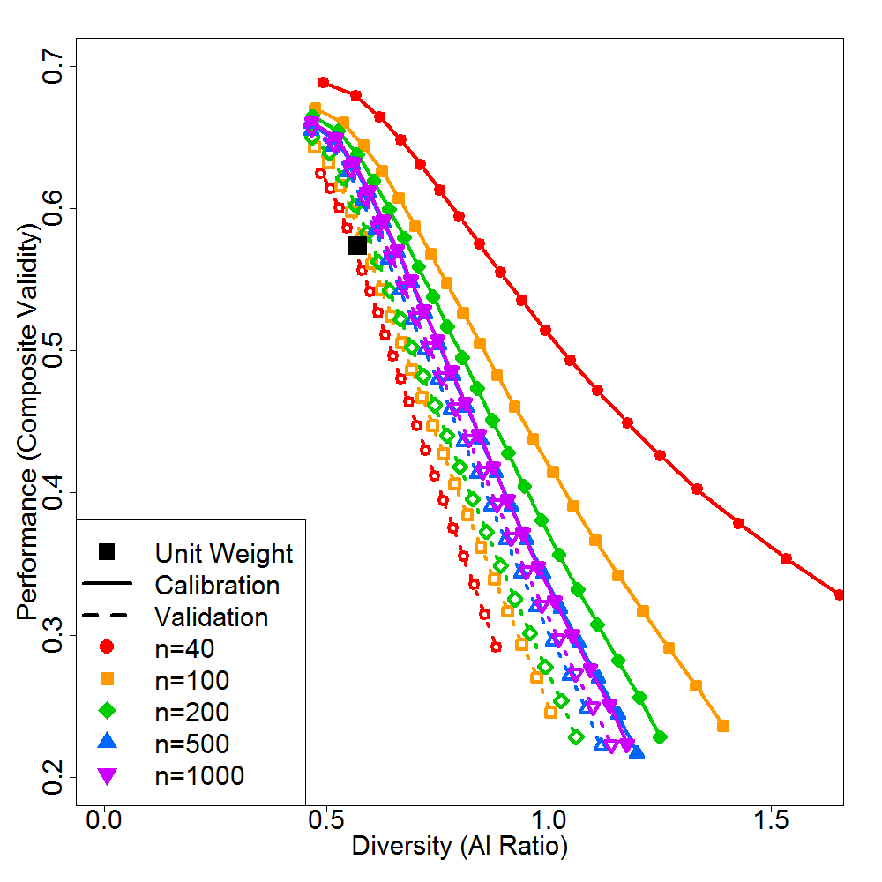
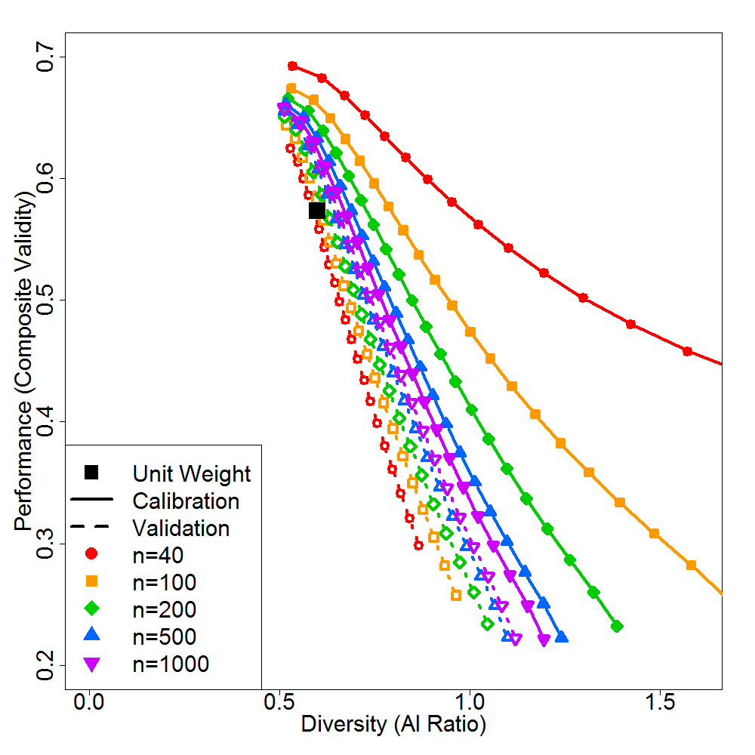
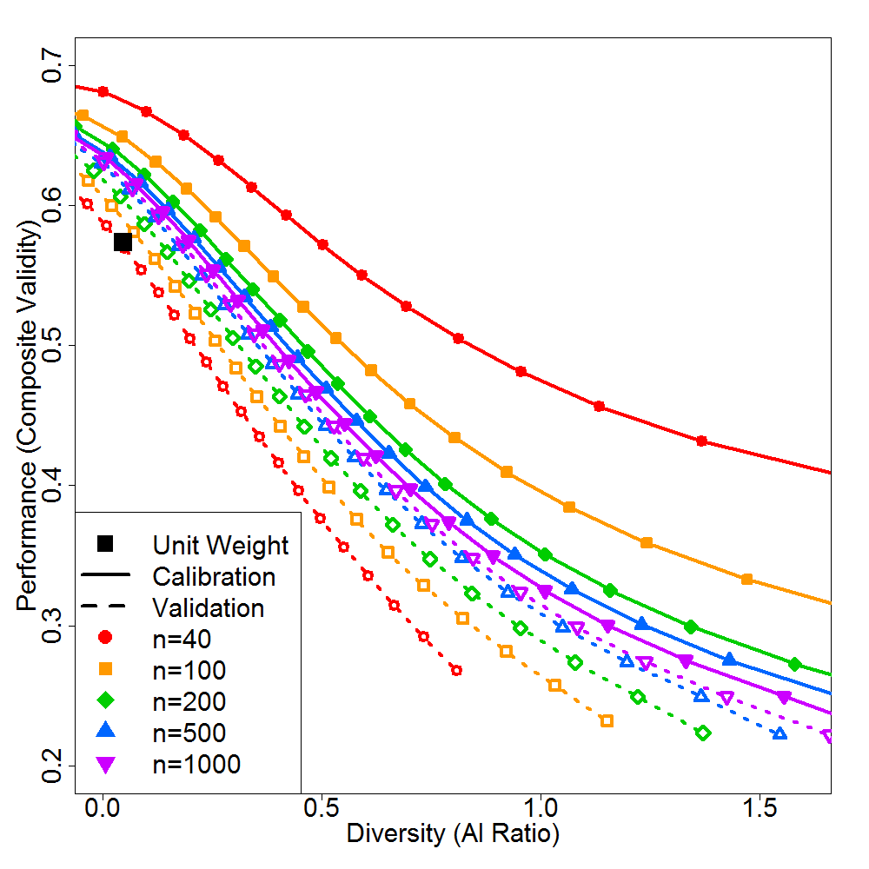
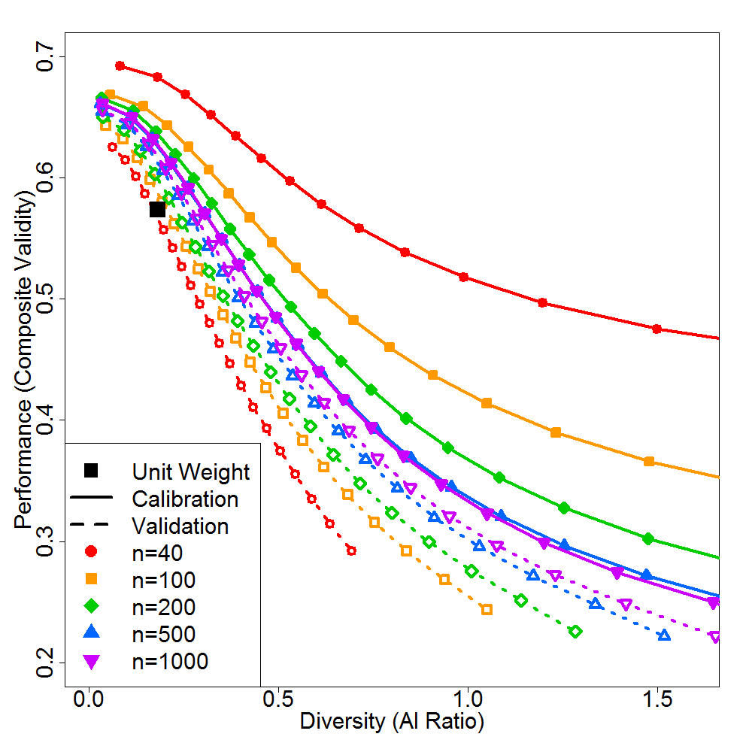
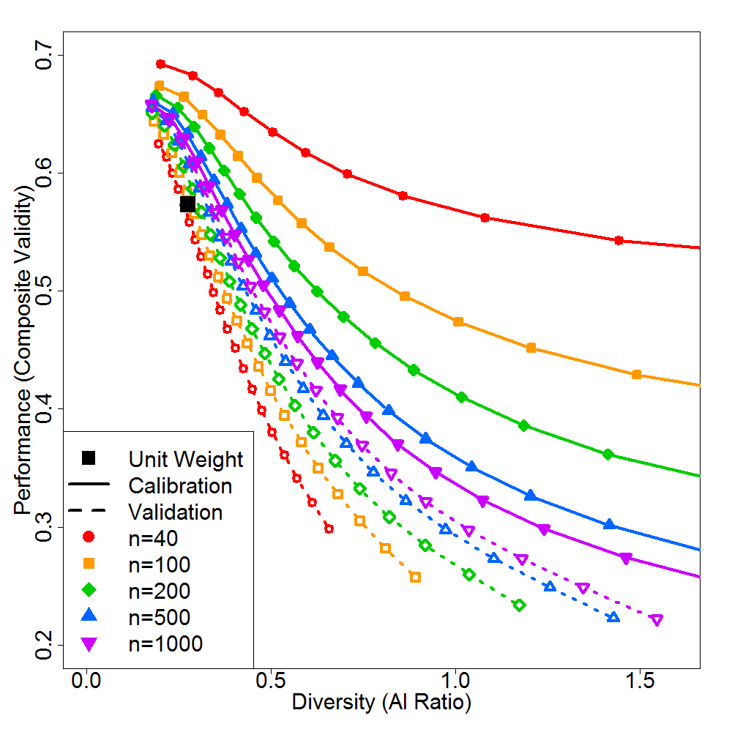
(SR = .30, prop = 1/4) | (SR = .30, prop = 1/6) | (SR = .30, prop = 1/10)
(SR = .15, prop = 1/4) | (SR = .15, prop = 1/6) | (SR = .15, prop = 1/10)
(SR = .10, prop = 1/4) | (SR = .10, prop = 1/6) | (SR = .10, prop = 1/10)
Notes:
As a conclusion, …

Slide 61
Table 1a: Criterion Validity and Diversity for Pareto Curve Endpoints using Bobko-Roth Predictors
Calibration Sample Size |  |  | Endpoint where criterion validity is maximized
 | Criterion Validity (R) |  |  |  | Diversity (AI ratio)
 | Unit- Weighted Validity | Calibration Sample Validity | Cross- Validated Validity | Validity Shrinkage (∆R) | Unit- Weighted AI ratio | Calibration Sample AI ratio | Cross- Validated AI ratio | Diversity Shrinkage (∆AI ratio)
N = 40 | .58 | .69 | .63 | .06 | 0.63 | 0.48 | 0.48 | 0.00
N = 100 | .58 | .67 | .65 | .03 | 0.63 | 0.47 | 0.47 | 0.00
N = 200 | .58 | .67 | .65 | .02 | 0.63 | 0.47 | 0.47 | 0.00
N = 500 | .58 | .66 | .66 | .01 | 0.63 | 0.47 | 0.46 | 0.00
N = 1000 | .58 | .66 | .66 | .00 | 0.63 | 0.46 | 0.46 | 0.00
Calibration Sample Size |  |  | Endpoint where diversity is maximized
 |  | Criterion Validity (R) |  |  |  | Diversity (AI ratio)
 | Unit- Weighted Validity | Calibration Sample Validity | Cross- Validated Validity | Validity Shrinkage (∆R) | Unit- Weighted AI ratio | Calibration Sample AI ratio | Cross- Validated AI ratio | Diversity Shrinkage (∆AI ratio)
N = 40 | .58 | .25 | .27 | -.02 | 0.63 | 2.15 | 0.91 | 1.24
N = 100 | .58 | .22 | .23 | -.01 | 0.63 | 1.46 | 1.03 | 0.43
N = 200 | .58 | .22 | .21 | .00 | 0.63 | 1.25 | 1.07 | 0.18
N = 500 | .58 | .21 | .21 | .00 | 0.63 | 1.20 | 1.12 | 0.08
N = 1000 | .58 | .21 | .21 | .00 | 0.63 | 1.17 | 1.14 | 0.03

Slide 62
Table 1b: Criterion Validity and Diversity for Pareto Curve Endpoints using Cognitive Subtest Predictors
Calibration Sample Size |  |  | Endpoint where criterion validity is maximized
 | Criterion Validity (R) |  |  |  | Diversity (AI ratio)
 | Unit- Weighted Validity | Calibration Sample Validity | Cross- Validated Validity | Validity Shrinkage (∆R) | Unit- Weighted AI ratio | Calibration Sample AI ratio | Cross- Validated AI ratio | Diversity Shrinkage (∆AI ratio)
N = 40 | .60/.52 | .64/.57 | .59/.53 | .04/.04 |  | 0.35/0.35 | 0.32/0.46 | 0.32/0.46
N = 100 | .60/.52 | .62/.57 | .61/.55 | .02/.02 |  | 0.35/0.35 | 0.31/0.48 | 0.31/0.48
N = 200 | .60/.52 | .62/.56 | .61/.55 | .00/.01 |  | 0.35/0.35 | 0.30/0.48 | 0.30/0.48
N = 500 | .60/.52 | .62/.56 | .61/.55 | .00/.00 |  | 0.35/0.35 | 0.30/0.48 | 0.30/0.48
N = 1000 | .60/.52 | .62/.56 | .62/.55 | .00/.00 |  | 0.35/0.35 | 0.30/0.48 | 0.30/0.48
Calibration Sample Size |  |  | Endpoint where diversity is maximized
 |  | Criterion Validity (R) |  |  |  | Diversity (AI ratio)
 | Unit- Weighted Validity | Calibration Sample Validity | Cross- Validated Validity | Validity Shrinkage (∆R) | Unit- Weighted AI ratio | Calibration Sample AI ratio | Cross- Validated AI ratio | Diversity Shrinkage (∆AI ratio)
N = 40 | .60/.52 | .37/.42 | .38/.43 | -.01/-.01 |  | 0.35/0.35 | 0.89/0.89 | 0.83/0.86
N = 100 | .60/.52 | .36/.43 | .36/.43 | .00/.00 |  | 0.35.0.35 | 0.92/0.92 | 0.91/0.92
N = 200 | .60/.52 | .35/.43 | .36/.43 | .00/.00 |  | 0.35/0.35 | 0.91/0.92 | 0.92/0.92
N = 500 | .60/.52 | .36/.43 | .36/.43 | .00/.00 |  | 0.35/0.35 | 0.92/0.92 | 0.92/0.92
N = 1000 | .60/.52 | .36/.43 | .36/.43 | .00/.00 |  | 0.35/0.35 | 0.91/0.92 | 0.92/0.92

Slide 63
Appendix: Study 2

Slide 64
Pareto-Optimal Shrinkage Formula: Development
Max. Shrunken R
Range of Shrunken Outcome
$$R_{Adj.P}=R_{Adj.max}−\left(R_{Cal.max}−R_{Cal.P}\right)×\frac{R_{Adj.max}−R_{Adj.min}}{R_{Cal.max}−R_{Cal.min}}$$
Shrunken R at Current Pareto Pt
Unshrunken Distance from Max to Current Pt
Range of Unshrunken Outcome
Range Ratio:
Unshrunken/Shrunken
Notes:
Broken down, the formula illustrates relationship between shrunken and unshrunken ratios.

Slide 65
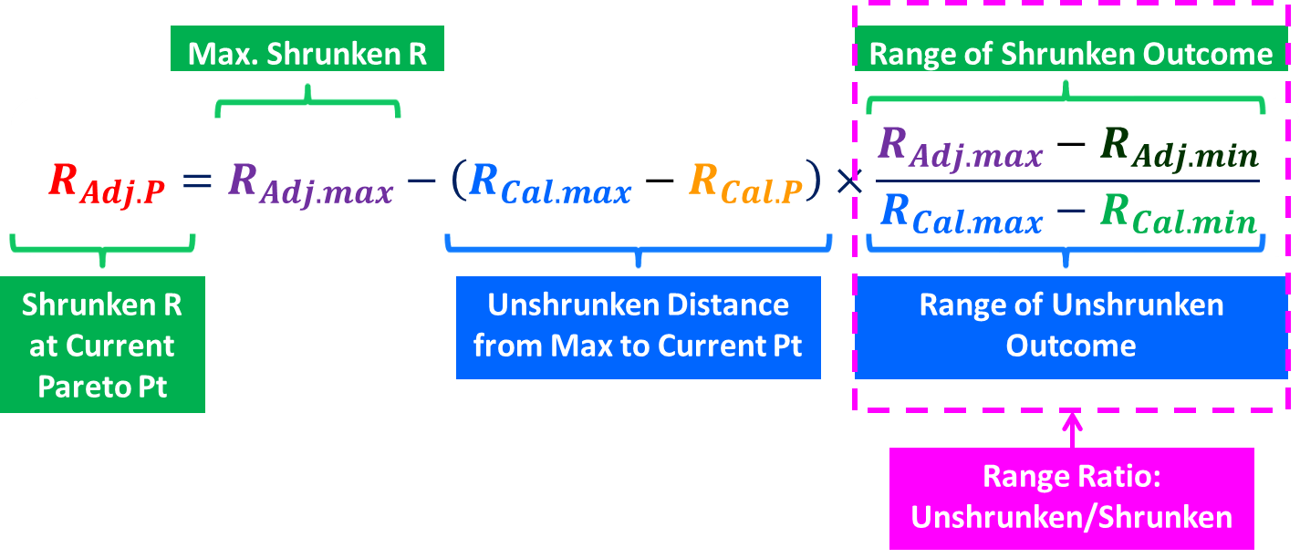
Notes:
That is, the formula estimates shrunken Pareto outcome (red dot) using relationship of these two ratios (point). This idea came from the logic behind the Pareto optimization algorithm

Slide 66
Pareto-Optimal Shrinkage Formula: Example
CONDITIONS
SHRINKAGE FORMULA: STEP 2
Calibration Sample Size (N) = 40
Number of Predictors (k) = 5
Olkin & Pratt formula
$${\hat{R}}_{perf_{Adj.max}}^{2}=1−\frac{N−3}{N−k−1}\left(1−R_{perf_{Cal.max}}^{2}\right)×\left[1+\frac{2\left(1−R_{perf_{Cal.max}}^{2}\right)}{N−k+1}+\frac{8{\left(1−R_{perf_{Cal.max}}^{2}\right)}^{2}}{\left(N−k−1\right)\left(N−k+3\right)}\right]=1−\frac{40−3}{40−5−1}\left(1−{\left(0.69\right)}^{2}\right)×\left[1+\frac{2\left(1−{\left(0.69\right)}^{2}\right)}{40−5+1}+\frac{8{\left(1−{\left(0.69\right)}^{2}\right)}^{2}}{\left(40−5−1\right)\left(40−5+3\right)}\right]=0.41$$
Browne formula
$$R_{perf_{Adj.max}}^{2}=\frac{\left(N−k−3\right){×\left({\hat{R}}_{perf_{Adj.max}}^{2}\right)}^{2} +{\hat{R}}_{perf_{Adj.max}}^{2} }{\left(N−2k−2\right)×{\hat{R}}_{perf_{Adj.max}}^{2} +k}=\frac{\left(N−k−3\right)×{\left({\hat{R}}_{perf_{Adj.max}}^{2}\right)}^{2} +{\hat{R}}_{perf_{Adj.max}}^{2} }{\left(N−2k−2\right){×\hat{R}}_{perf_{Adj.max}}^{2} +k}=\frac{\left(40−5−3\right){×\left(0.41\right)}^{2} +0.41 }{\left(40−2×5−2\right)×0.41 +5}=0.35$$
$$R_{perf_{Adj.max}}=\sqrt{0.35}=0.59$$
Calibration Sample Size = 40
Pareto Point | $$R_{perf_{Cal.P}}$$ | $$R_{perf_{Cal.max}}$$ | $$R_{perf_{Cal.min}}$$
11 | 0.51 | 0.69 | 0.28
0.69
0.51
0.28
Notes:
And this is how we apply to real data, where these information are known for certain selection setting. For sake of time, I won’t go in details.
---
Now, how to use the formula with real data?
Let’s assume we want to estimate the shrunken job performance criterion validity for calibration sample of size 40, with 5 predictors, for the Pareto-optimal weight that correspond to the 11th Pareto point.
We know in advance the calibration sample job performance validity at point #11 (0.51), at point where job performance was maximized (0.69), and at point where job performance was least maximized (0.28).

Slide 67
Pareto-Optimal Shrinkage Formula: Example
CONDITIONS
SHRINKAGE FORMULA: STEP 2
Calibration Sample Size (N) = 40
Number of Predictors (k) = 5
Olkin & Pratt formula
$${\hat{R}}_{perf_{Adj.max}}^{2}=1−\frac{N−3}{N−k−1}\left(1−R_{perf_{Cal.max}}^{2}\right)×\left[1+\frac{2\left(1−R_{perf_{Cal.max}}^{2}\right)}{N−k+1}+\frac{8{\left(1−R_{perf_{Cal.max}}^{2}\right)}^{2}}{\left(N−k−1\right)\left(N−k+3\right)}\right]=1−\frac{40−3}{40−5−1}\left(1−{\left(0.69\right)}^{2}\right)×\left[1+\frac{2\left(1−{\left(0.69\right)}^{2}\right)}{40−5+1}+\frac{8{\left(1−{\left(0.69\right)}^{2}\right)}^{2}}{\left(40−5−1\right)\left(40−5+3\right)}\right]=0.41$$
Browne formula
$$R_{perf_{Adj.max}}^{2}=\frac{\left(N−k−3\right){×\left({\hat{R}}_{perf_{Adj.max}}^{2}\right)}^{2} +{\hat{R}}_{perf_{Adj.max}}^{2} }{\left(N−2k−2\right)×{\hat{R}}_{perf_{Adj.max}}^{2} +k}=\frac{\left(N−k−3\right)×{\left({\hat{R}}_{perf_{Adj.max}}^{2}\right)}^{2} +{\hat{R}}_{perf_{Adj.max}}^{2} }{\left(N−2k−2\right){×\hat{R}}_{perf_{Adj.max}}^{2} +k}=\frac{\left(40−5−3\right){×\left(0.41\right)}^{2} +0.41 }{\left(40−2×5−2\right)×0.41 +5}=0.35$$
$$R_{perf_{Adj.max}}=\sqrt{0.35}=0.59$$
Calibration Sample Size = 40
Pareto Point | $$R_{perf_{Cal.P}}$$ | $$R_{perf_{Cal.max}}$$ | $$R_{perf_{Cal.min}}$$
11 | 0.51 | 0.69 | 0.28
0.59
Notes:
First step is to estimate shrunken maximum validity using maximum validity obtained from calibration sample. We can do this using Olkin & Pratt and Browne formula and the blue value.
---
The result shows that shrunken value will be 0.59.

Slide 68
Pareto-Optimal Shrinkage Formula: Example
CONDITIONS
SHRINKAGE FORMULA: STEP 2
Calibration Sample Size (N) = 40
Number of Predictors (k) = 5
Plug $R_{perf_{Cal.P}}$, $R_{perf_{Cal.max}}$, $R_{perf_{Adj.max}}$, $R_{perf_{Cal.min}}$, $R_{perf_{Adj.min}}$into Shrinkage Formula:
$$R_{perf_{Adj.P}}$$
$$=R_{perf_{Adj.max}}−\left(R_{perf_{Cal.max}}{−R}_{perf_{Cal.P}}\right)×\frac{R_{perf_{Adj.max}}{−R}_{perf_{Adj.min}}}{R_{perf_{Cal.max}}{−R}_{perf_{Cal.min}}}$$
$$=0.59−\left(0.69−0.51\right)×\frac{0.59−0.28}{0.69−0.28}=0.46$$
Calibration Sample Size = 40
Pareto Point | $$R_{perf_{Cal.P}}$$ | $$R_{perf_{Cal.max}}$$ | $$R_{perf_{Cal.min}}$$
11 | 0.51 | 0.69 | 0.28
0.59
0.69
0.51
0.28
0.28
Notes:
Finally, we can pug the values into the shrinkage formula and obtain shrunken validity at this Pareto point (Pareto point 11).
---
We get 0.46.

