Slide 1
Modernizing Job Classifications & Career Progression for Facilities Personnel
Traci Lepicki, Brooke Parker, Desiree Weber
The Center on Education and Training for Employment
Facilities Operations and Development
Notes:
Introduce self
CETE – small-midsize business – within EHE
Funded exclusively by grants and contracts

Slide 2
Agenda
Background
Project Planning & Challenges
Methodology
Lessons Learned
Next Steps
Notes:
Context = background and methodology
Data usage = analysis, interpretations, and recommendations
Outcomes = organizational impact

Slide 3
BACKGROUND
Objectives
Adopt common titles across the university
Update job duties and responsibilities
Update minimum qualifications
Establish competitive compensation ranges
Address education and career progression
Scope
9 business units
Geographically dispersed across Ohio
~400 employees
Projected Go Live: July 1, 2018
Notes:
Approached OHR to update FOD skilled trades classifications
OHR asked us to share proposal to other business units that used these titles
Project impact increased from 2 units and 250 employees to 9 units and 400 employees

Slide 4
2013 FACILITIES INTEGRATION
Different service delivery methods
Align staffing models, titles and compensation practices
Outdated job descriptions
ACADEMIC
MEDICAL
Notes:
In 2013 Wexner Medical Center Facilities Services Department integrated with Facilities Operations and Development. Although both departments maintained university buildings and equipment, they employed different titles, staffing models and compensation practices to do so. The major integration goals were: improve efficiency and customer service, align titles and compensation practices, and develop a career progression and training program.
The Wexner Medical Center Facilities Services Department utilitized multi-craft titles. General Maintenance Technicians comprised 55% of the workforce. These first responders addressed routine maintenance requests that could be resolved within 2 hours and managed customer relationships. The other 45% of the workforce was comprised of specialists, who focused on preventive maintenance and repairing complex mechanical and electrical systems. The Wexner Medical Center service lead time was 0.90 days.
Facilities Operations and Development utilized traditional trades titles. The workforce was comprised of 67% specialists (e.g., plumbers, electricians) and 33% general maintenance technicians. Many of the general maintenance technicians focused on a specific trade with hopes to become a specialist. The service lead time was 20 days due to technician availability and the need to schedule several technicians to perform a task due to the narrow scope of the position description.

Slide 5
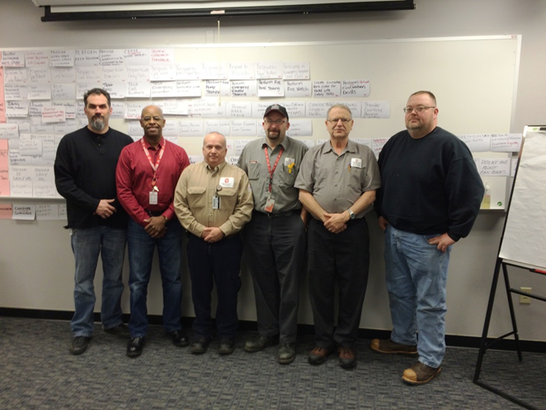
DACUM and SCID Developing A CurriculUM I Systematic Curriculum and Instructional Development
Big Ten and Friends presentation
DACUM and SCID Workshops
312 hours analyzing current positions
13 job analysis panels (February – August 2015)
12 task analysis panels (February – November 2016)
Notes:
Over 312 hours of analysis
Recognized the need to hire a consultant to develop the career progression program

Slide 6
FACILITIES OPERATIONS AND DEVELOPMENT
Facilities Maintenance Technician (1,2,3) Maintenance Repair Worker (1,2,3) Zone Maintenance Technician (1,2,3) Air Quality Technician (1,2) Building Operations Technician (1,2) Carpenter (1,2) Construction Technician (1,2,3) Electrician (1,2) Maintenance Machinists (1,2) Mechanical Technician (1,2,3) Painter (1,2) Plumber (1,2) Systems Technician (1,2,3) | Facilities Electronic/Electric Systems Technician (1,2,3) Electrician (1,2) Systems Technician (1,2,3)
Facilities Renovation and Restoration Technician (1,2,3) Carpenter (1,2) Construction Technician (1,2,3) Painter (1,2) | Facilities Mechanical Systems Technician (1,2,3) Air Quality Technician (1,2) Maintenance Machinists (1,2) Mechanical Technician (1,2,3) Plumber (1,2) Steam Fitters (1,2)
Facilities Building Systems Technician (1,2,3) Air Quality Technician (1,2) Building Operations Technician (1,2)
Notes:
Proposed classification alignment
Broadens scope of position
Aligns trades technicians into specialized cohorts
OJT opportunities – working with experienced technicians
Identify credentials needed to operate in classification
Identify training curriculum and refresher training needs
Identifies career progression
Competencies one must master to be eligible for classification
# of classifications/titles available in the unit
Allows staff to plan their training program that will make them eligible for future promotions
Equal importance placed on all classifications
Better opportunity to analyze internal equity and career advancement opportunities
Increased efficiency by sending 1 or 2 skilled technicians to resolve an issue vs. 5.

Slide 7
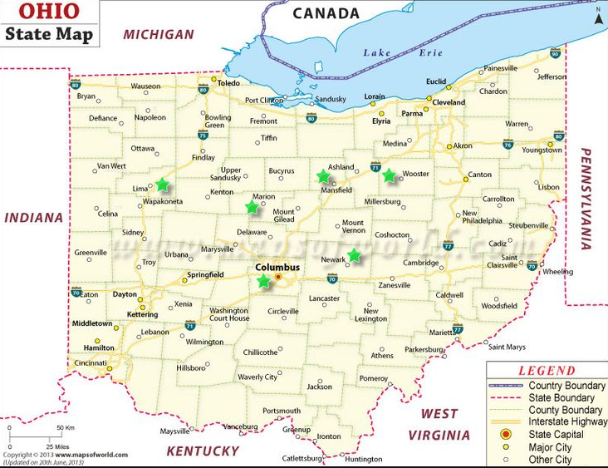
UNIVERSITY-WIDE PROJECT
Presented proposal to business units and union leadership
Adjusted project timeline
Notes:
Approached OHR to update FOD skilled trades classifications
OHR asked us to share proposal to other business units that used these titles
Project impact increased from 2 units and 250 employees to 9 units and 400 employees
What’s in it for me; how will my unit be impacted; how much will it cost
What’s the overall impact for current staff – union; when will it be completed

Slide 8
PARTNERSHIP WITH CETE
July 2016 developed career progression and skill enhancement project scope
January 2017 selected CETE
February 2017 launched project

Slide 9
PROJECT PLANNING
Notes:
Orient to chart—colors represent project phases (1 analysis, 2 planning, 3 development, 4 implementation)
You are here = red Phase 1

Slide 10
CHALLENGES
Classification Series
Number and levels
Ambitious Timeline
6 months
Organizational Distinctions
Location and unit
Various Stakeholders
Leadership, unions, incumbents
Notes:
One overall challenge before getting into specifics on Phase 1—catching up to FOD bc of previous work, depth of understanding of conditions, implications, etc.
Classifications (5 series) R&R has three jobs—construction tech, painter, carpenter; Electric/Electronic has two—Electrician, Systems Tech; Maintenance has two—Zone Maintenance Tech, Air Quality Tech; Mechanical—Air Quality Tech, Maintenance Machinist, Mechanical Tech, Plumber, Steam Fitter, Utilities; Building Systems has two—Building Operations Tech, Air Quality Tech; an important consideration was that each classification have 3 levels. The higher levels should be able to perform any task at a lower level. So a L2 can do L2 and L1 and a L3 can do L3 and L2 and L1.
Timelines—5 classifications simultaneously on short timeline (phase 1 Jan-June)
A lot in short time
Distinctions—locations, units
academic units (student life, athletics),
regional campuses [including Wooster which houses our Agricultural Research and Development Center (OARDC) and our Agricultural Technical Institute (ATI)], and
medical center—everything from barns to offices to dorms to labs to hospitals.
Stakeholders
FOD as champion—partnered with CETE; liaison to leadership; creating buy-in with unit leadership, communicating to employees and managers (at verification panels and through presentations and newsletters)
Leadership across distinctions
Unions

Slide 11
DOCUMENTATION REVIEW
METHODOLOGY
Navigating Existing Data
Current job and task analysis
KSA linkages
Mapping Old Jobs to New Jobs
Suspicious doubles
Common to most
KSA categorization
Notes:
Existing Data
There was a lot of archival data for this project. We started with Existing Data for each of the jobs inside the 5 classification series--(Mech Tech had 512 tasks; 6 jobs) ( Elect 207; 2 jobs) (R&R 165; 3 jobs) (Maint 105; 2 jobs) (Building 102; 2 jobs). Tasks analysis existed for jobs as well, although analysis was selective based on verification survey results and sponsor priorities. We organized the data into single spreadsheet and arrayed the KSAs to individual tasks to understand the extend of existing linkages
Mapping
Identified same or similar tasks within and between classifications by examining TA. For example, we identified 5 tasks that mentioned humidifiers. 4 of those were from individual jobs that rolled up into the Mechanical Systems Tech classification—the classification covering the most jobs. 2) We then recommended action based on the TA. In the example, it was the Air Quality Tech TA that included steps data. So, we recommended that the Air Quality task be the one of the 4 retained.
We worked with FOD in a similar manner on the Common to Most Tasks. These are tasks that were worded same or similarly and were in the areas of emergency response, customer service, administrative tasks, and professional development.
As with proposing revisions to the tasks, we arrayed the KSA data within classifications and recommended single wording for KSAs as well as categories (rolling discrete KSAs into broader statements) for example, combining “Basic plumbing, Plumbing systems, Basic HVAC” into “basic plumbing”

Slide 12
VERIFICATION
METHODOLOGY
Verification of tasks and levels in new series
Challenges
High stakes, low stakes?
Current state versus future state
Representation by organizational distinction
Representation by current job classification
Reactions to organizational change
Goals
Complete verification and linkage activities
Gather missing, and curriculum-related information
Notes:
Because of challenges we couldn’t send out a survey, but we needed SMES!!

Slide 13
VERIFICATION
METHODOLOGY
How did we do it?
2-day Face-to-Face Workshops
Facilities Maintenance Technician
Facilities Electric and Electronic Systems Technician
Facilities Renovation and Restoration Technician
Facilities Mechanical Systems Technician
Facilities Building Systems Technician
Notes:
Each of these

Slide 14
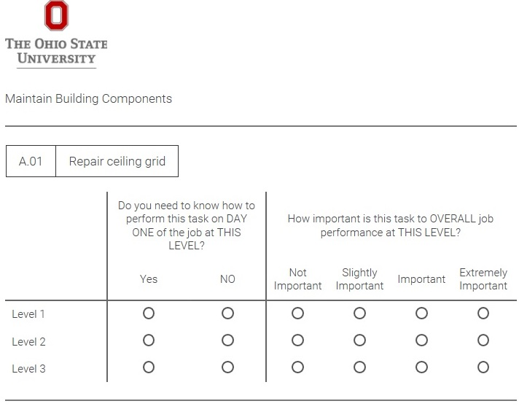
VERIFICATION
METHODOLOGY
How did we do it?
F2F Panel WS #1
Established future frame of reference
Individual activity: verification survey, iPads
Facilitated small-group work: missing KSAs identification
Notes:
Note the size of KSA lists and task lists so we sampled across SMEs
Both workshops included evaluation

Slide 15
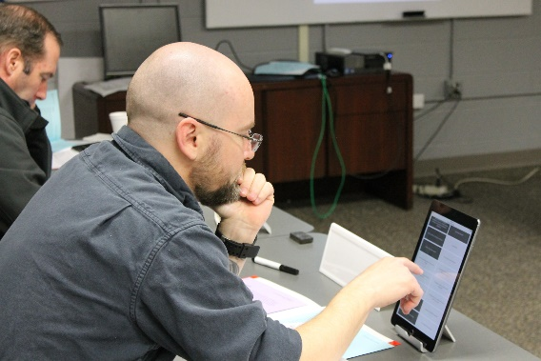
VERIFICATION
How did we do it?
F2F Panel WS #2
Individual activity: KSA linkage survey, iPads
Facilitated small-group work: curriculum discussion

Slide 16
ANALYSIS
METHODOLOGY
What happen next?
Curriculum Map/Specifications
Multiple training segments: entry into level, growth within level
Criteria for training within segments
≥.75 Day1 = entry training, ≥.2.50 Importance = growth training
CORE across units, locations = priority; non-CORE may be added
“Common to Most” training will cross classifications
Assessment Specifications
Focused on use for placement
Criteria for inclusion in initial assessments
≥.75 Day1, ≥.2.50 Importance
CORE across units, locations
Exclude “Common to Most”
Notes:
Identified duty-task and ksa areas for inclusion in initial assessments partnering with PAN

Slide 17
LESSONS LEARNED
Increase HR Generalists involvement across campuses in communicating project/change
Engage senior leadership more in the process
Revise implementation of workshops to include break in-between days
Start with a conceptual job analysis
Produce KSAs during job analysis and link differently

Slide 18
NEXT STEPS
Notes:
WHAT WE DO
WHO WE SERVE

Slide 19
NEXT STEPS
Procure curriculum and assessment
Custom-build curriculum and assessment
Assess current population; sort into new classifications
Future work in other areas
Custodial, Housekeeping
Groundskeepers

Slide 20
THANK YOU!
WHAT QUESTIONS DO YOU HAVE?

