Slide 1
Assessing Positive Organizational Capital

Slide 2
What?

Slide 3
Competitive Advantage
Economic Capital
Human Capital
Social Captial
What you have
Who you know
What you know

Slide 4
Who you are
PsyCap
Hope
Efficacy
Resilience
Optimism

Slide 5
Why?

Slide 7
Decisions

Slide 8
Potential
Root Cause
Reality

Slide 9
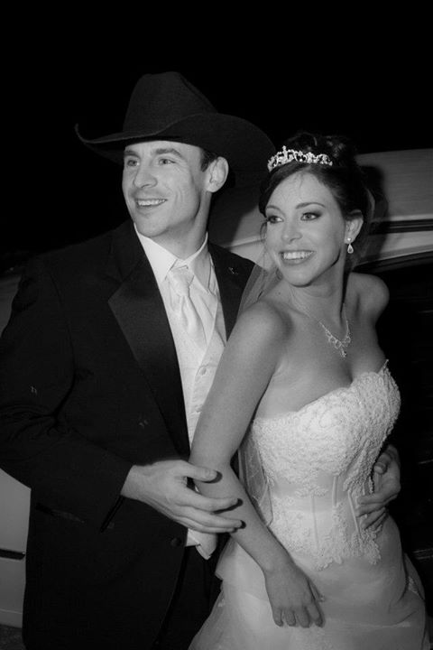
Root Cause

Slide 11
Negative
Positive
Depression: 54,040
Anxiety: 41,416
Anger: 5,584
Joy: 415
Happiness: 1,710
Satisfaction: 2,582

Slide 12
Example

Slide 13
“Doing the right things, the right way, at the right time”

Slide 14
Mentoring
Performance

Slide 15
?
Mentoring
Performance

Slide 16
PsyCap
Mentoring
Performance

Slide 17
Descriptive Statistics
Cohort | Response Rate | N | % Male | Tenure (years)
2013 Pre |  | 33 | 66% | 6.04 (SD = 5.21)
2013 Post | 40% | 33 | 66% | 7.04 (SD = 5.21)
2014 Pre (2012) |  | 43 | 68% | 6.99 (SD = 6.5)
2014 Pre (2013) | 49% | 43 | 68% | 7.97 (SD = 6.52)
2014 Post | 77% | 34 | 65% | 8.14 (SD = 5.56)
2015 Pre (2013) |  | 64 | 77% | 5.76 (SD = 5.7)
2015 Pre (2014) | 61% | 64 | 77% | 6.31 (SD = 6)
2015 Post | 75% | 48 | 73% | 6.76 (SD = 5.72)
140 participants
16 different states
Average tenure 6.68 years (SD = 5.95)
16 years (SD = 2.15) of education

Slide 18
Descriptive Statistics
Cohort | Response Rate | N | % Male | Tenure (years)
2013 Pre |  | 33 | 66% | 6.04 (SD = 5.21)
2013 Post | 40% | 33 | 66% | 7.04 (SD = 5.21)
2014 Pre (2012) |  | 43 | 68% | 6.99 (SD = 6.5)
2014 Pre (2013) | 49% | 43 | 68% | 7.97 (SD = 6.52)
2014 Post | 77% | 34 | 65% | 8.14 (SD = 5.56)
2015 Pre (2013) |  | 64 | 77% | 5.76 (SD = 5.7)
2015 Pre (2014) | 61% | 64 | 77% | 6.31 (SD = 6)
2015 Post | 75% | 48 | 73% | 6.76 (SD = 5.72)
140 participants
16 different states
Average tenure 6.68 years (SD = 5.95)
16 years (SD = 2.15) of education

Slide 19
Equivalence
 | Comparison | p
Tenure | 2013 Cohort / 2014 Cohort (2012) | .49
 | 2014 Cohort / 2015 Cohort (2013) | .07
Education | 2013 Cohort / 2014 Cohort | .80
 | 2014 Cohort / 2015 Cohort | .61
Performance | 2013 Cohort / 2014 Cohort (2012) | .83
 | 2014 Cohort / 2015 Cohort (2013) | .86
Gender
Minority
Survey Completion

Slide 20
Correlations
 | 1 | 2 | 3 | 4 | 5
1 Mentoring Pre
2 PsyCap Pre | .194*
3 Performance Pre | .189 | .405**
4 Mentoring Post | -.027 | -.159 | .118
5 PsyCap Post | -.155 | -.159 | .039 | .563**
6 Performance Post | -.026 | -.053 | .290** | .338** | .403**
**. Correlation is significant at the 0.01 level (2-tailed).
*. Correlation is significant at the 0.05 level (2-tailed).

Slide 21
Correlations
 | 1 | 2 | 3 | 4 | 5
1 Mentoring Pre
2 PsyCap Pre | .194*
3 Performance Pre | .189 | .405**
4 Mentoring Post | -.027 | -.159 | .118
5 PsyCap Post | -.155 | -.159 | .039 | .563**
6 Performance Post | -.026 | -.053 | .290** | .338** | .403**
**. Correlation is significant at the 0.01 level (2-tailed).
*. Correlation is significant at the 0.05 level (2-tailed).

Slide 22
T-test for Intervention Effectiveness
Variables | Comparison | p
Mentoring | 2013 Post / 2014 Pre | .00
PsyCap | 2013 Post / 2014 Pre | .02
Performance | 2013 Post / 2014 Pre | .04
Mentoring | 2014 Post / 2015 Pre | .00
PsyCap | 2014 Post / 2015 Pre | .44
Performance | 2014 Post / 2015 Pre | .01
Variables | p
Mentoring | .00
PsyCap | .04
Performance | .01

Slide 23
T-test for Intervention Effectiveness
Variables | Comparison | p
Mentoring | 2013 Post / 2014 Pre | .00
PsyCap | 2013 Post / 2014 Pre | .02
Performance | 2013 Post / 2014 Pre | .04
Mentoring | 2014 Post / 2015 Pre | .00
PsyCap | 2014 Post / 2015 Pre | .44
Performance | 2014 Post / 2015 Pre | .01
Variables | p
Mentoring | .00
PsyCap | .04
Performance | .01

Slide 24
PsyCap
Mentoring
Performance
(N=115). χ²=1.729; df=2; GFI=.993; CFI=1.00; TLI=1.01; NFI=.997; RMSEA=.000.

Slide 25
PsyCap
Mentoring
Performance
(N=115). χ²=1.729; df=2; GFI=.993; CFI=1.00; TLI=1.01; NFI=.997; RMSEA=.000.

Slide 26
Trickle Effect
Mentoring
PsyCap
Performance

Slide 27
Workplace attitude (Avery, Luthans, & Youssef, 2010)
Job Satisfaction (Fu, Sun, Wang, Yang, & Wang, 2013)
Commitment & Well Being (Avey et al., 2011)
Citizenship Behaviors (Avey et al, 2011)

Slide 28
Who you are
PsyCap
Hope
Efficacy
Resilience
Optimism

Slide 29
Who you are
PsyCap
H
E
R
O

Slide 30
thanks!
Any questions?

