Slide 1
How Can I Use Competencies?
Alexandra Zelin
Dennis Doverspike
Kim Hollman
Marianne Tonjes

Slide 2
Why Competencies?
What is a competency?
Competencies are considered sets of behaviors
  Such behaviors support workplace objective obtainment
  For instance, working within Microsoft Excel to manage budgeting accounts.
Competencies are behaviors one needs to display to demonstrate successful performance
  How one reaches desired outcomes
Competencies are not personal attributes
  Thus, they are widely applicable to selection, training, development, performance management, succession planning, etc.
Competencies are not results and/or consequences of specific behaviors

Slide 3
Why Competencies?
How is it different from a knowledge, skill, ability, and/or regular behavior?
Competencies involve mastering a certain behavior to successfully reach specific goals and/or outcomes
  For instance, one needs to master social skills to effectively communicate with people in the workplace
Competencies are the integration of knowledge, skills and abilities; displaying competency is applying the knowledge, skills, and abilities that are required performance standards
  A competency could include using short cuts in Microsoft Excel to achieve necessary data output. It is not just one knowing how to work Microsoft Excel, but actually performing that function in a competent manner
  The behaviors one needs to display to be successful in a given role
Knowledge, skills, and abilities are job-specific and unlimited. Competencies can be applied across multiple jobs and are typically limited
  Thus, competencies are generally broader than knowledge, skills, and abilities

Slide 4
How are Competencies Useful?
Translation into training protocols
Creation of situational judgment test questions
Broad competency modeling vs. job-specific competencies in developing a selection tool
Creation of structured interview questions

Slide 5
From the Ground Up: Developing Competencies in a University Setting For Use in Training
Alexandra I. Zelin, Ph.D.
Notes:
NOTE that this is being presented as part of a broader session on: Workplace policies, leadership, and support for work-family balance and well-being

Slide 6
Overview
Technology Training Group (TTG) at the University of Tennessee at Chattanooga (UTC) noticed a need for personnel training in various technological capacities
Problem: unsure of the wide array of technical competencies necessary for success in all job qualifications around campus
Goal: create a list of technology-related competencies used within various job families across the university that can be used to spearhead training initiaves

Slide 7
Step I: Interview
Job family of Administrative Support Staff chosen for the pilot group
  180 employees within this job family
  90 contacted for an interview
  75 interviews conducted

Slide 8
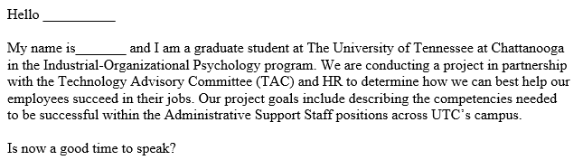
Step I: Interview
What we learned:
Emphasize the goal of the study in the introduction
Dismiss ideas of “I am not qualified to answer this question”/ “I have not been on the job long enough to answer this question”

Slide 9
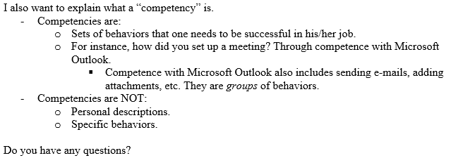
Step I: Interview
What we learned:
The explanation of a competency is critical
May need to guide people through their days to gather all competency information

Slide 10
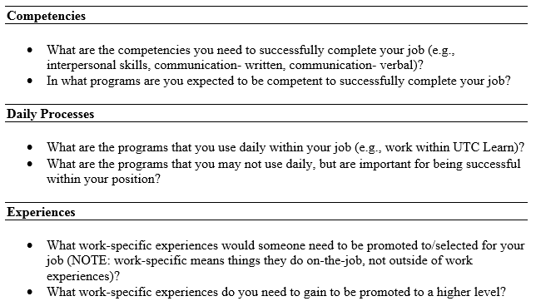
Step I: Interview

Slide 11
Step II: Design and Administer Competency Modeling Survey
Collect basic demographic data
  Years in current position
  Gender
  Ethnicity
Compiled a list of all competencies mentioned during interviews
  Combined similar competencies into one overall descriptor
    (e.g., ARGOS reports and ARGOS)

Slide 12
Step II: Design and Administer Competency Modeling Survey
Presented the list of competencies with two rating scales:
  “Please rate the following competencies with respect to their importance in your job position. ” 1 (Not Important) to 7 (Extremely Important)
  “Please rate the following competencies with respect to the frequency they are needed to be successful in your job position.”
    Scale points included: “Never,” “Rarely, less than 10% of the time,” “Occasionally, about 30% of the time,” “Sometimes, about 50% of the time,” “Frequently, about 70% of the time,” “Usually, about 90% of the time,” and “All the time.”

Slide 13
Step III: Results of the Competency Modeling Survey
Mean Importance Ratings
Technical Program | Mean Importance Rating
Microsoft Outlook* | 6.84
Microsoft Word* | 6.80
Microsoft Windows Operating System* | 6.71
Printer* | 6.61
Microsoft Excel* | 6.58
Internet Browser* | 6.45
Telephone System* | 6.45
S-drive | 6.23
Office 365* | 6.23
IRIS (SAP)* | 5.97
Note: A * indicates the program is ranked in the top 10 for mean importance and mean frequency.

Slide 14
Step III: Results of the Competency Modeling Survey
Mean Frequency Ratings
Technical Program | Mean Frequency Rating
Microsoft Outlook* | 6.59
Microsoft Windows Operating System* | 6.20
Microsoft Word* | 6.03
Internet Browser* | 5.67
Microsoft Excel* | 5.65
Printer* | 5.62
Telephone System* | 5.45
Office 365* | 5.20
Adobe | 4.94
IRIS (SAP)* | 4.90
Note: A * indicates the program is ranked in the top 10 for mean importance and mean frequency.

Slide 15
Step IV: Turning Competencies Into Training Directives
Based on the importance and frequency of use ratings, the Microsoft Office Suite, the internet, printer, telephone system, and IRIS (accounting system)
TTG is developing trainings on these technical programs to best fit the needs of employees in the Administrative Support Staff job family
  Other job families are going through the same interview and survey process to best fit training to their particular needs

Slide 16

HOW CAN I USE COMPETENCIES? Practical Measurement Of A Competency Model: Leadership In Public Safety
Dennis Doverspike, Doverspike Consulting LLC

Slide 17


Dennis Doverspike, Doverspike Consulting LLC
Dennis Doverspike, Ph.D., ABPP, is President of Doverspike Consulting LLC. He is certified as a specialist in Industrial-Organizational Psychology and in Organizational and Business Consulting Psychology by the American Board of Professional Psychology (ABPP), serves on the Board of the American Board of Organizational and Business Consulting Psychology, and is a licensed psychologist in the State of Ohio. Dr. Doverspike has over forty years of experience working with consulting firms and with public and private sector organizations. He is the author of 3 books and over 150 other professional publications. Dennis Doverspike received his Ph.D. in Psychology in 1983 from the University of Akron.

Slide 18

Avesta, Greg Lawton, Partner
Greg Lawton brings thirty years of EMS and medical transportation senior management experience to Avesta. In 2007, he founded Avesta with the purpose of offering new strategies and innovative human resource solutions to the EMS industry. These solutions are backed by behavioral science insight, technology, and a thorough understanding of how EMS organizations function, and how industry regulations and challenges affect their every move.

Slide 19

NEMSMA
NEMSMA is a professional association of EMS leaders dedicated to the discovery, development, and promotion of excellence in leadership and management in EMS systems, regardless of EMS system model, organizational structure, or agency affiliation.

Slide 20

Problem – More General
How can we improve work (and satisfaction with work) for first responders and public safety employees?
More specifically, Emergency Medical Services (EMS)
EMS
  Public Sector - Fire Departments
  Public Sector - Stand Alone EMS Departments
  Private Sector EMS
  Hospital Based EMS
Jobs
  Paramedics and EMTs
  Supervisors
  Managers
  Executives

Slide 21
Multi-Prong Approach of Applied Research
Entry Level Selection and Testing
  Personality Assessment
  Physical Ability Tests (PATs)
  Testing for Potential CWBs
Improving Leadership
  Through Competency Models
  Certification and Credentialing
Surveying Attitudes and Engagement

Slide 22

The Problem
Start with competency model for leadership in public safety
  More specifically, leadership in Emergency Medical Services (EMS)
    Supervisors, Managers, and Executives
Turn it into tests or assessments appropriate for certification testing or credentialing using a competency model
  Movement in health care and with heath care providers
Solution - Several types of assessments
  Traditional Knowledge Tests
  Situational Judgment Tests (SJTs)
  Oral Boards

Slide 23

Basics and Definitions

Slide 24

Competencies
A worker-oriented, higher level characteristic
  Which can be linked to associated KSA clusters
  Defined in terms of behavioral exemplars
  Allows for operationalization and measurement
Competency Modeling
  Technique similar to job analysis
  But intended for the identification of competencies
Competency Measurement
  Move beyond simple knowledge based testing

Slide 25
The NEMSMA COMPETENCY MODEL

Slide 26
5 Competencies for Translation into SJTs
Self Attributes
Leading Others
Task Management
Innovation
Social Responsibility

Slide 27
CERTIFICATION OR CREDENTIALING
Credentialing - refers to a guarantee to the public that individuals in a profession have met certain standards.
  Encompasses licensure and certification.
Licensing ‐ the granting of permission by some authority, usually in the United States a state or state board, to an individual to practice an occupation. Is generally mandated by law.
Certification – a recognition that an individual has voluntarily met some requirement set by an organization. Generally voluntary.
Thus, it is critical to remember that certification is a voluntary process. And, different from pre‐employment or employment testing.

Slide 28
Approach: Competencies into SJTs

Slide 29
New Element – SJTs for Competencies
Decision to use Situational Judgment Test (SJT) items
What is an SJT?
  Mike McDaniel & Deb Whetzel
  Winfred Arthur

Slide 30
SJT
Low fidelity simulation
Dilemmas relate to core competencies
Ideal for jobs with a great deal of interaction with others
Job relevant scenario – followed by alternatives
A number of scoring solutions
  Due to nature – used single correct answer
You notice a man robbing a store. What would you do?
  Leave the store quickly.
  Try to apprehend the robber.
  Call the police.
  Nothing, just keep shopping.

Slide 31
TRADITIONAL ELEMENTS
Job Analysis
Source List
  For Job Knowledge Test
  Also valuable in writing SJT
Collection of Critical Incidents

Slide 32
Critical Incidents
We are going to ask you to write-up critical incidents for the Supervising EMS Office.
You will be given a specific competency, and then you will be asked to write a critical incident for this competency.
A critical incident, think:
  About a time when someone did something really good (or bad)
  A recent challenge at work
  A crisis – (fire, shooting, hurricane)
  Someone made a mistake
  Someone did an exceptional job
  You were particularly proud

Slide 33
Critical Incidents
Your competency is: SELF ATTRIBUTES (Work Habits, Work Attitudes, Stress Management, Self Insight, and Learning).
  We would like you to think of an effective incident.
  Recalling this incident, please describe the incident or situation. What led to this situation?
  What would be an expert or excellent response in this situation?
  What would be an average or minimally competent response?
  What would be a poor or unacceptable response?

Slide 34
Write Items Based on Competencies
Sort and Analyze Critical Incidents
Turn critical incidents, values, and competencies into item stems
Generate Response choices
    What would be the best thing to do?
    What is a bad response that you think many people would do?
    What would a poor employee do?
    What would really good employee do?
Edit responses
Develop Scoring Key
Pilot

Slide 35
Typical Competency Model
Definition of Leadership: A leader motivates and drives others. A leader is willing to make decisions and resolve conflicts. A leader is engages in ethical behavior.
Level of Competence | Prototypical Behaviors
Easily Exceeds Expectations and Performs at Expert Level | Seen by others as a leader. Is confident. Drives change and inspires others to take ownership of change. Motivates others to high levels of performance. Is willing to make decisions even when criticized by others or in times of crisis. Maintains high levels of ethical behavior and inspires others to do the same. Identifies conflicts before they occur.
Meets Expectations | Is seen by others as a leader in some situations. Makes a case that change is necessary and acts in a manner to try to get others to accept changes. Motivates others to meet set goals. Is willing to make decisions, especially when it is an area in which they have experience. Adheres to ethical standards in own behavior. Listens to others and resolves disagreements when they occur.
Below Expectations | Lacks confidence in self. Others lack confidence in the ability to lead. Fails to make a strong case for change. Actions fail to motivate others. Prefers to leave decisions to others. Does not always consider ethical issues. Avoids dealing with conflicts.

Slide 36
Typical Competency Scales
3. Exceeds Expectations - Expert
2. Meets Expectations
1. Below Expectations
4. Expert
3. Advanced
2. Competent
1. Novice

Slide 37
NEMSMA Competencies
Confidence - The supervising officer handles assignments efficiently and completes work punctually and with consistent, expected, quality.
Over Confident - The supervising officer completes assignments early and meets minimum quality standards but could provide higher quality work if the full timetable was utilized without rushing through the projects.
Limited Confidence - The supervising officer manages time ineffectively and has trouble completing tasks on schedule and/or with expected quality.

Slide 38
SJT Item
You respond to assist one of your teams at a scene in a socioeconomically depressed section of town with a higher than average minority population. After the call, a person from the crowd approaches you. They complain that your EMS units “always” take a long time to respond. They also report the neighborhood is getting angry about this discrimination. What should you do:
  A. Talk calmly and inform him the perception of time often seems to move slowly in emergencies. Assure him you monitor response times and they are fine.
  B. Move him closer to the crowd so they can hear the exchange. Let him know response times are closely watched and they are within acceptable limits.
  C. Give him your business card. Ask him to arrange a community meeting with you & your manager to discuss the matter. Inform him response times are appropriate.
  ****D. Express concern for his comments. Let him know response times are monitored closely. Ask if he will help you speak with the community.
Option or Alternative D, represents the best answer. Social Responsibility.

Slide 39
SJT Item
Recently, your team has been the subject of a series of unfounded patient complaints. No one member in particular is the subject, but your Manager has met with you expressing his concern. You’ve noted no change in your team’s demeanor that would suggest they are mistreating patients. You should:
  Call a team meeting and let them know about the company’s concern. Remind them it is their professional obligation to act competently and with compassion. The patient’s perception is paramount.
  Call a team meeting and express the company’s disappointment. Remind them that discipline will result if anyone is found responsible for poor treatment of a patient.
  ****Call a team meeting and candidly advise them of what’s happening. Express your belief that they can overcome this and you will work with them as needed.
  Don’t worry the team with the company’s concern since the complaints are unfounded. This will only hurt morale. Praise them for the good work they do.
Best answer: C

Slide 40
Pilot Testing Plus
Confirm correct answer
Job relevance or importance
Angoff estimate – likelihood of passing

Slide 41
Results and Conclusions
SJT approach represents a easy to use and implement approach to:
  Testing for competencies
  In a certification or credentialing setting
  Excellent fit to requirements
Decent reliability

Slide 42
Issues
Scoring?
  Correct Answer?
Number of alternatives?
Depends on competency?
Use in certification or credential testing - traditionally knowledge based.

Slide 43

THE END

Slide 44
Using Competencies in Civil Service Testing
Kimberly Hollman, M.A.
Cuyahoga County Personnel Review Commission

Slide 45
Agenda
Cuyahoga County and the role of the PRC
Development of competency model
Application of competencies to different types of tests

Slide 46
Cuyahoga County and the PRC
Cuyahoga County has 7823 full-time employees
The PRC is an independent agency, and part of our role in the County is to provide civil service testing for competitive classifications
Since 2015, we have developed tests for over 140 unique classifications
Notes:
There are over 500 competitive classifications in the County.

Slide 47
Body of Work
Multiple tests representative of County’s jobs
  Structured interviews
  Skill and ability testing (e.g., reading comprehension, typing, data entry, proofreading, etc.)
  Applied work samples (written, computerized, and practical)
  Written exercises
  Oral presentations
Notes:
Classified positions across County agencies (e.g., IT, HR, HHS, PW, Fiscal, Sheriff, MEO)
Because there are so many different classifications, we develop different kinds of tests to meet the needs of each classification

Slide 48
Role of Competencies
Tests are validated through job analysis
Factors affecting implementation of competencies:
  Day-one KSAs identified in job analysis
  Number of qualified candidates
  Resource availability
Notes:
Content validation approach
Implementation of competencies depends on the nature of the classification and other factors

Slide 49
Competency Model for Interviews
Identified 16 competencies assessed through interviews
Structured Interview Competencies
Conflict Management | Employee Development & Feedback
Ethics & Integrity | Initiative & Problem Solving
Interpersonal Skills | Maintaining Composure
Managing Work | Motivating Others
Oral Communication | Process Improvement
Professional Development | Promoting Teamwork
Research & Analysis | Safety
Teamwork & Collaboration | Time Management & Prioritization
Notes:
Average ~6 different questions per competency, with a range of 4 to 9

Slide 50
Structured Interview Bank
Created bank of 100 questions across 16 competencies
Applies to multiple job situations
Standardized scoring methods
Includes interviewer training guidelines

Slide 51
Example: Conflict Management
Effective Behaviors | Ineffective Behaviors
Focuses on common goals and interests Identifies points of agreement Shows respect for other side and their positions Tries to understand other sides’ perspective Takes a problem-oriented approach; describes the problem and its impact, not the characteristics of the person | Ignores conflict rather than addressing it Accommodates instead of compromising Gives in and says yes too soon Gets upset as a reaction to conflict; takes it personally Excessively competitive and has to win every dispute
Notes:
- Each competency is defined by a set of effective behaviors and a set of ineffective behaviors.

Slide 52
Conflict Management
Example Interview Item
  Describe a prior work experience when you faced a conflict with a client or customer. What was the context of the situation, what did you to do resolve the conflict, and what was the outcome?
  Rationale: This item assesses a candidate’s ability to respond to client/customer concerns and implement solutions in a professional manner.

Slide 53
Example Scoring Anchors
Describe a prior work experience when you faced a conflict with a client or customer. What was the context of the situation, what did you do to resolve the conflict, and what was the outcome?
4 points: 7+ of the following actions:
  Remained calm and professional.
  Listened to and understood client concerns.
  Asked clarifying questions if necessary.
  Explained reasons/rationale behind actions previously taken.
  Took ownership for their role in conflict; apologized if necessary.
  Discussed potential solutions to the problem.
  Implemented a solution that was acceptable to both sides; ensured compliance with applicable standards.
  Monitored situation; followed up with client.
  Took steps to prevent problem from occurring in the future.
3 points: 5-6 actions
2 points: 3-4 actions
1 point: 1-2 actions
0 points: 0 actions

Slide 54
Applying Competencies to Other Tests
Identify ways in which competencies can be integrated in test
Example: Senior Training Officer (Children & Family Services)
  Scheduling work sample
  SJT
  Constructed response

Slide 55
Summary
All competencies are based on KSAs from job analysis
Competencies are applied to different types of tests
Implementation of competencies depends on factors such as the classification, the number of candidates, and resource availability

Slide 56
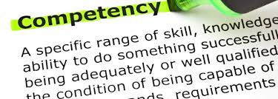

Competency-Based Interviews
Marianne Tonjes
Executive Director
CODESP
www.codesp.com

Slide 57
Competency Based Interviews
Traditional hiring has focused primarily on evaluating a candidate's skills and technical qualifications
Competency questions include an analysis of a candidate's behavioral characteristics as well
Begins with identification of core competencies required for success
Followed by the subsequent evaluation of each candidate's demonstration of those competencies in their past experiences

Slide 58


Advantages of Competency-Based Interviews
“You can teach a turkey to climb a tree,
but is easier to hire a squirrel”
    Competence at Work by Spencer and Spencer

Slide 59
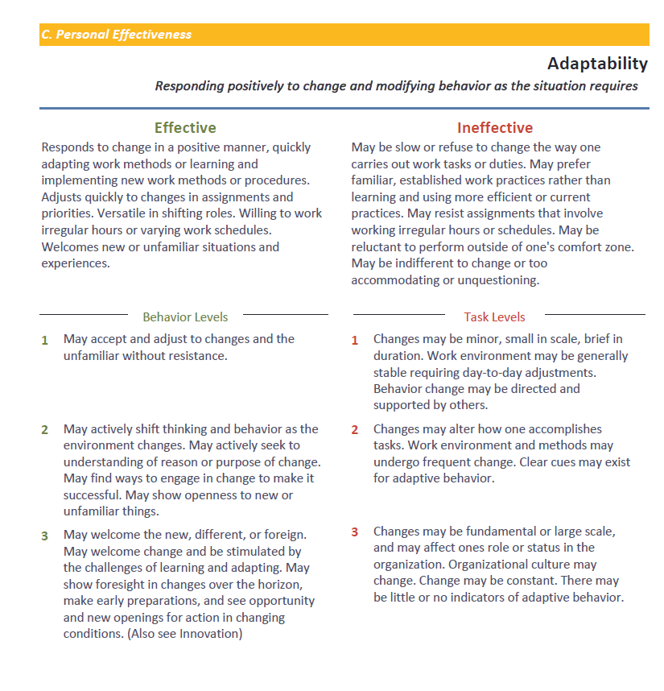
CODESP Development Steps
We chose LA County of Office of Education’s Competency Dictionary created by Rod Freudenberg Ph.D.

Slide 60

Customer Development Steps
Adopt a Competency Model
Conduct a job analysis
  Conduct interviews and focus group discussions with Job Experts
  Identify essential tasks for each job
Link competencies to each job task.

Slide 61
Select Competencies with Job Expert
Sample List
Personal Effectiveness
Action and Results Focus - Initiating tasks and focusing on accomplishment
Adaptability - Responding positively to change and modifying behavior as the situation requires
Attention to Detail - Focusing on the details of work content, work steps, and final work products
Handling Stress - Maintaining emotional stability and self-control under pressure, challenge, or adversity
Innovation - Imagining and devising new and better ways of doing things
Learning Agility - Seeking learning opportunities and applying the lessons to one's work
Professional Integrity and Ethics - Displaying honesty, adherence to principles, and personal accountability
Self-Management - Showing personal organization, self-discipline, and dependability

Slide 62
Criticality of the Competency
Scale Value | Definition (0-3) | Importance (0-4)
0 | Possession of the Competency is NOT RELATED to overall satisfactory job performance. | Does Not Apply
1 | Possession of the Competency is HELPFUL to overall satisfactory job performance. | Moderately Important
2 | Possession of the Competency is IMPORTANT to overall satisfactory job performance. | Important
3 | Possession of the Competency is VERY IMPORTANT to overall satisfactory job performance. | Very Important
4 | Possession of the Competency is CRITICAL to overall satisfactory job performance. | Critical

Slide 63
Link Competencies To Tasks
Scale Value | Definition (0-2) | Relationship to Job Performance (0-1)
0 | Possession of this Competency is NOT RELATED to successful overall performance of this task. | No Observable Relationship
1 | Possession of this Competency is DESIRABLE, but not essential, for the overall satisfactory performance of this task. | Observable Relationship
2 | Possession of this Competency is IMPORTANT for the overall satisfactory performance of this task.

Slide 64
Task – Competency Matrix
To what extent is each Competency needed when performing each job task?
4 = Extremely necessary, the job task cannot be performed without the Competency
3 = Very necessary, the Competency is very helpful when performing the job task
2 = Moderately necessary, the Competency is moderately helpful when performing the job task
1 = Slightly necessary, the Competency is slightly helpful when performing the job task
0 = Not necessary, the Competency is not used when performing the job task
Competency | A | B | C | D | E | F
Task 1 | 4 | 3 | 4 | 0 | 1 | 3
Task 2 | 2 | 4 | 2 | 0 | 0 | 1
Task 3 | 0 | 0 | 0 | 4 | 2 | 1
Task 4 | 0 | 1 | 0 | 0 | 4 | 0

Slide 65

Competencies Used in Interviews
Essential competencies are turned into questions which require the applicant to typically provide specific, detailed descriptions of how the candidate behaved in the past

Slide 66
Competency to Interview Questions
ADAPTABILITY-Maintaining effectiveness in varying environments, tasks and responsibilities, or with various types of people.
Tell me about a situation in which you have had to adjust to changes over which you had no control. How did you handle it?
Tell me about a time when you had to adjust to a colleague's working style in order to complete a project or achieve your objectives.
By providing related examples, convince us that you can adapt to a wide variety of people, situations and environments.

Slide 67
CODESP Interview Builder
Competency / Job Family
Choose questions by either Competency and/or Job Family

Slide 68
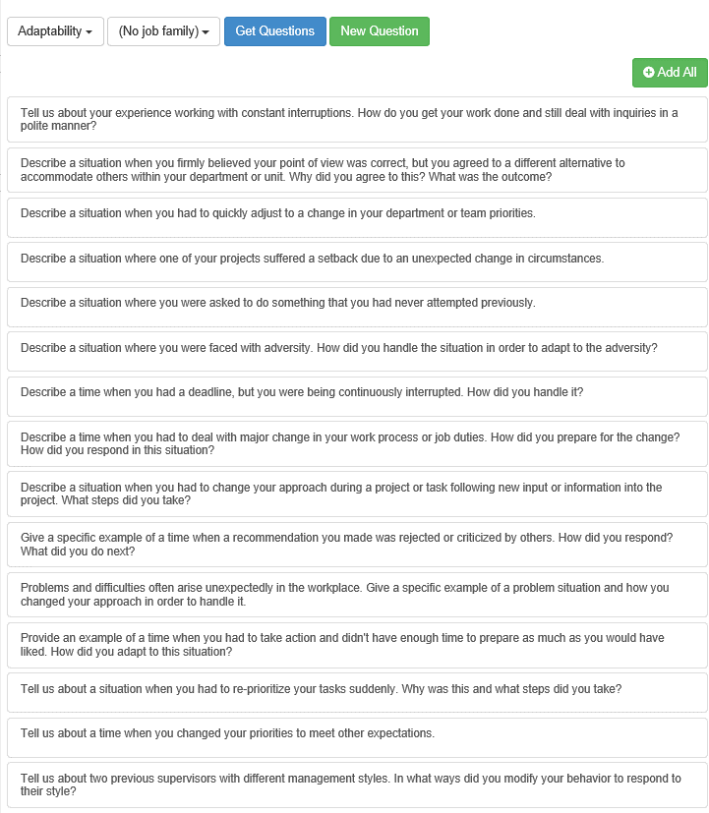
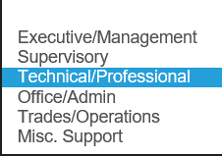
Using the Interview Builder for a Competency Search by Job Level

