Slide 1
Physical Jobs in a Digital World
Deborah L. Gebhardt
HumRRO
IPAC July 18, 2017

Slide 2
Introduction
Bureau of Labor Statistics reported 28% of workerforce in US perform arduous jobs.
Job areas
  Construction
  Machinery installation and repair
  Public safety and other professions
Physical jobs best paying in many geographical locations
Physical demand involves multiple fields of study
  Exercise science and biomechanics
  Industrial engineering and applied psychology

Slide 3
Topics
Examples of physical jobs in a digital age
Physical performance research
Exercise is medicine

Slide 4
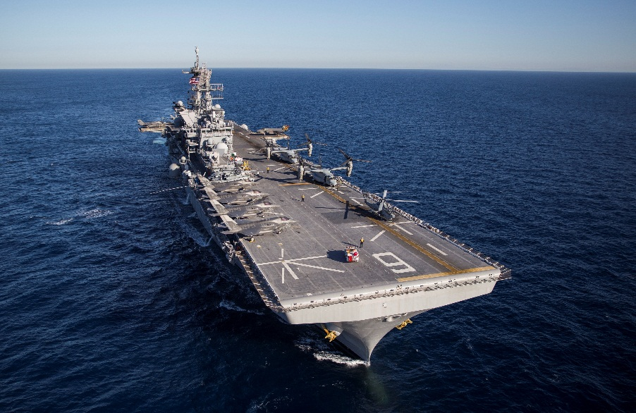
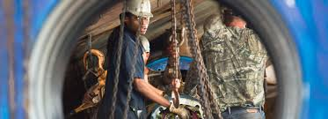
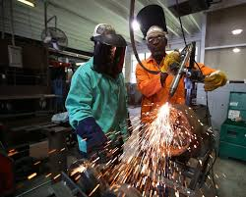
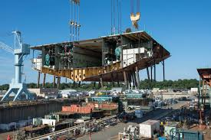
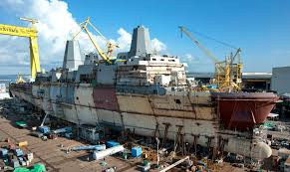
Shipbuilding – USS America

Slide 5
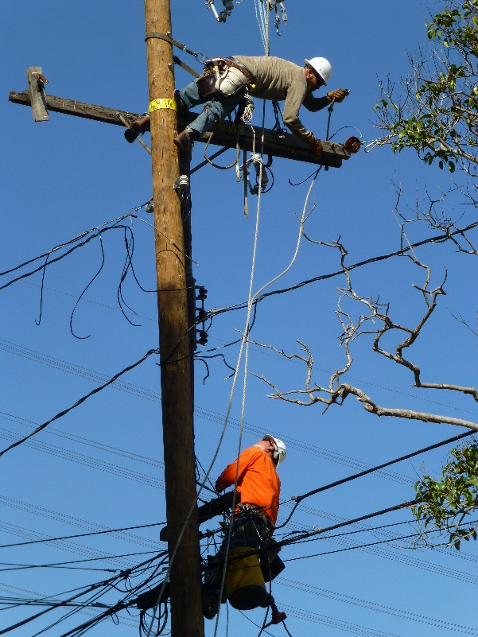
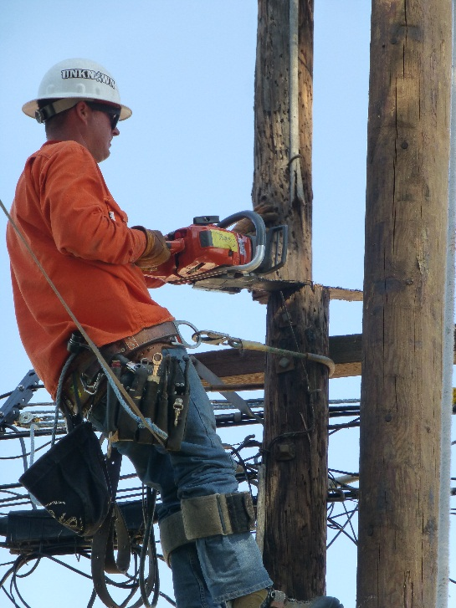
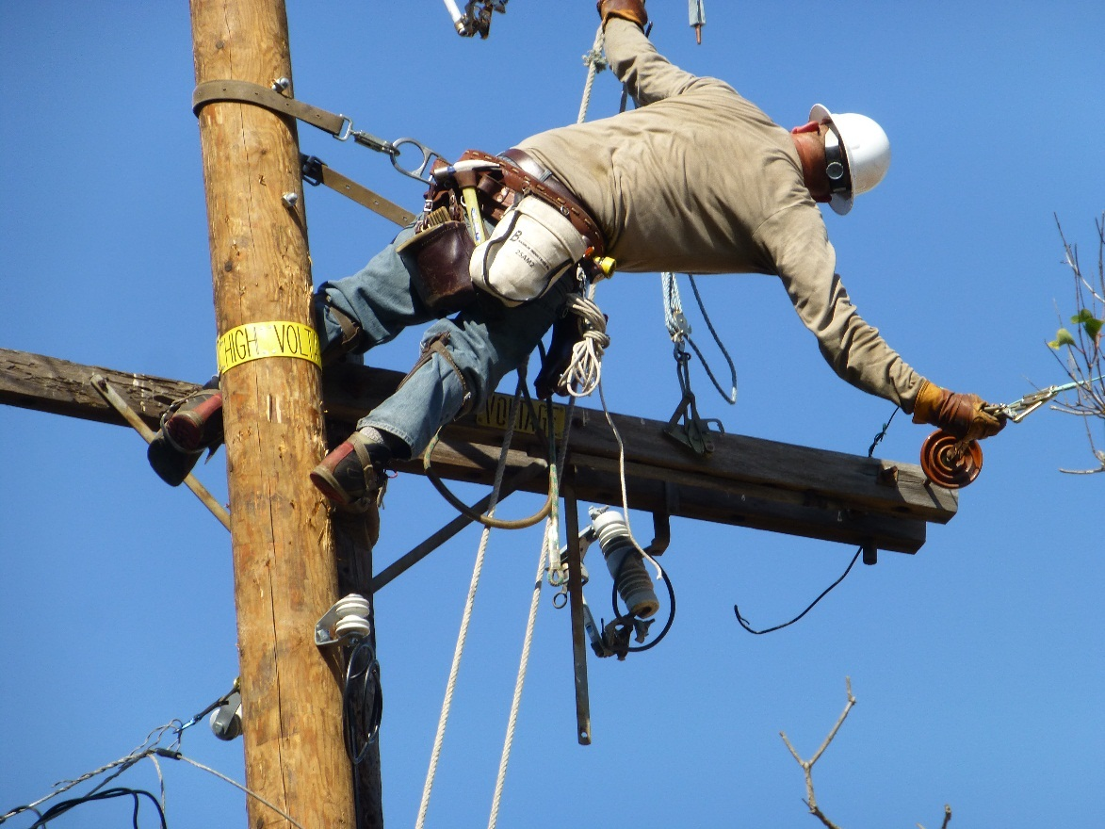
Electric Industry
Copyright © Pictures: Gebhardt & Baker 2017

Slide 6
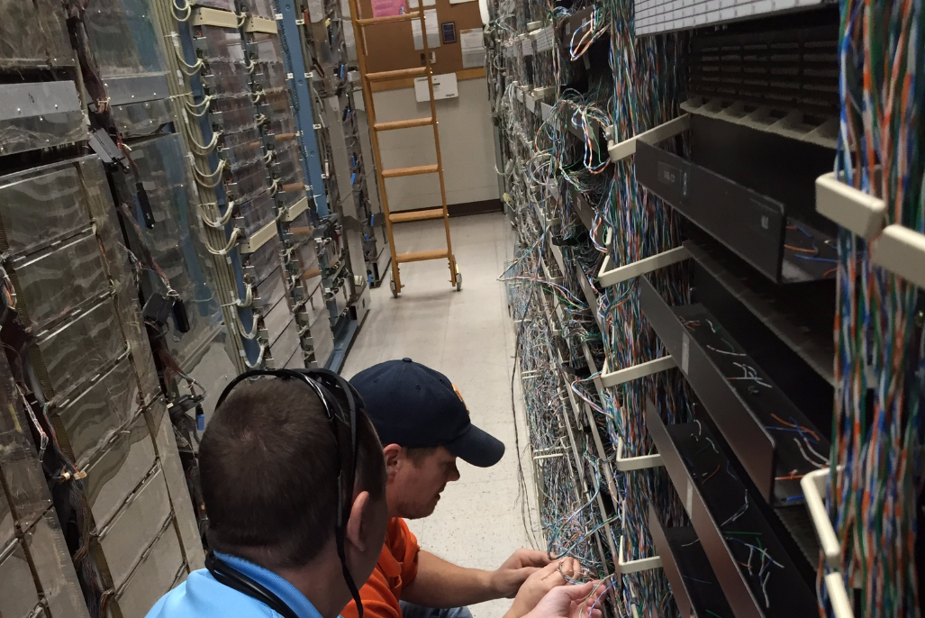
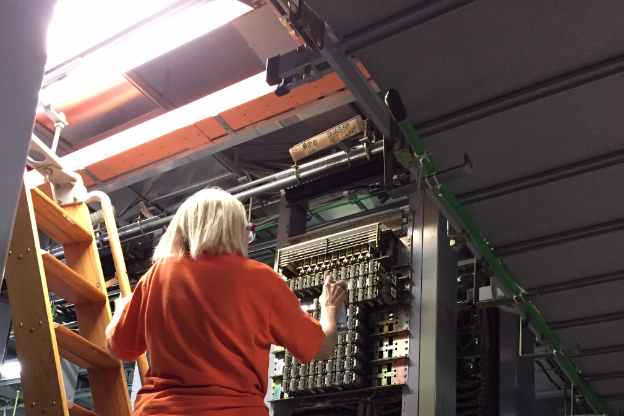
Telecommunications Industry
Copyright © Pictures: Gebhardt & Baker 2016

Slide 7
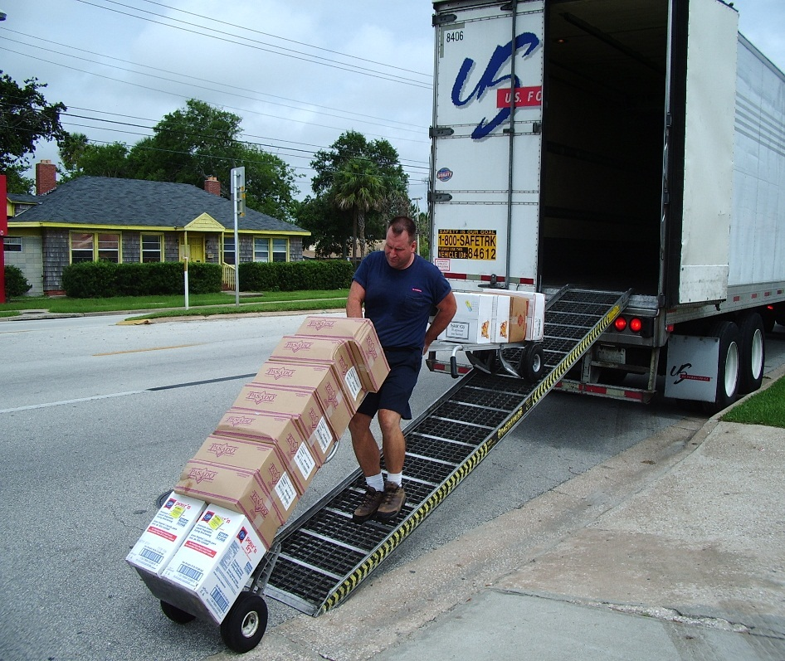
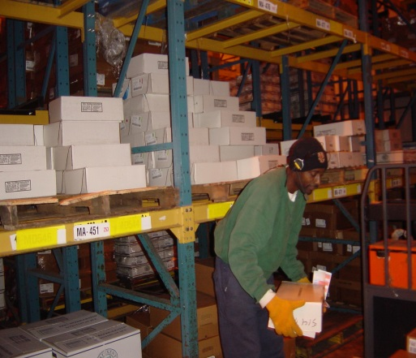
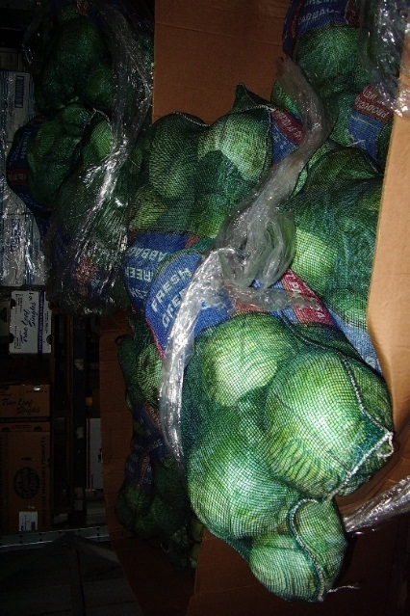
Warehousing Industry
Copyright © Pictures: Gebhardt & Baker 2012

Slide 8
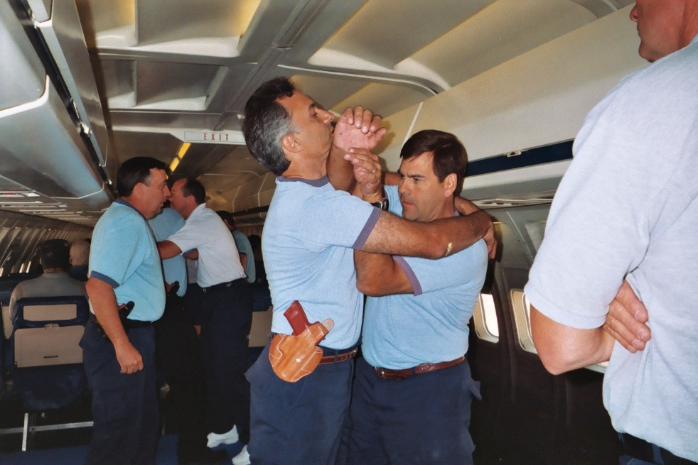
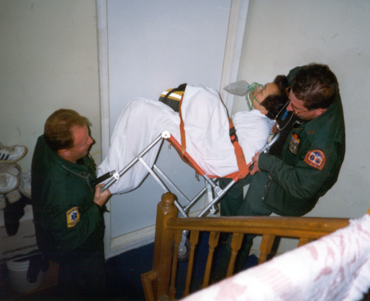
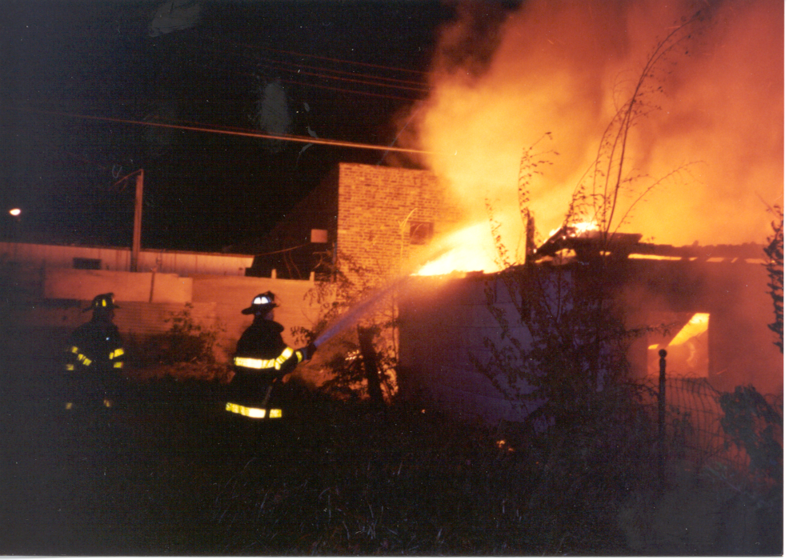
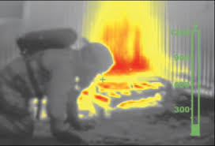
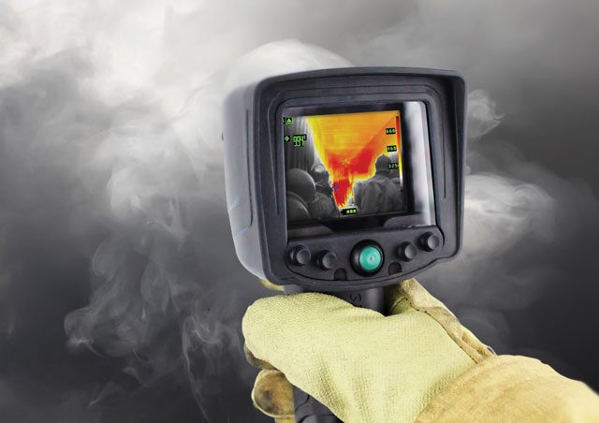
Fire Service and Law Enforcement
Copyright © Pictures: Gebhardt & Baker 2014

Slide 9
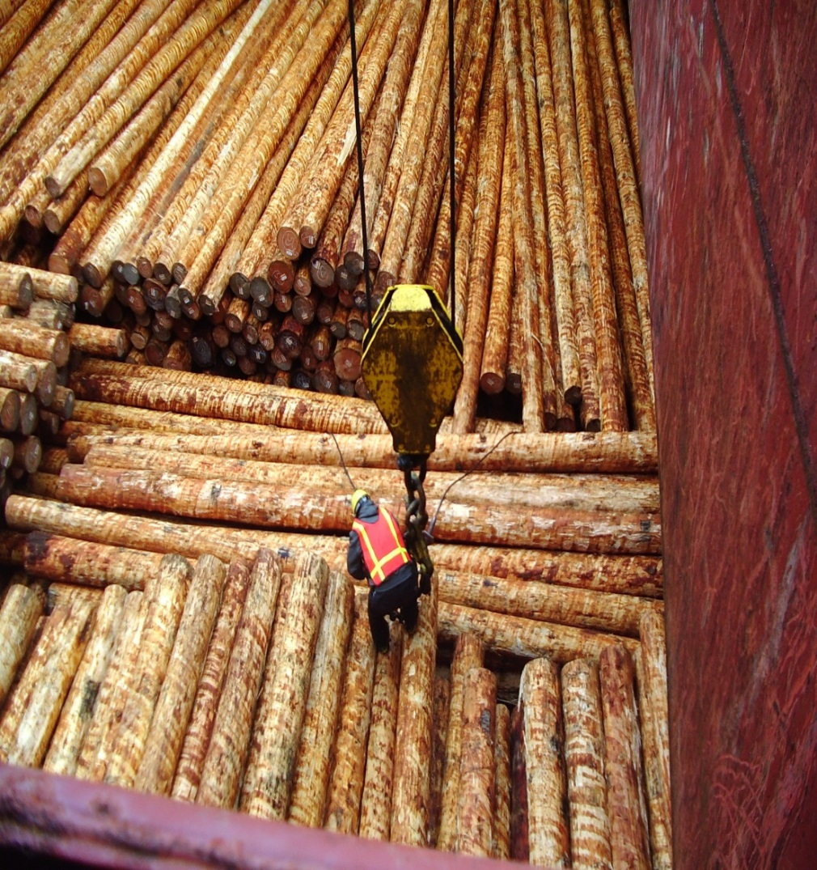
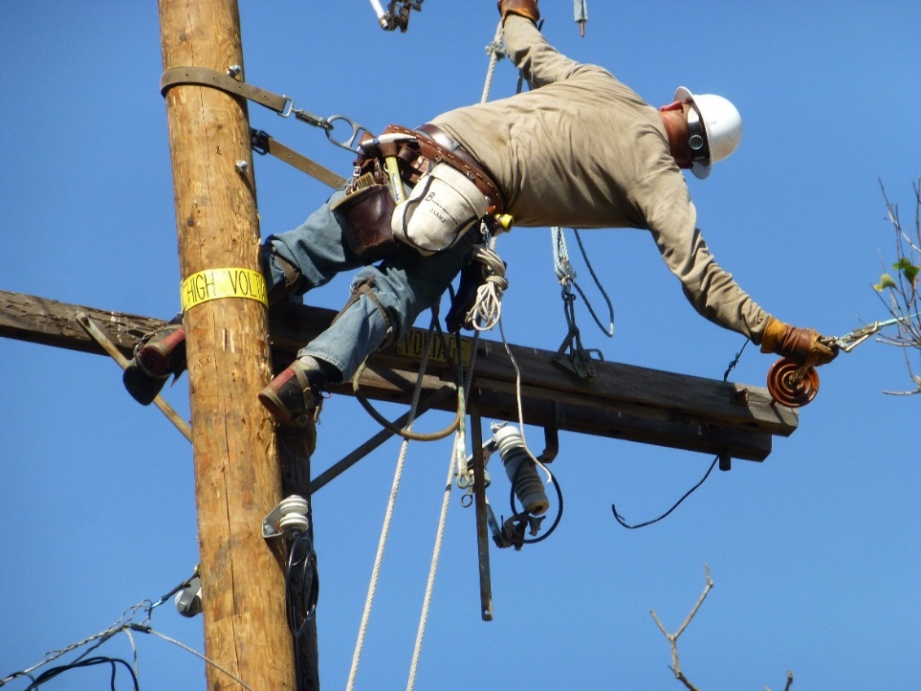
Dangerous Work
Line worker
80 feet above ground
Copyright © Pictures: Gebhardt & Baker 2017
Notes:
Title Slide based on fire and police for the England audience
Also mention other types like truck repair from YF, manual materials handling, diesel mechanic/machinist, fire, police,

Slide 10
Physical Employment Standards
Worldwide Issue
  Fire Service & Law Enforcement
    Australia
    Canada
    Netherlands
    Scotland
    United Kingdom
  Electric Industry
    Canada
  Military
    Australia
    Belgium
    Canada
    United Kingdom

Slide 11
Value of Physical Employment Standards
Railroad Industry Injury Reduction
Baker & Gebhardt, 2002

Slide 12
Value of Physical Employment Standards
Freight Industry Injury Reduction
Baker & Gebhardt, 2002

Slide 13
Value of Physical Employment Standards
Law Enforcement Injury Reduction
  Investigate injuries in defensive tactics training & other physical tasks
  Higher injury rate associated with lower physical capability
    Recruits who come to academy training at higher physical capability (muscular strength, aerobic capacity) have lower injury rate
Reduced Worker Replacement Costs
  Cost incumbent $25/hr
  Cost substitute - mostly overtime $37.50/hr
  Cost of injury – range $200 - $10,000⁺
Knapik et al., 2011

Slide 14
Value of Physical Employment Standards
Reduced Turnover
  Recruits who fail to complete academy have significantly lower physical test scores
  Cost implications of losing a recruit
    Selection process & entry into academy ($45K⁺)
    Shorthanded on the job - overtime
Reduced Training Time
  Orderfiller – shorter time to achieve standard for warehouse

Slide 15
Areas to Consider with Physical Tests
Type of test
Sex differences and adverse impact
Environmental conditions
Differences across location

Slide 16
Type of Physical Test
Basic Ability
  Assess physical abilities
    Muscular Strength
    Muscular Endurance,
    Aerobic Capacity
    Anaerobic Power
    Flexibility & Equilibrium
    Coordination
  Advantage
    Assess individual ability
    Use for multiple jobs
Job Simulation
  Simulate job tasks
  Include job components
    Tools
    Objects (e.g., weight)
  Assess multiple abilities
  Advantage
    Resemble job
    Develop directly from job analysis

Slide 17
Type of Physical Test
Adverse Impact - Sex
  Job simulations have slightly greater adverse impact than basic ability tests
  Courtright, et al., 2013; Gebhardt & Baker, 2017
Adverse Impact - Ethnic
  Large scale study male blue collar worker (50,000⁺)
    Whites performed better than Blacks on basic ability and job simulation tests
    Whites and Blacks better than Hispanics on strength tests
  Baker, 2007

Slide 18
Sex Differences
Women Compared to Men
  8% less in stature
  20% less body mass
  30-50% less muscle mass
    40-60% less muscular strength
    30-40% less anaerobic power
  30% smaller lung capacity
    10-30% lower maximal oxygen uptake

Slide 19
Sex Differences - Strength
Sharp, 1994

Slide 20
Sex Differences – Aerobic Capacity (VO₂)
Absolute Measure
  Measured in liters of oxygen/minute (L•min^{–1})
Normalized for body mass
  Measured in milliliters of oxygen per kilogram of body mass/minute (mL•kg^{–1}•min^{–1})
CO Emergency Response | Men | Women
L•min^{–1} | 3.71±0.82 | 2.95±0.49
mL•kg^{–1}•min^{–1} | 51.8±3.9 | 46.4±5.9
CO Actual Task | Men | Women
mL•kg^{–1}•min^{–1} | 38.5±4.7 | 39.5±4.3
Jamnick, 2010a, b (studies 2 & 3)

Slide 21
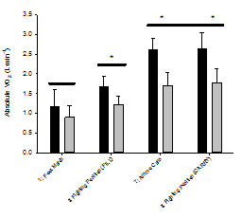
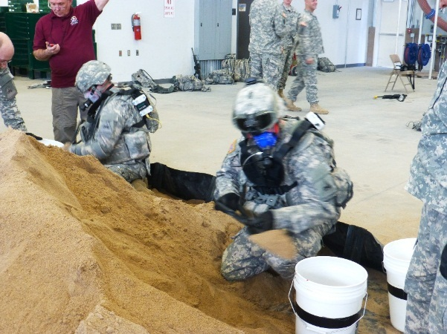
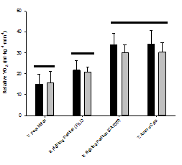
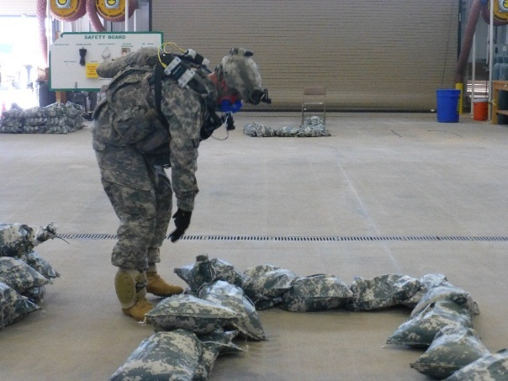
Sex Differences – Aerobic Capacity
13F Fire Support
Foulis et al., 2015a, b
Copyright © Pictures: Gebhardt 2016

Slide 22
Sex Differences
Orderfillers lift over 20,000 lb in 10-hour shift
Weight range is <10 lb to 80 lb
Gebhardt, Baker, Volpe, & Billerbeck, 2009

Slide 23
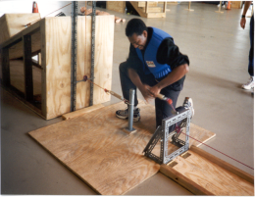
Sex Differences
Pursuit and Handcuff
Gebhardt & Baker, 2012; unpublished data
Copyright © Pictures: Gebhardt 2017

Slide 24
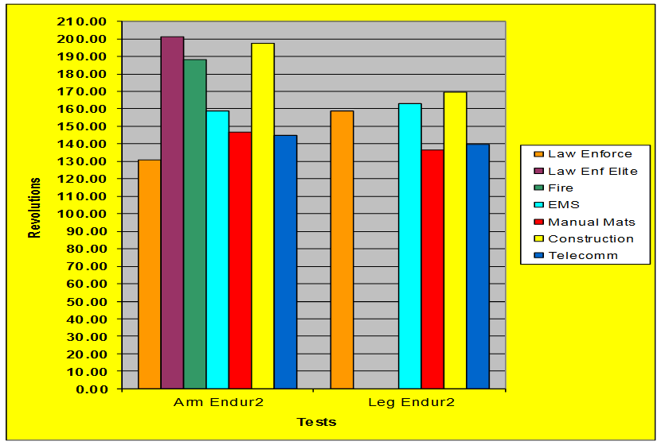
Sex Differences – Women by Job
HumRRO Database, 2013

Slide 25
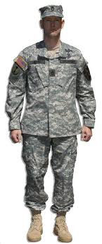
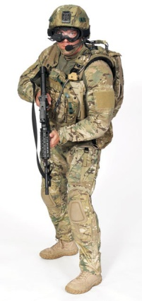
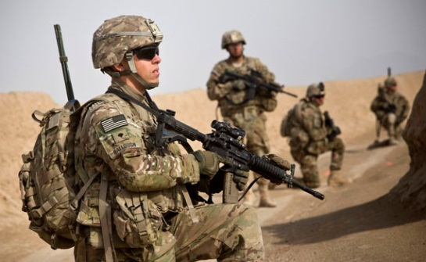
Sex Differences
12.4 lbs
< 24 hr Sustainment Load
Total Load = 94.43 to 108.97
PPE Fighting Load:
75.43 to 89.97 lb
Foulis, Sharp, Redmond, Frykman, Warr, Gebhardt et al., 2017
Copyright © Pictures: Sharp 2017

Slide 26
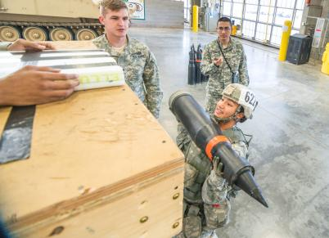
Practice Effect - Heavy Repetitive Lifting
Performing to standard (%)
21%
Tests (separated by 48-72 hours)
PPE = 71 lb
Round = 55 lb
Sharp, 2015 unpublished data

Slide 27
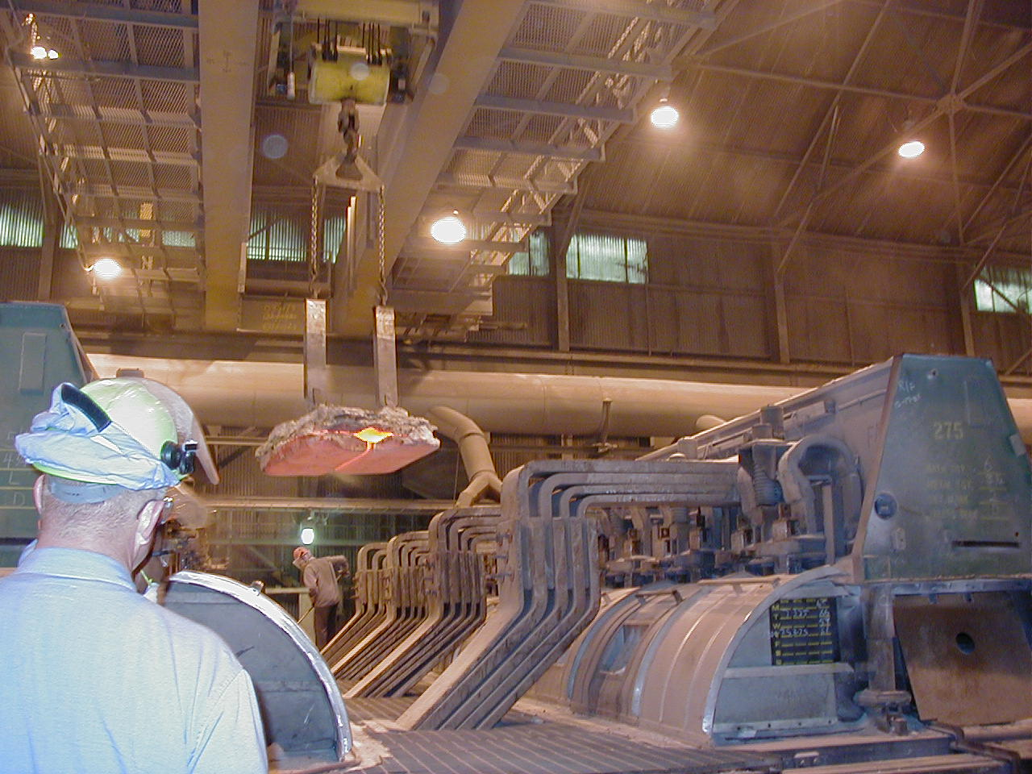
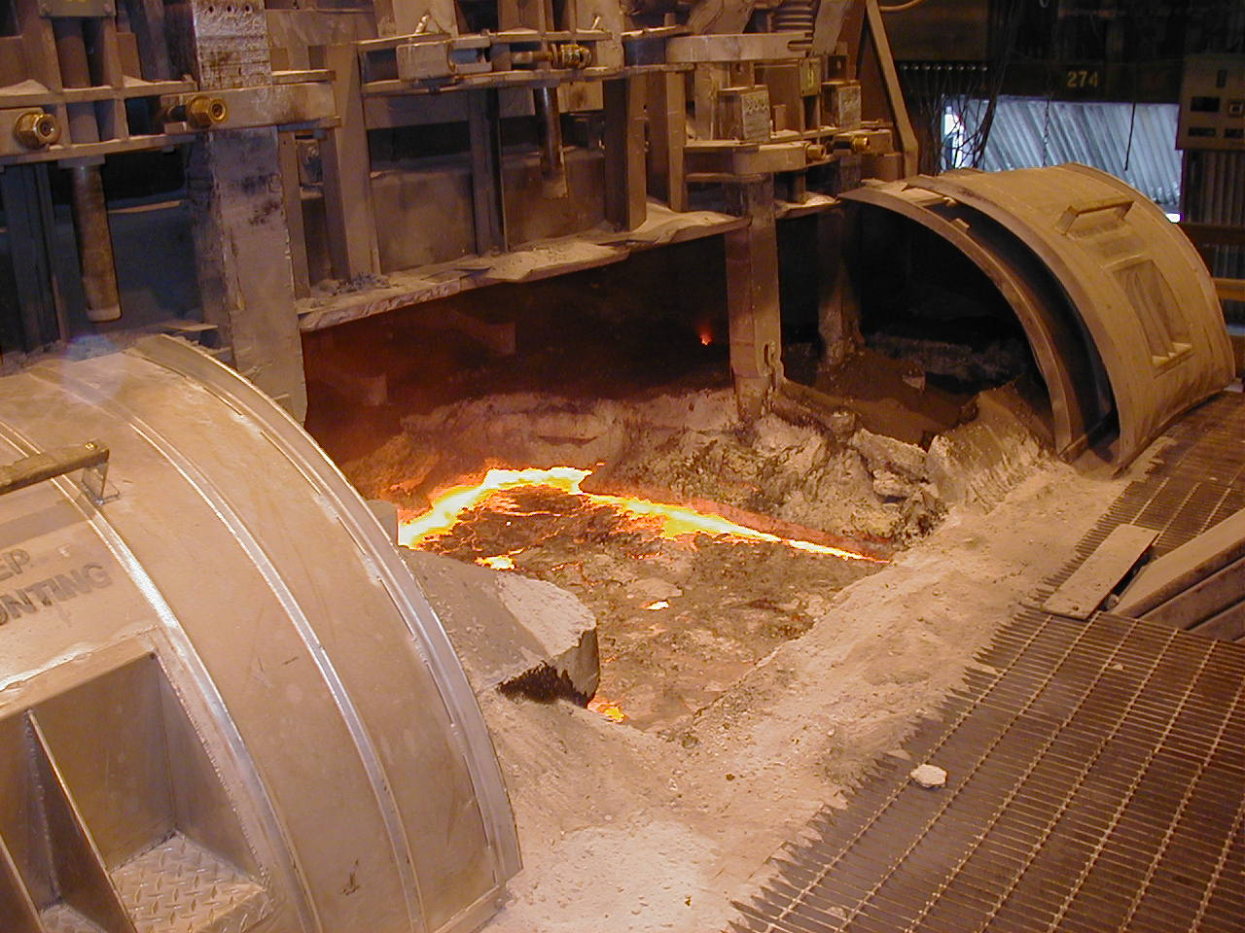
Environmental/Ergonomic Parameters
Copyright © Pictures: Gebhardt 2016

Slide 28
Environmental/Ergonomic Parameters
Temperature and Increase in Metabolic Rate
Dorman & Havenith 2009

Slide 29
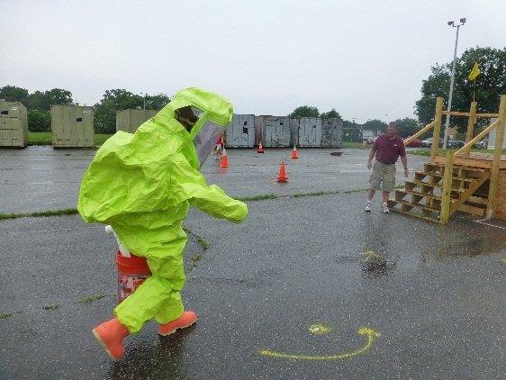
Environmental/Ergonomic Parameters
Thermal Stress & Occupational Injuries
10°C= 50°F; 22°C= 71°F; 25°C= 77°F; 28°C= 82.4°F
Fortune, Mustard, & Brown, 2014

Slide 30
Environmental/Ergonomic Parameters
Cold
  Jobs affected
    Firefighter
    Lineman and Telecommunications Technician
    Construction/Street Repair/Street Light Repair
  Decrements in performance
    Reduction in manual dexterity
    More demanding (e.g., ⬆ in clothing weight)
    Respiratory symptoms

Slide 31
Environment/Ergonomic Parameters
Multiple Work Locations
Whetzel, Gebhardt et al, 2012

Slide 32
Environment/Ergonomic Parameters
Work Locations
Whetzel, Gebhardt et al, 2012

Slide 33
Overview of U.S. Army Study
Combat MOSs and Congressional Mandate
4-Year Study to Develop and Validate Test
  Unique challenge – No women in Combat Arms Military Occupational Specialties (MOSs)s

Slide 34
Overview of U.S. Army Study
Study Participants – 7 Combat Arms MOSs
Sharp, Foulis, Redmond, Frykman, Zambraski, Gebhardt, Baker et al, 2015-2017

Slide 35
Overview of U.S. Army Study
Study Steps
  Job analysis
  Test and criterion measure development
    8 criterion measures (e.g., build fighting position, stow ammo on tank)
    14 predictor tests (e.g., Beep Test, Seated Throw)
Foulis, Sharp, Redmond, Frykman, Warr, Gebhardt, Baker, Canino, & Zambraski, 2016

Slide 36
Overview of U.S. Army Study
Study Steps (cont.)
  Reliability studies – Criterion measures highly reliable (0.76-0.96)
  Concurrent and predictive validation
    Concurrent study: 4-Test Battery with R² of 0.80
    Predictive study: 4-Test Battery with R² of 0.70
Implement at all Military Entrance Stations
  Beep Test Squat Lift
  Seated Throw Standing Long Jump
Foulis, Redmond, Frykman, Warr, Zambraski, & Sharp, 2017
Foulis, Redmond, Frykman, Warr, Gebhardt, Baker, Canino, & Zambraski, 2017
Sharp, Foulis, Redmond, Cohen, Frykman, Canino, & Pacheco, 2017

Slide 37
Summary
28% of workforce in physical jobs that combine arduous tasks and technology
Areas to consider
  Sex differences
  Affect of environment on job performance
  Differences in job by location
Benefit
  Decrease in injuries
  Decrease in training time or attrition from training
Unique opportunities for research
Foulis, Sharp, Redmond, Frykman, Warr, Gebhardt, Baker, Canino, & Zambraski, 2016

Slide 38
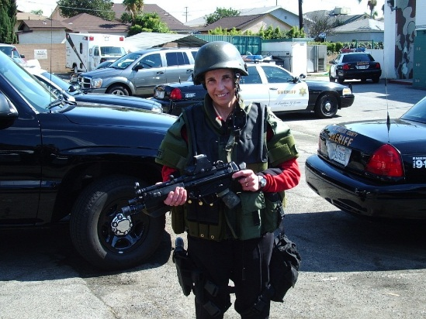
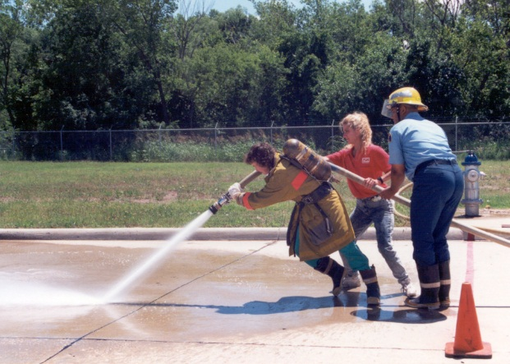
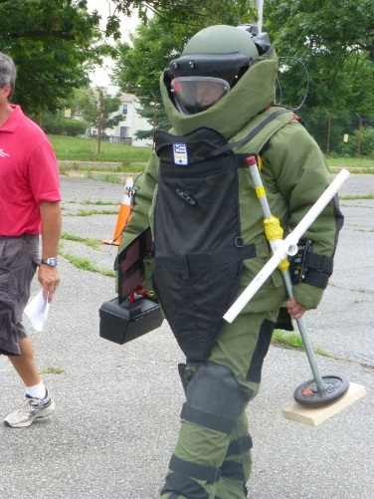
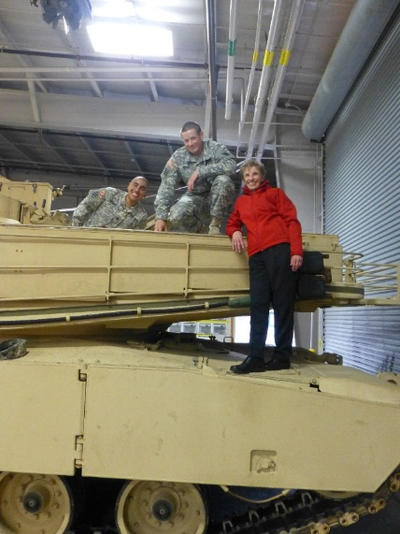

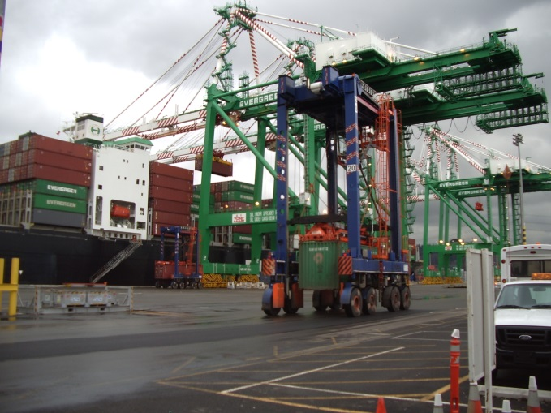
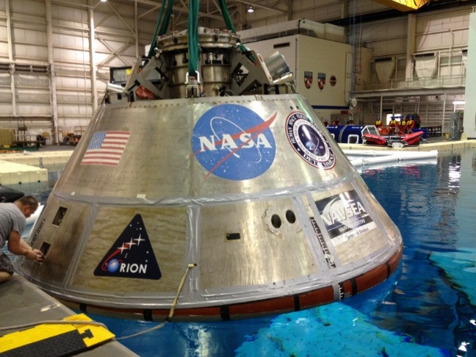
Unique Opportunities for Research
Get Dressed Up
Go to Explosive Events
Ride Unique Equipment
Get Great Views
Copyright © Pictures: Gebhardt & Baker 2017

Slide 39
Exercise Is Medicine
What is your routine?

Slide 40
Exercise is Medicine
Executive function (EF)
  Higher order functioning
    Inhibition control (self control)
    Interference control (selective attention, cognitive inhibition)
    Working memory
    Cognitive flexibility (creative thinking “out of the box”)
Stress affects EF
  Sleep loss (e.g., Oaten & Cheng, 2005)
  Sadness (e.g., Hirt et al., 2008)
  Loneliness (Barnes et al., 2002)
  Lack of physical fitness (Chaddock et al., 2012)

Slide 41
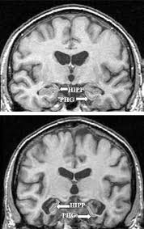
Exercise is Medicine
EF depends on gray matter
  Hippocampus and other cortical
  areas contribute to executive function
Hippocampus shrinks with age
  Volume of area decreases
  Leads to impaired memory and
  risk of dementia
NIH longitudinal study found
  Exercise increased of volume
  of hippocampus with exercise
  Resulted in improved memory
Erickson et al, 2010

Slide 42
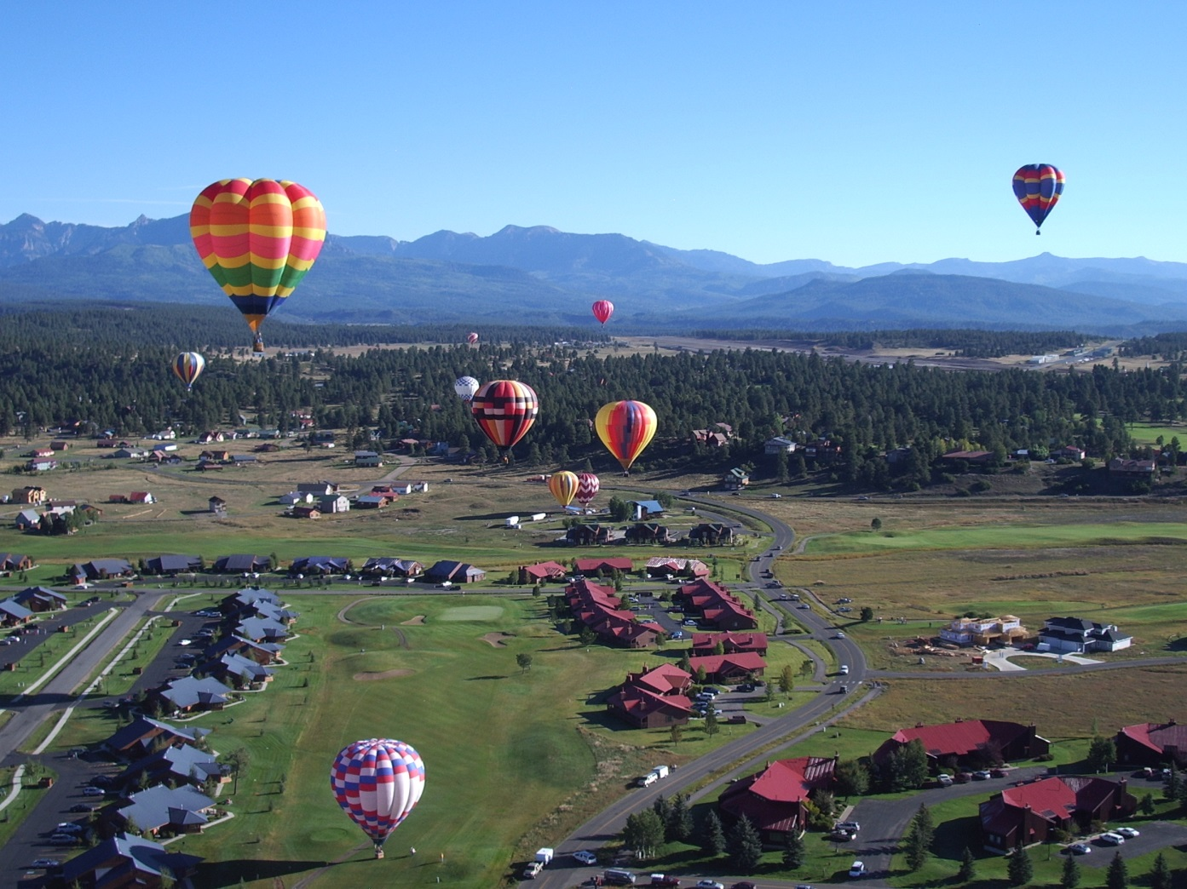
Thank You
March 7,

