Slide 1
ENGAGEMENT 101
EMPLOYEE
ASSESSMENT & MEASUREMENT
Jose Valadez | Kelly Stewart | Frank Igou | Zollie Saxon
Louisiana Tech University
Notes:
Brief introductions
Why engagement? This is IPAC!

Slide 2
CONTENT
OVERVIEW
DEFINING ENGAGEMENT
MEASURING ENGAGEMENT
ENGAGEMENT & SELECTION
EMPLOYEE
ENGAGEMENT 101
Notes:
DEFINITION
Differences between applied and academic definitions
MEASUREMENT
Theoretical and practical measurement differences
SELECTION
Can organizations select for engagement?

Slide 3
DEFINING
ENGAGEMENT
Academic
_________________
Engagement as role-expression
Engagement as the opposite-of-burnout
Engagement as a process
Applied
_________________
Engagement as everything BUT engagement.
Notes:
Little consensus on what exactly engagement is.
Large disparity between research and practice in defining research.
Even among academic researchers, there is a lack of agreement.
We will briefly review the main perspectives researchers use when examining engagement and where the current state of the literature is.
We will also examine the more popular definitions practitioners refer to when measuring engagement in the workplace.

Slide 4
ENGAGEMENT
AS ROLE-EXPRESSION
A function of what aspects of the personal self people bring to work
__________
Harnessing this expression of a person’s physical, cognitive, and emotional selves during work role performance
__________
Simultaneous expression and use of preferred self connects people to their work and to their coworkers
William Kahn (1990)
Notes:
Kahn’s seminal article has been cited almost 5,000 times (4,921 as of 7.15.17)
Within the first 2 decades of engagement research: 891 citations
In the past 7 years there have been 4,220 citations (86% of the citations > major increase in relevancy)

Slide 5
ENGAGEMENT
AS THE OPPOSITE OF
BURNOUT
Job
Demands
_________________
Aspects of work that incur physical, psychological, physiological, and/or mental costs
Job Resources
_________________
Aspects of work that support development, growth, goal attainment and reduce the cost of job demands.
Schaufeli & Bakker (2004)
Notes:
Demands predictive of burn-out
Resources positively related to engagement and negatively related to burnout.
Resources allow people to cope and provide a shield against the effects of job demands

Slide 6
PERSONAL ENVIRONMENT
WORK ENVIRONMENT
IDEALIZED SELF
ENGAGEMENT
ENGAGEMENT
AS A PROCESS
Note. Adapted from Byrne, Z. (2015). Understanding Employee Engagement: Theory, Research, and Practice (p. 240), New York.
Zinta Byrne (2015)
Notes:
Personal environment refers to the environment around the person, outside of the job (e.g., social support from family/friends, life sustenance [think Maslow’s Hierarchy of Needs], cognitive load).
Work environment refers to anything having to do with the workplace itself (e.g., leadership, job characteristics, resources, culture, fit).
Person (self) refers to what the person brings to the workplace (e.g., personality, identification with the occupation, need for belongingness)
As individuals experience engagement, their feelings of personal alignment, fit, and competence feeds back into work environment.
Engaged employees choose to be engaged and are reinforced both internally and externally for their engagement.
Model also incorporates time to reflect that engagement in one moment affects engagement in the next (engagement may come in chunks as opposed to a single continuous stream of focus, energy, and thought).

Slide 7
ENGAGEMENT
APPLIED
Notes:
What we’re noticing is that its completely different than the academic
In the early 2000s engagement really exploded in the applied sector. However it tends to rely heavily on other constructs
Orgs define it as behavioral outcomes and psychological state leading to performance, and creating more productive and loyal employees
Employee job satisfaction, feelings of being valued
To really analyze it in the applied settitng, we need to look at how its measured.

Slide 8
ENGAGEMENT
APPLIED
EXAMPLE
Notes:
Most organizations have a handful of engagement questions as a part of a broader opinion survey.
Most will include key drivers (e.g., senior leadership, recognition, benefits, communication, pay, coworkers, learning and development, work-life balance) that pose threats to and opportunities for improving engagement.
Survey Monkey as an example
Most questions worded as satisfaction item
For example, “I am satisfied with the investment my organization makes in training and education.”
Career development
Training
Involvement
Change readiness
Compensation
Communication
Supervisor/Coworker satisfaction
Benefits
Corporate Social Responsibility

Slide 9
ENGAGEMENT
MEASURED
Academic
_________________
Utrecht Work Engagement Scale (UWES)
Job Engagement Scale (JES)
Applied
_________________
Gallup Q¹²
Glint
SHRM
Aon Hewitt
Notes:
Main difference is who the end-user is.

Slide 10
ENGAGEMENT
MEASURED
UWES
_________________
Vigor
Dedication
Absorption
JES
_________________
Affective
Cognitive
Physical
Schaufeli et al. (2002)
Rich, LePine, & Crawford (2010)
Notes:
UWES is indistinguishable from the Maslach Burnout Inventory (Cole et al., 2012)
UWES has poor model fit with engagement and indistinguishable from job satisfaction (Viljevac et al., 2012)
JES:
Physical: (energetic and active physical movement at work [Kahn, 1990])
1. I work with intensity on my job.
2. I exert my full effort to my job.
3. I devote a lot of energy to my job.
4. I try my hardest to perform well on my job.
5. I strive as hard as I can to complete my job.
6. I exert a lot of energy on my job.
Affective (empathetic connection to others and expression of excitement in work role [Kahn, 1990]):
7. I am enthusiastic about my job.
8. I feel energetic about my job.
9. I am interested in my job.
10. I am proud of my job.
11. I feel positive about my job.
12. I am excited about my job.
Cognitive (being aware, actively thinking and tracking information, mentally connecting puzzle pieces in problem-solving, displaying curiosity, focused and absorbed during role performance [Kahn, 1990]):
13. At work, my mind is focused on my job.
14. At work, I pay a lot of attention to my job.
15. At work, I concentrate on my job.
16. At work, I focus a great deal of attention on my job.
17. At work, I am absorbed in my job.
18. At work, I devote a lot of attention to my job.
UWES:
Vigor (opposite of exhaustion):
1. At my work, I feel bursting with energy.
2. At my job, I feel strong and vigorous.
3. When I get up in the morning, I feel like going to work.
4. I can continue working for very long periods at a time.
5. At my job, I am very resilient, mentally.
6. At my work I always persevere, even when things do not go well.
Dedication: (opposite to cynicism)
7. I find the work that I do full of meaning and purpose.
8. I am enthusiastic about my job.
9. My job inspires me.
10. I am proud of the work that I do.
11. To me, my job is challenging.
Absorption (opposite of lack of efficacy or detachment):
12. Time flies when I’m working.
13. When I am working, I forget everything else around me.
14. I feel happy when I am working intensely.
15. I am immersed in my work.
16. I get carried away when I’m working.
17. It is difficult to detach myself from my job

Slide 11
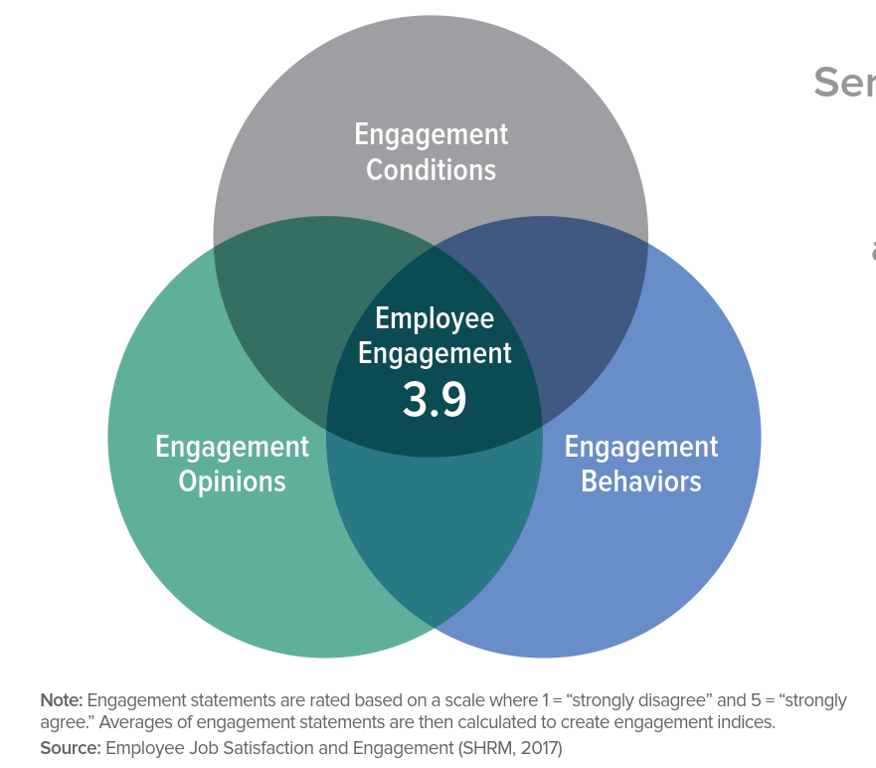
ENGAGEMENT
MEASURED
Notes:
Why is SHRM’s definition so important?
285,000+ members
2017 showed moderately engaged workforce
Engagement opinions were rated higher than engagement behaviors
Conditions for engagement: the workplace environment and the work itself (18 items)
Meaningfulness of the job, work itself, variety of work, autonomy and independence, overall corporate culture, job-specific training
Engagement behaviors: colleagues’ connection with employees’ work
Flexibility of org/work group, colleagues quick to adapt, volunteerism
Engagement opinions: employees’ connection with their work
Determination to accomplish work, passion and excitement about work, provided with the resources to do my job well, clear understanding of org vision/mission

Slide 12
Notes:
Scale does not assess engagement, per se, but rather satisfaction with proposed work conditions, such as resources, support and task significance that might relate to engagement
Meta-analysis and utility analysis (Harter, et al., 2002) showed the value of Gallup’s engagement
Connected to many key outcomes: Customer Satisfaction, Safety, Turnover, Productivity, Profit across various industries
“Business units in the top quartile on employee engagement, had on average, from $80,000 to $120,000 higher MONTHLY revenue or sales
Translates to about a $960,000 difference per year per business unit for highly engaged vs. not engaged
1. I know what is expected of me at work.
2. I have the materials and equipment I need to do my work right.
3. At work, I have the opportunity to do what I do best every day.
4. In the last seven days, I have received recognition or praise for doing good work.
5. My supervisor, or someone at work, seems to care about me as a person.
6. There is someone at work who encourages my development.
7. At work, my opinions seem to count.
8. The mission/purpose of my company makes me feel my job is important.
9. My associates (fellow employees) are committed to doing quality work.
10. I have a best friend at work.
11. In the last six months, someone at work has talked to me about my progress.
12. This last year, I have had opportunities at work to learn and grow.

Slide 13
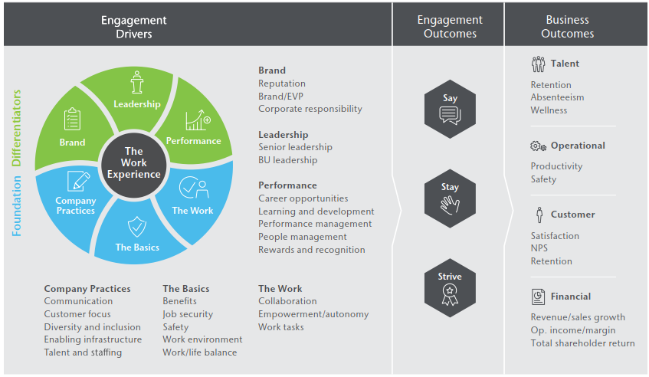
Notes:
Aon defines employee engagement as “the level of an employee’s psychological investment in their organization” using a Say, Stay, Strive model. (6 items)
Do employees Say positive things about their organization and act as advocates?
Do employees intend to Stay at their organization for a long time?
Are employees motivated to Strive to give their best efforts to help the organization succeed?
Global Trends 2017:
Rewards and Recognition was the top engagement opportunity/driver
Pay can be low hanging fruit, but may not have the long-term effect we think it has
Recency effect: high engagement after a pay bump, but levels off after 3 to 4 weeks
Senior leadership
Transparency from senior leaders is an important driver
Employees need to know that the organization is going in the right direction

Slide 14
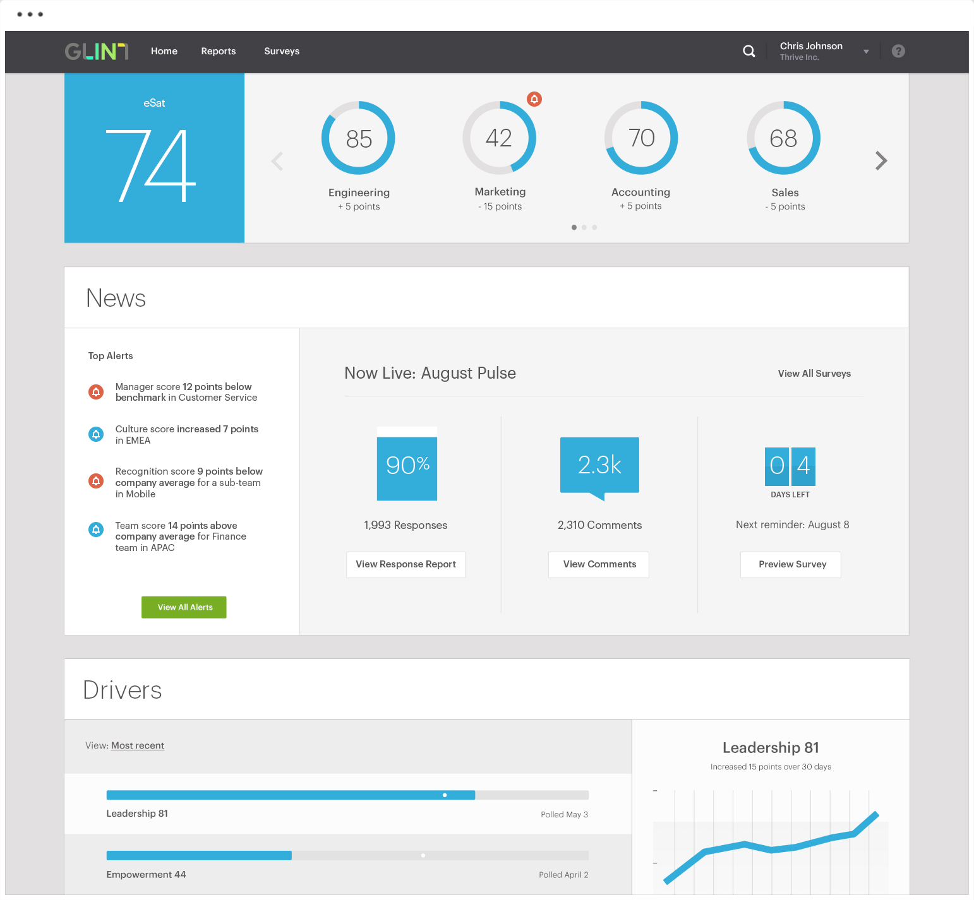
Notes:
Glint mirrors recent academic research using ESM to explore engagement.

Slide 15
ENGAGEMENT
AND TRAIT FACTORS
Creating engagement profiles for candidates during the hiring process

Slide 16
ENGAGEMENT
AND THE BIG FIVE
The Big Five Trait Taxonomy
Openness to Experience
Conscientiousness
Extraversion
Agreeableness
Emotional Stability
Lewis R. Goldberg (1990)

Slide 17
ENGAGEMENT
AND THE BIG FIVE
Examining personality traits at the sub-facet level with regard to work engagement
Woods & Sofat (2013)

Slide 18
ENGAGEMENT
AND THE BIG FIVE
What is the pathway through which this occurs?
Makikangas et al. (2013)
Bakker et al. (2011)

Slide 19
ENGAGEMENT
AND THE BIG FIVE
Work Engagement
Conscientiousness
Contextual Performance
Bakker et al. (2012)

Slide 20
ENGAGEMENT
AND PERSONALITY OUTCOMES
Researchers have focused on investigating how certain outcomes of each of the Big Five factors may influence engagement levels.
Notes:
Transition: rather than examining Big Five traits broadly, researchers have focused on investigating how certain outcomes of each of the Big Five factors may influence engagement levels.

Slide 21
ENGAGEMENT
AND PERSONALITY OUTCOMES
Extraversion
Higher Interaction with Others
Positive Emotions
Optimism
Makikangas et al. (2013)
Xanthopoulou et al. (2007)

Slide 22
Selection & Assessment
Measurement Refinement
Construct Clarity
ENGAGEMENT
FUTURE DIRECTIONS
Woods & Sofat (2013)
Notes:
Big Five at sub-facet level (Woods & Sofat, 2013)
Assessing the extent to which a candidate possesses certain Big Five dimensions may provide the organization with fruitful information and foresight towards the degree to which levels of employee engagement are likely to vary.

Slide 23
ENGAGEMENT
SUMMARY
There are numerous definitions of engagement between and within both researcher and practitioner groups.
Differences in conceptualizations can be seen in the numerous academic and commercial measures of engagement.
If practitioners and researchers can address these concerns, perhaps engagement can be of value to assessment and selection.
EMPLOYEE
ENGAGEMENT 101
Notes:
If practitioners and researchers can address these concerns, perhaps engagement can have both practical and theoretical importance outside of the attitudes arena.

Slide 24
ADDITIONAL
Bakker, A. B., & Demerouti, E. (2008). Towards a model of work engagement. Career Development International, 13(3), 209-223. doi:10.1108/13620430810870476
Byrne, Z. (2015). Understanding employee engagement: Theory, research, and practice. New York: Routledge.
Byrne, Z., Peters, J. M., & Weston, J. W. (2016). The struggle with employee engagement: Measures and construct clarification using five samples. Journal of Applied Psychology, 101(9), 1201-1227. doi:10.1037/ap10000124
Dalal, R. S., Baysinger, M., Brummel, B. J., & LeBreton, J. M. (2012). The relative importance of employee engagement, other job attitudes, and trait affect as predictors of job performance. Journal of Applied Social Psychology, 42(1), E295-E325. doi:10.1111/j.1559-1816.2012.01017
Saks, A. M., & Gruman, J. A. (2014). What do we really know about employee engagement? Human Resource Development Quarterly, 25(2), 155- 182. doi: 10.1002/hrdq.21187
READINGS
EMPLOYEE
ENGAGEMENT 101

Slide 25
Jose Valadez
mail.jjv@gmail.com
Frank Igou
Associate Professor
Louisiana Tech University
figou@latech.edu

