Slide 1
City of Columbus
Civil Service Commission
A Journey Through the Development of a Video-Based SJT
Elizabeth A. Reed
Public Safety Test Manager

Slide 2
What is a Situational
Judgment Test?
a type of test which present the test-taker with realistic, hypothetical scenarios and typically ask the test-takers to identify the best and/or worst response (Morowildo et el., 1990; Olson-Buchanan et al., 1998), rate the agreement to responses (Chan & Schmitt, 2002) or to rank the responses in the order they feel is most effective.

Slide 3
Why Use a Situational
Judgment Test?
SJTs have become a distinctive predictor of work performance (McDaniel, Morgesen, Finnegan, Campion & Braverman 2001; de Meijer & Born, 2009; Weekly & Polyhart, 2005).
SJTs have incremental validity over other assessment methods, such as cognitive ability tests and measurement of the big five personality dimensions (Bergman et al., 2006; McDaniel, Hartman, Whetzel & Grubb III 2007).

Slide 4
Why Use a Situational
Judgment Test?
SJTs have also been found to provide incremental validity beyond more typically used assessments, such as cognitive ability tests and appear to have less adverse impact (Chan & Schmitt, 2002; Clevenger et al., 2001; Morowildo, Dunnette, & Carter, 1990; Olson-Buchanan, et al., 1998; Weekly & Jones, 1997, 1999).

Slide 5
The State of Research on Situational
Judgment Tests: A Content Analysis and
Directions for Future Research
Michael C. Campiona, Robert E. Ployharta & William I. MacKenzie Jr.b

Slide 6
Decision Points
Video-Based vs. Written
True Video vs. Video Using Stills

Slide 7
Decision Points
Generic Jobs vs. Job Specific
Response Format

Slide 8
Types of Responses Formats
Dichotomized
Select the Best Response
Select the Worst Response
Rank the Responses
Evaluate the Responses

Slide 9
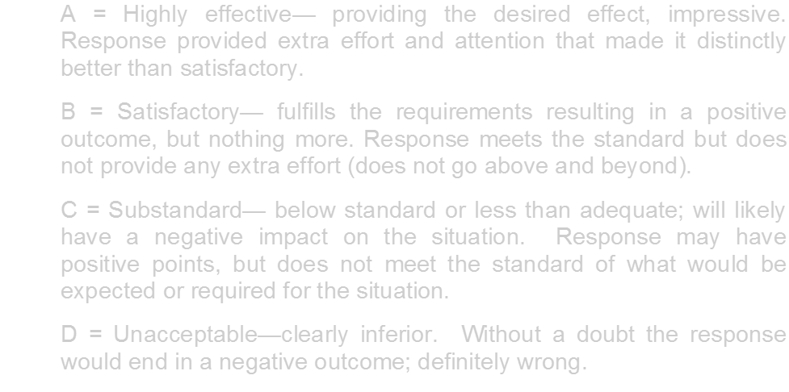
Response Format Selected

Slide 10
Scenario Development Process
Focus on What is to be Measured
Create Scenario Seeds
-Decision: Which seeds to grow?
Script Scenarios and Responses
-Decision: Which responses to record?
Determine Setting(s)

Slide 11
Scenario Development Process
Obtain Actors/Role-Players
Secure Props and Locations
Schedule Video Shoots
Edit Videos/Response Times
Decision: Which takes to use?

Slide 12
Scenario Development Process
Organize Scenarios/Responses
Draft Candidate Instructions
Pilot Test and Obtain Linkages
Collect Responses for Key

Slide 13
Decision Points
How do you get response data?
How do you get enough data?

Slide 14
Pilot During 2014 Firefighter Test Administration(s)
12 Scenarios-Piloted 10
20 to 24 Responses per Scenario
3000 Firefighter Candidates
3 Weeks of Testing
Subtest of Multiple-Choice Exam
200-300 Responses to 10 Scenarios

Slide 15
Evaluating Candidate Responses
Initial Candidate Reaction
Item Analysis
McDaniel’s Method for Key

Slide 16
Creating the Key
“. . . different scoring keys can lead to an SJT assessing different constructs. Currently, there is insufficient research to judge one scoring strategy to be substantially better than other. More research is clearly needed in this area.” (Whetzel, McDaniel 2009)

Slide 17
Scoring Situational Judgment Tests: Once You
Get the Data, Your Troubles Begin
“Although situational judgment tests (SJTs) have been in use for decades, consensus has not been reached on the best way to score these assessments or others (e.g., biodata) whose items do not have a single demonstrably correct answer.”
Mindy E. Bergman*, Fritz Drasgow, Michelle A. Donovan, Jaime B. Henning, Suzanne E. Juraska Personnel Decisions Research Institute ARTICLE in INTERNATIONAL JOURNAL OF SELECTION AND ASSESSMENT · AUGUST 2006

Slide 18
Scoring Strategies
Empirical Scoring
Theoretical Scoring
Vroom’s Decision Model Keys
Hybridized Scoring
Expert Based Scoring
Subject Matter Experts
Comparison of Novices vs. Expert
Factorial Scoring
Subgrouping

Slide 19
Creating the Key Exercise
Distribute Item Analysis
Break up into groups
Show Video

Slide 20
What We Decided
Toss Criteria: To keep the response in the exam it must have 80% or more candidates responding to the top 2 responses (80% agreement in the top 2 responses).

Slide 21
What We Decided
0-20% response rate is equal to 0 points
21-59% response rate is equal to 1 point
60-79% response rate is equal to 2 points
80-100% response rate is equal to 3 points

Slide 22
Situational Judgment Test Pilot Test with Recruits
Edit Exams to Final Versions
Create Evaluation for Fire Recruits
Administer Pilot Test
Confirm Key
Analyze Results

Slide 23
Decision Point
Do we use the results in 2017?
Not certain it would meet our original goal that this alternative method would mitigate impact

Slide 24
Result
We used the SJT in scoring for 2017 FF
The SJT did mitigate impact when standardized and weighted as 30% of the multiple-choice exam
Standardized by version
More analysis to come

Slide 25
Q & A

