Slide 1
Talent Analytics: Why Are We Not There Yet?
Wayne F. Cascio
IPAC
Birmingham, AL, July 17, 2017

Slide 2
Talent Analytics
It is a set of quantitative approaches that answer two simple questions:
What do we need to know about our organization and workforce to run the company more effectively?
How do we turn that knowledge into action?
Notes:
*

Slide 4
Source: Mercer Global Talent Trends Study, 2017

Slide 5
Despite the enormous interest in talent analytics (TA), organizations struggle to move from operational reporting to analytics
Deloitte (2015): 75% of surveyed companies believe that using TA is important for business performance
Only 8% viewed their organizational capabilities in this area as “strong”

Slide 6
Not a New Dilemma
It has existed at least since the 1950’s - advocates of HR accounting had difficulty “putting people on the balance sheet” (Brummet et al., 1968)
In the 1980’s, as the field of I/O psychology experienced the “futility of utility analysis” (Latham & Whyte, 1994)
In the 1990’s as researchers lamented the “black box” of reasons for the correlation between high-performance work systems and firm financial performance (Jiang et al., 2013)
More recently, in the form of questions about why TA are not more widespread and standardized

Slide 7
Why do most organizations have few TA investments and only moderate effectiveness?
Consider the “push” factors - the conditions necessary for suitable TA to be available
L_A_M_P – Each element suggests a potential reason why TA are not sufficiently ready for their audience

Slide 8
Talent Analytics

Slide 9
Getting Started: The L-A-M-P Model
4 critical components of a measurement system to drive organizational change:
Logic
Analytics
Measures
Process

Slide 10
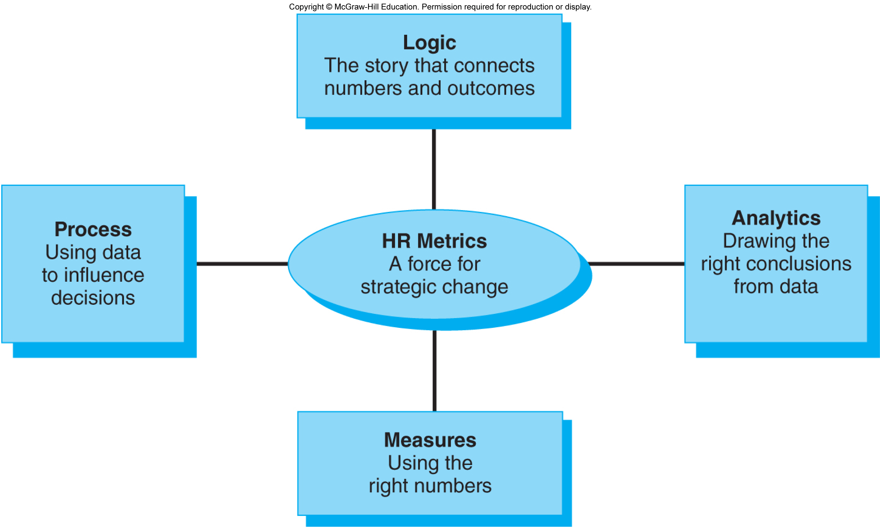
Lighting the LAMP
Notes:
*

Slide 11
Logic
Provides the “story” that connects numbers and effects or outcomes

Slide 12
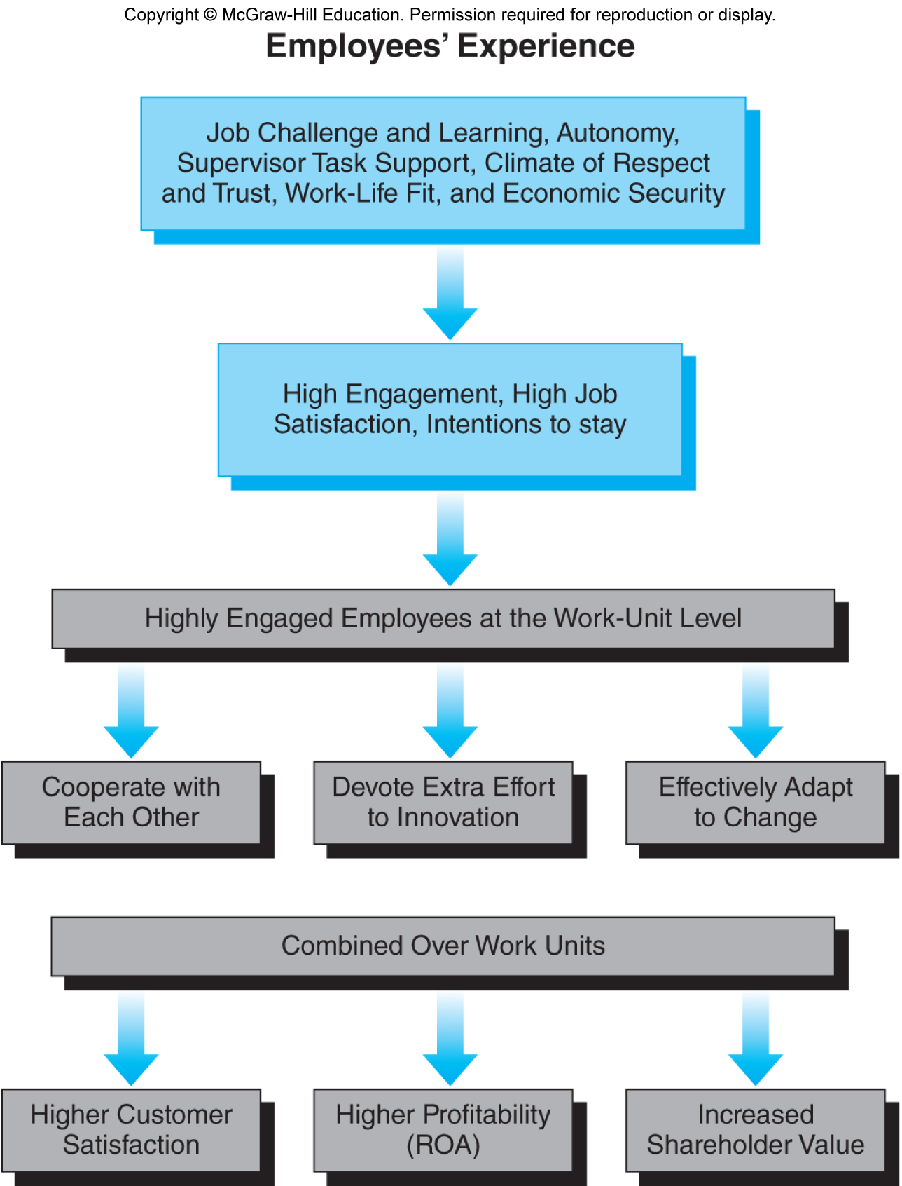
Linking Investments in Employee Engagement to Firm-Level Outcomes
Notes:
*

Slide 13
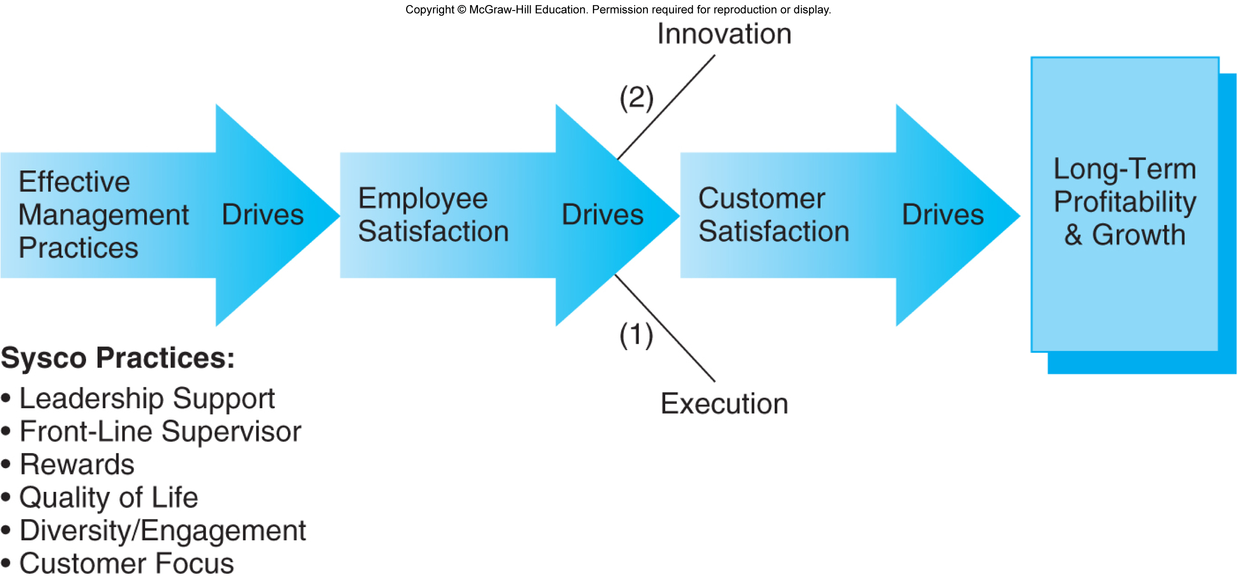
Sysco's Value-Profit Chain
Notes:
*

Slide 14
Logic of Work-Life Fit
Employer Investments in Work-Life Programs
(range, scope, cost, quality)
Extent and Quality of Communications, Training, Supervisor Support
Employees Achieve Greater Work and Life Fit
Reduced Stress, Burnout, Conflict
Improved Engagement, Satisfaction, and Commitment
Less absence
Lower turnover
Better work and career behaviors
Better recruiting
Improved staffing quality
Reduced absenteeism costs
Reduced turnover costs
Increased performance and service

Slide 15
The Critical Role of Logic
Helps leaders outside HR understand and use measurement systems to enhance their decisions

Slide 16
Analytics
It’s about drawing the right conclusions from data
It includes statistics and research design + skill in identifying key issues
It transforms HR logic and measures into rigorous, relevant insights

Slide 17
Correlation $≠$Causation!

Slide 18
Roles of Data Scientists and HR Professionals
Data scientists: research design and data analysis using models from simple (contingency tables, means, SDs) to sophisticated (multilevel models, structural equation modeling, predictive analytics)
HR professionals: responsible for asking strategically relevant questions, framing them so the logical connections are clear, and storytelling with data

Slide 20
Measures - Getting the #s Right
Logic supports good measures
Measures not linked to logic cannot drive strategic change
Example: employee turnover
Must show how it affects business or strategic success

Slide 21
Process: Creating Actionable Insights
How will you “sell” your ideas to decision makers?

Slide 22
Creating Actionable Insights (Cont.)
“Push” factors include:
timeliness of the analytics - delays in reporting make results less relevant to decision makers
are they presented with awareness of the beliefs, needs, and capabilities of those who are supposed to use them?
With advances in real-time analysis and reporting, we may be entering an era where leaders can call up TA in real-time as they face decisions

Slide 23
“Pull”Factors
“Pull” factors may hold back talent analytics
No matter how rigorously or completely TA are prepared and “pushed” out to their audiences, the advancement and effectiveness of TA still depend on the capability, opportunity, and motivation of users – leaders outside of HR

Slide 24
Five Necessary Conditions for Effective “Pull”
Users must receive the analytics: Are they timely in the context of other organizational decisions?
Users must attend to the analytics: Do users believe the analytics will be useful to them?
Distinguish compliance, service quality, and decision support, as outcomes of TA
Analytics to verify compliance with rules serve a very different purpose from analytics to evaluate the quality of the HR services delivered to clients, which, in turn, is a very different value proposition from analytics designed to support decisions or to reduce mistakes

Slide 25
Conditions for Effective “Pull” (Continued)
Users must believe the analytics: Do decision makers find the analytics credible?
Much research devoted to methods of making TA predictions more valid and correct
Little research has examined if users perceive credibility similarly
Example: utility analysis - users are sensitive to the error variance in the analytics
Analytics that suggest very high payoffs may be “too good to be true.” Users may perceive results as so unreliable that they are not credible

Slide 26
Conditions for Effective “Pull” (Continued)
Users must believe that the analytics suggest effects that are large and compelling enough to merit attention or action
Focus on “pivotal” issues – Are TA likely to improve decisions or correct mistakes that have serious consequences to the user and the organization?

Slide 27
Conditions for Effective “Pull” (Continued)
Users must see implications for their actions or decisions
Analytics that focus on improving the HR department are often not very relevant to leaders outside HR
Broad effects of investments in high-performance work systems may seem irrelevant to leaders who have little authority to approve such programs
Perhaps analytics have not yet advanced because they are not adequately “tuned” to the specific decisions that leaders make, and presented in context

Slide 28
To Get “There” with Talent Analytics
Remember: Analytics is 70% logic!
Pay careful attention to “push” factors
Use the L-A-M-P model
Be sure to address the “pull” factors too. Be sure analytics are:
Timely, useful to decision makers, credible, focus on pivotal issues, presentations are “tuned” to the contexts that managers face

